Slide 1
31st Annual Report on Liver and Intestinal Transplantation Activity in Australia and New Zealand Data to 31 December 2019

Slide 2
11. Patient Survival

Slide 3
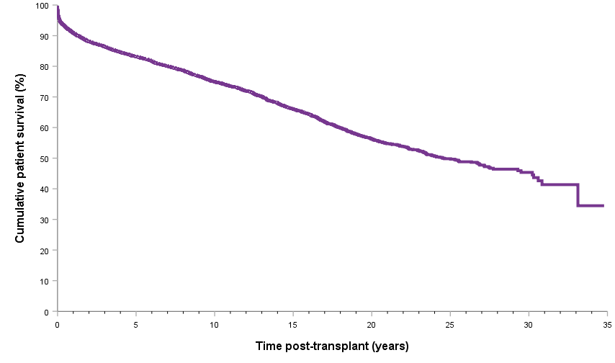
Patient survival curve
Notes:
Figure 22. Patient survival curve

Slide 4
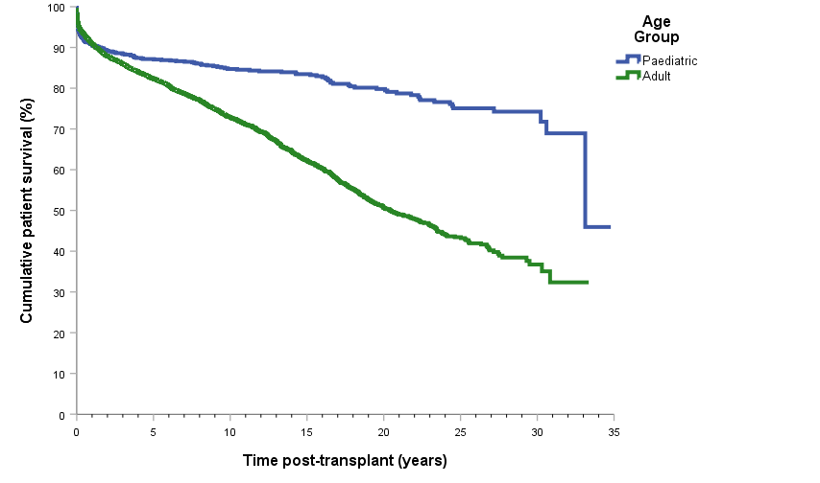
Patient survival curve by age category
Notes:
Figure 23. Patient survival curve by age category

Slide 5
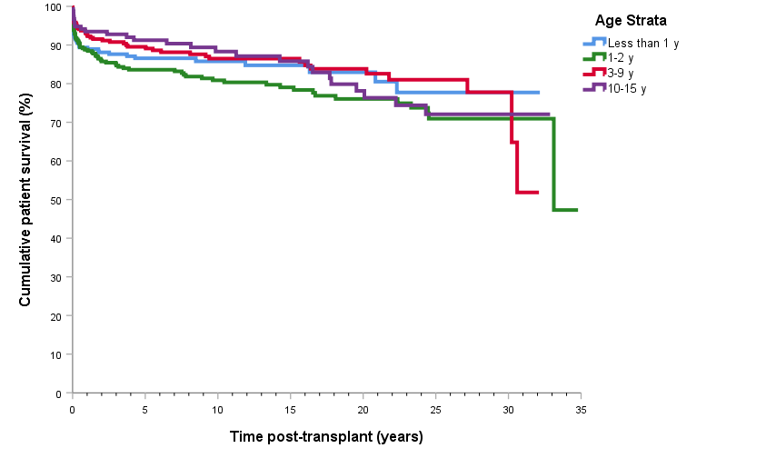
Paediatric patient survival curve by age strata
Notes:
Figure 24. Paediatric patient survival curve by age strata

Slide 6
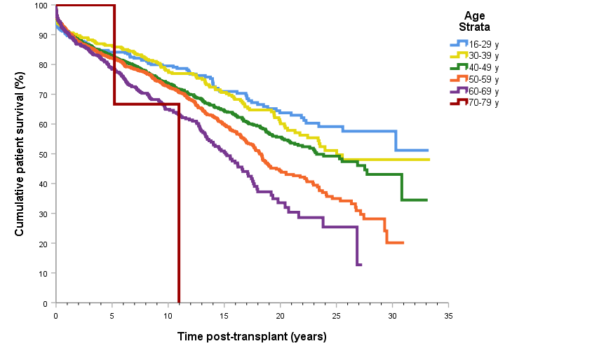
Adult patient survival curve by age strata
Notes:
Figure 25. Adult patient survival curve by age strata

Slide 7
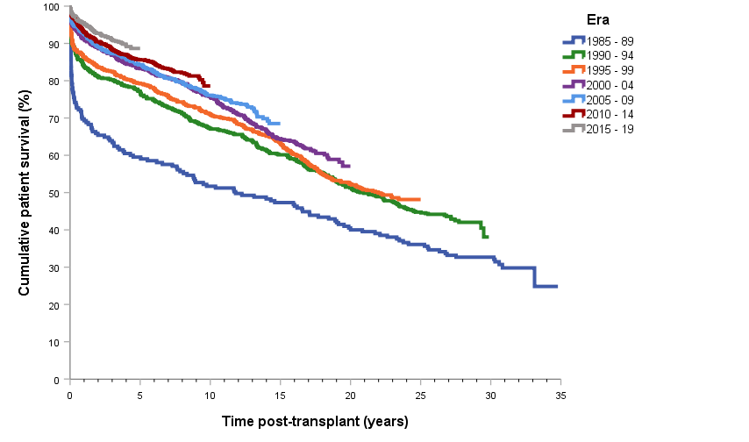
Patient survival curve by era of transplant
Notes:
Figure 26. Patient survival curve by era of transplant

Slide 8
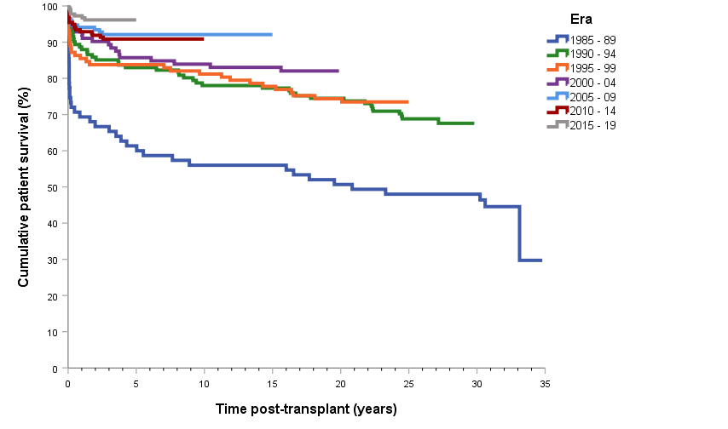
Paediatric patient survival curve by era of transplant
Notes:
Figure 27. Paediatric patient survival curve by era of transplant

Slide 9
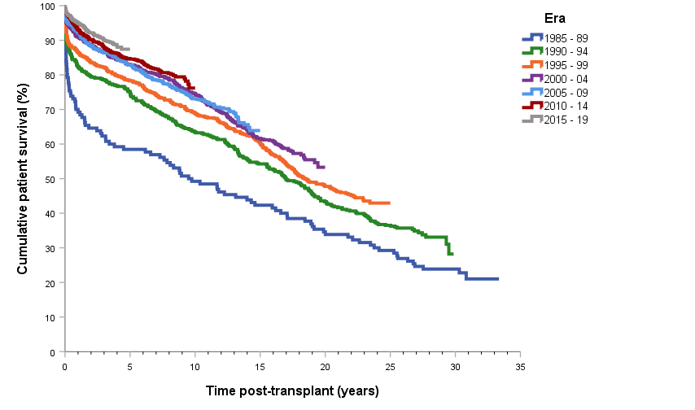
Adult patient survival curve by era of transplant
Notes:
Figure 28. Adult patient survival curve by era of transplant

Slide 10
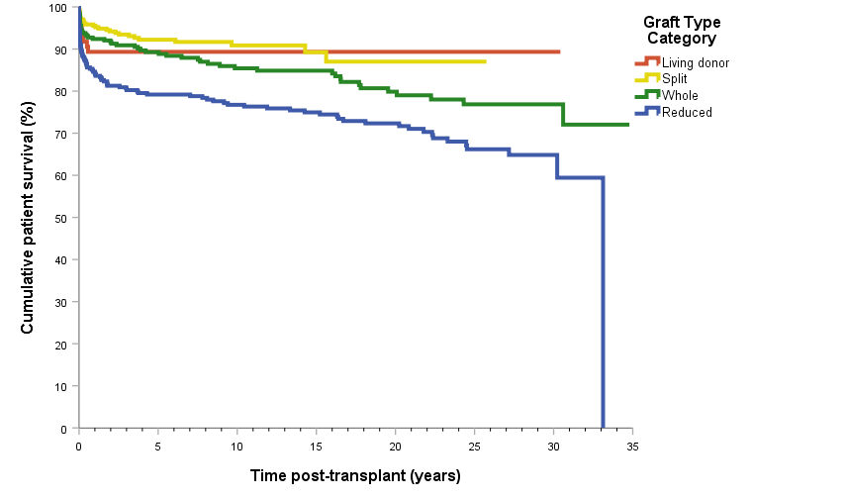
Paediatric patient survival curve by type of primary graft
Notes:
Figure 29. Paediatric patient survival curve by type of primary graf

Slide 11
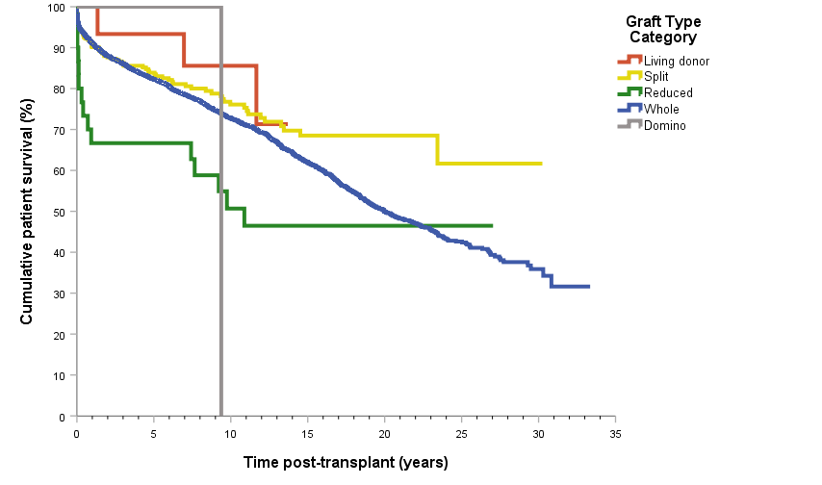
Adult patient survival curve by type of primary graft
Notes:
Figure 30. Adult patient survival curve by type of primary graf

Slide 12
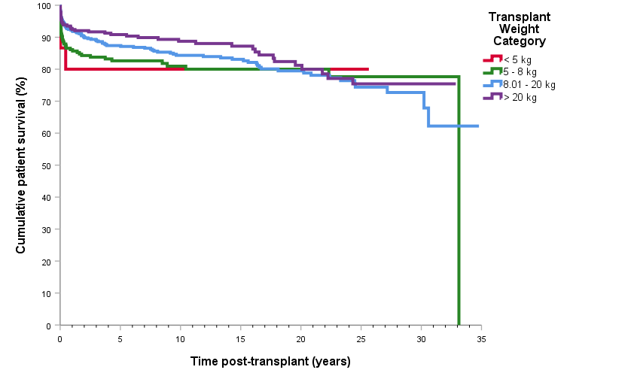
Paediatric patient survival curve by transplant weight
Notes:
Figure 31. Paediatric patient survival curve by transplant weight

Slide 13
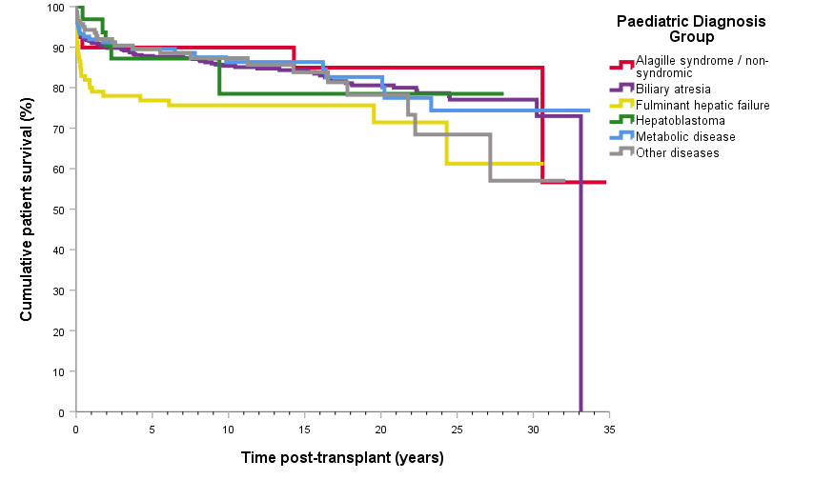
Paediatric patient survival curve by primary disease
Notes:
Figure 32. Paediatric patient survival curve by primary disease

Slide 14
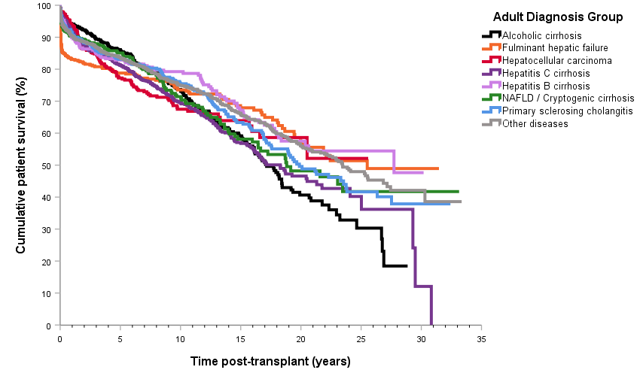
Adult patient survival curve by primary disease
Notes:
Figure 33. Adult patient survival curve by primary disease

Slide 15
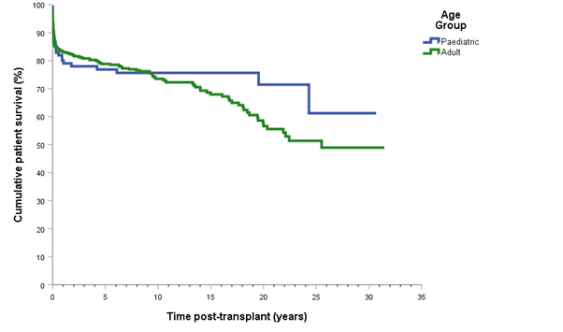
Patient survival curve by age group with primary diagnosis of fulminant hepatic failure
Notes:
Figure 34. Patient survival curve by age group with primary diagnosis of fulminant hepatic failure

Slide 16
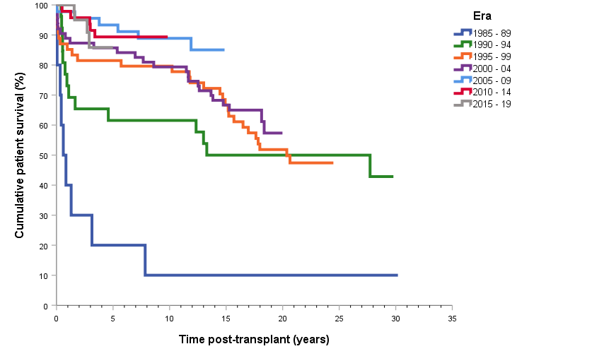
Adult patient survival curve by transplant era with primary diagnosis of Chronic Viral Hepatitis B
Notes:
Figure 35. Adult patient survival curve by transplant era with primary diagnosis of Chronic Viral Hepatitis B

Slide 17
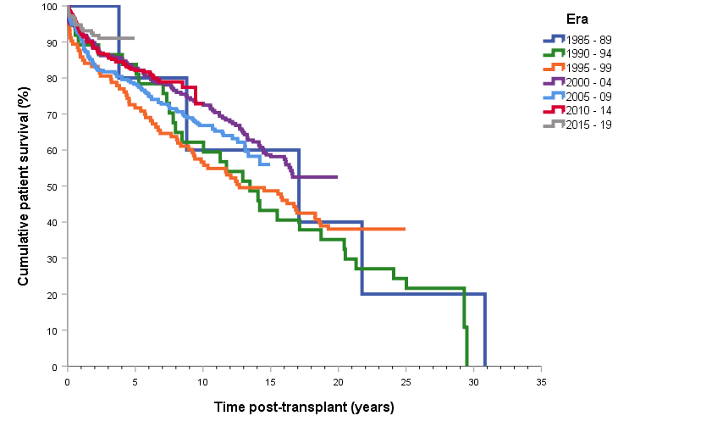
Adult patient survival curve by transplant era with primary diagnosis of Chronic Viral Hepatitis C
Notes:
Figure 36. Adult patient survival curve by transplant era with primary diagnosis of Chronic Viral Hepatitis C

Slide 18
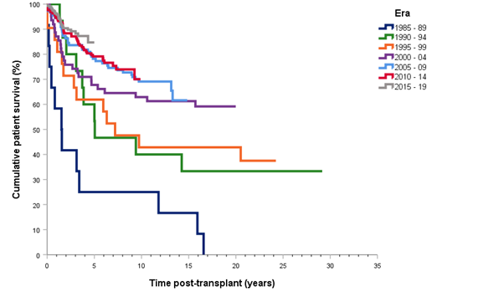
Patient survival curve with primary diagnosis of malignancy by era of transplant
Notes:
Figure 37. Patient survival curve with primary diagnosis of malignancy by era of transplant

Slide 19
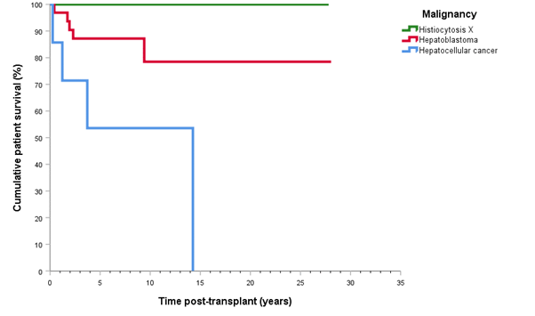
Paediatric patient survival curve with primary diagnosis of malignancy
Notes:
Figure 38. Paediatric patient survival curve with primary diagnosis of malignancy

Slide 20
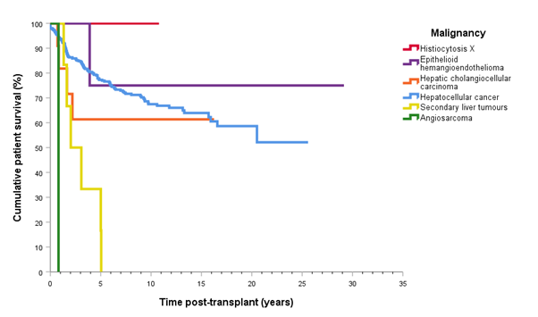
Adult patient survival curve with primary diagnosis of malignancy
Notes:
Figure 39. Adult patient survival curve with primary diagnosis of malignancy

