Slide 1
31st Annual Report on Liver and Intestinal Transplantation Activity in Australia and New Zealand Data to 31 December 2019

Slide 2
Section 5. Liver Transplant Waiting List

Slide 3
Liver transplant waiting list activity – all patients
Notes:
Figure 1. Liver transplant waiting list activity – all patients

Slide 4
Paediatric liver transplant waiting list activity
Notes:
Figure 2. Paediatric liver transplant waiting list activity

Slide 5
Adult liver transplant waiting list activity
Notes:
Figure 3. Adult liver transplant waiting list activity

Slide 6
Urgent category 1 waiting list outcomes
Notes:
Figure 4. Urgent category 1 waiting list outcomes

Slide 7
Urgent category 2 waiting list outcomes
Notes:
Figure 5. Urgent category 2 waiting list outcomes

Slide 8
Time on waiting list by year of delisting
Notes:
Figure 6. Time on waiting list by year of delisting

Slide 9
Section 6. Deceased Liver Donors

Slide 10
Deceased donors and grafts transplanted by year
Notes:
Figure 7. Deceased donors and grafts transplanted by year

Slide 11
Deceased donor age by transplant era
Notes:
Figure 8. Deceased donor age by transplant era

Slide 12
Section 7. Living Liver Donors

Slide 13
Living liver donor demographics
Notes:
Table 1. Living liver donor demographics

Slide 14
8 Liver Transplantation in 2019

Slide 15
Patient demographics by age group (Transplanted in 2019)
Notes:
Table 2. Patient demographics by age group (2019)

Slide 16
9 Liver Transplantation from 1985 – 2019

Slide 17
Cumulative number of liver transplants and new patients transplanted
Notes:
Figure 9. Cumulative number of liver transplants and new patients transplanted

Slide 18
Liver transplant rate and total Australia & New Zealand population
Notes:
Figure 10. Liver transplant rate and total Australia and New Zealand population

Slide 19
Patient demographics by age group (1985 – 2019)
Abbreviation: ANZ: Australia or New Zealand
Notes:
Table 3. Patient demographics by age group (1985 – 2019)

Slide 20
Number of patients transplanted by age group by year of first transplant
Notes:
Figure 11. Number of patients transplanted by age group by year of first transplant

Slide 21
Recipient age strata at first Australian or New Zealand transplant (1985 –2019)
Notes:
Figure 12. Recipient age strata at first Australian or New Zealand transplant (1985 – 2019)

Slide 22
Recipient age strata by transplant era
Notes:
Figure 13. Recipient age strata (percentages) by transplant era

Slide 23
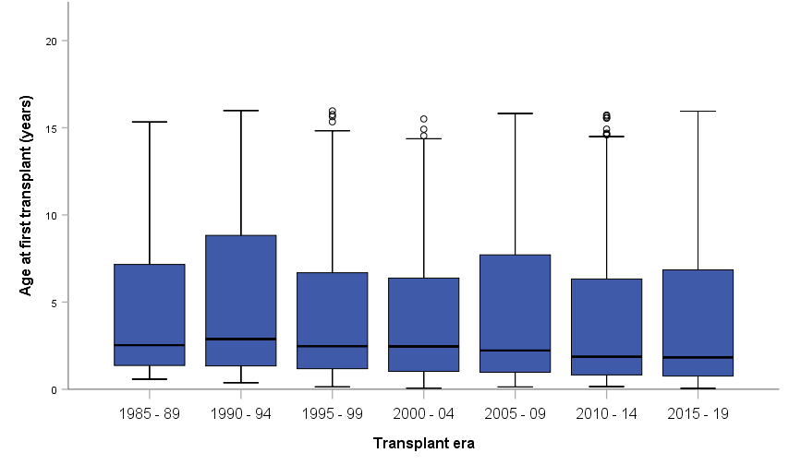
Paediatric age at first transplant by transplant era
Notes:
Figure 14. Paediatric age at first transplant by transplant era
Box and whisker plot: median, interquartile range, 1.5 times interquartile range and outliers shown

Slide 24
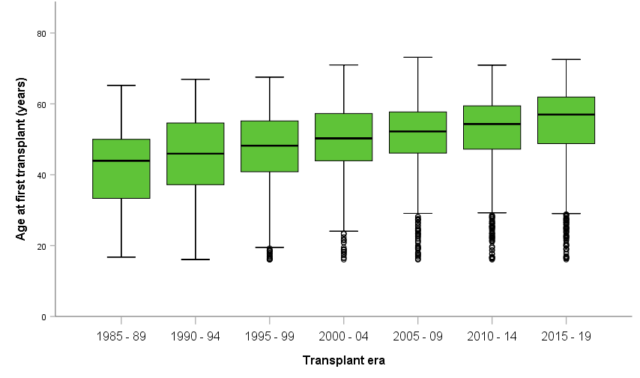
Adult age at first transplant by transplant era
Notes:
Figure 15. Adult age at first transplant by transplant era
Box and whisker plot: median, interquartile range, 1.5 times interquartile range and outliers shown

Slide 25
Cumulative number of liver transplants per year by age category
Notes:
Figure 16. Cumulative number of liver transplants per year by age category

Slide 26
Number of liver transplants per year by recipient age category
Notes:
Figure 17. Number of liver transplants per year by recipient age category

Slide 27
Type of graft for paediatric recipients – all years
Notes:
Figure 18. Type of graft for paediatric recipients – all years

Slide 28
Type of graft for adult recipients – all years
Notes:
Figure 19. Type of graft for adult recipients – all years

Slide 29
10 Diagnoses at First Transplant

Slide 30
Primary diagnosis in children
Notes:
Table 4. Primary diagnosis in children

Slide 31
Paediatric primary diagnosis (graft 1) all years
Notes:
Figure 20. Paediatric (< 16 years) primary diagnosis percentages (based on graft 1) all years

Slide 32
Primary diagnosis in adults
Notes:
Table 5. Primary diagnosis in adults

Slide 33
Adult primary diagnosis (based on graft 1) all years
Notes:
Figure 21. Adult primary diagnosis percentages (based on graft 1) all years

Slide 34
Breakdown of fulminant hepatic failure category by age group
Notes:
Table 6. Detailed breakdown of fulminant hepatic failure category by age group

Slide 35
Breakdown of metabolic disorders category by age group
Notes:
Table 7. Detailed breakdown of metabolic disorders category by age group

