Slide 1
32nd Annual Report on Liver and Intestinal Transplantation Activity in Australia and New Zealand Data to 31 December 2020

Slide 2
12. Graft Outcome

Slide 3
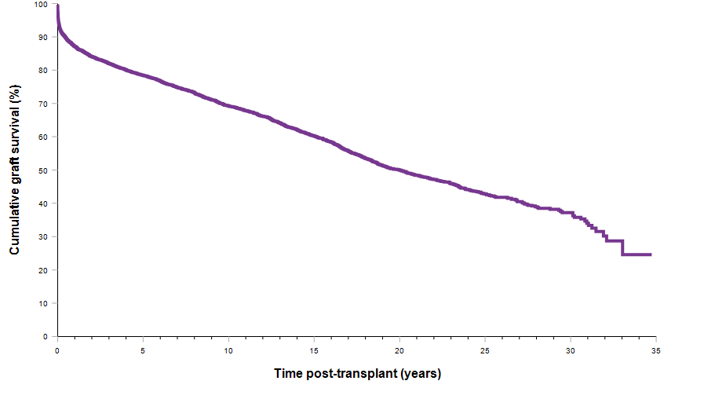
Graft survival curve for all grafts
Notes:
Figure 44. Graft survival curve for all grafts

Slide 4
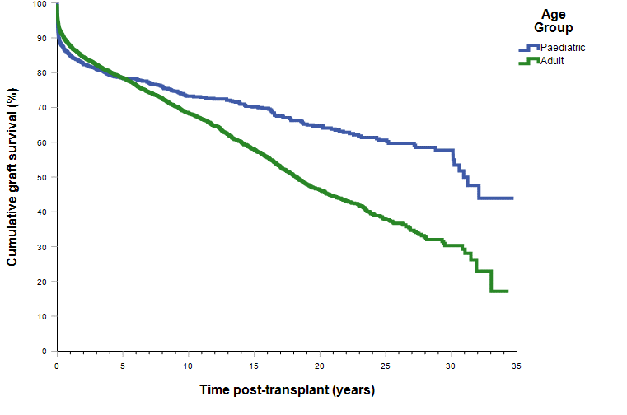
Graft survival curve for all grafts by age group
Notes:
Figure 45. Graft survival curve for all grafts by age group

Slide 5
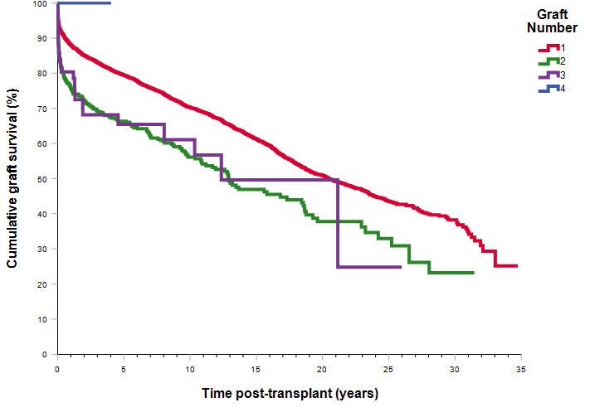
Graft survival curve for all grafts by graft number
Notes:
Figure 46. Graft survival curve for all grafts by graft number

Slide 6
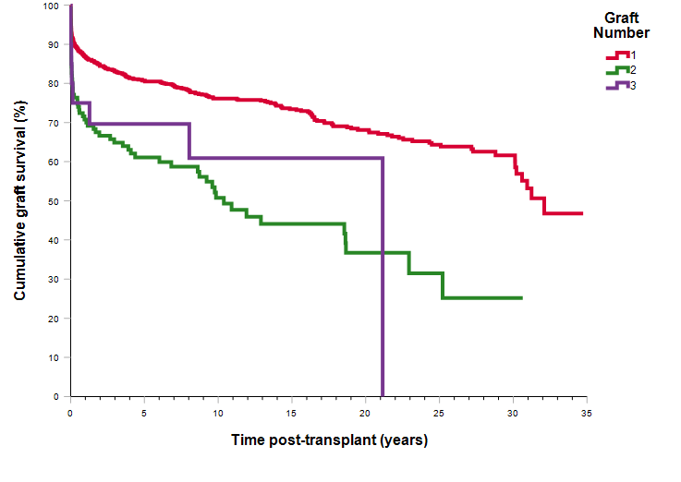
Graft survival curve for paediatric recipients by graft number
Notes:
Figure 47. Graft survival curve for paediatric recipients by graft number

Slide 7
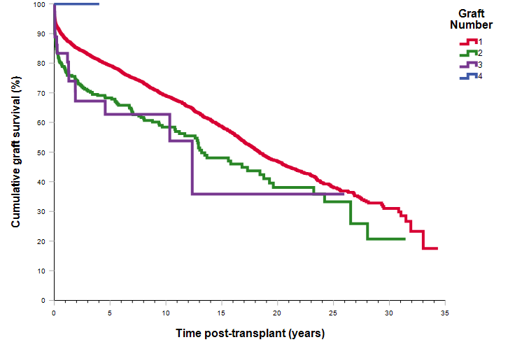
Graft survival curve for adults by graft number
Notes:
Figure 48. Graft survival curve for adults by graft number

Slide 8
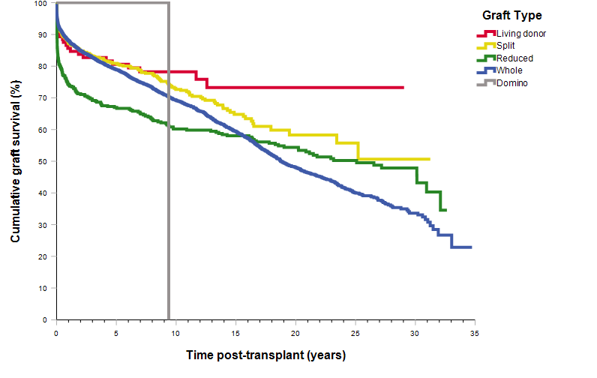
Graft survival curve for type of graft, all grafts
Notes:
Figure 49. Graft survival curve for type of graft, all grafts

Slide 9
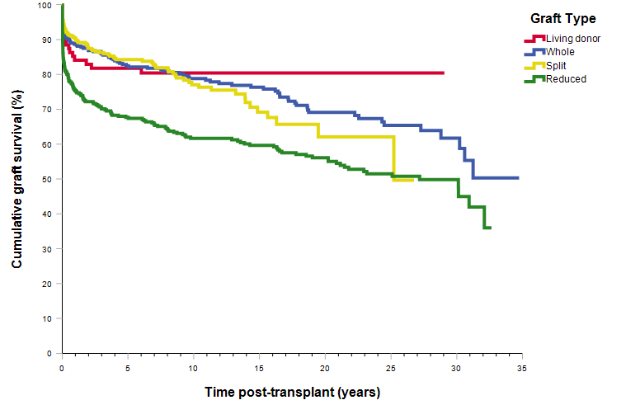
Paediatric graft survival curve for type of graft, all grafts
Notes:
Figure 50. Paediatric graft survival curve for type of graft, all grafts

Slide 10
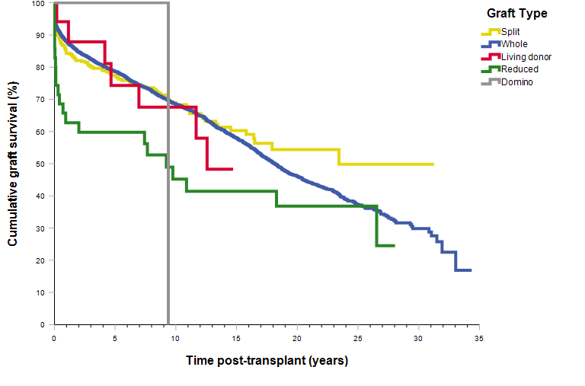
Adult graft survival curve for type of graft, all grafts
Notes:
Figure 51. Adult graft survival curve for type of graft, all grafts

Slide 11
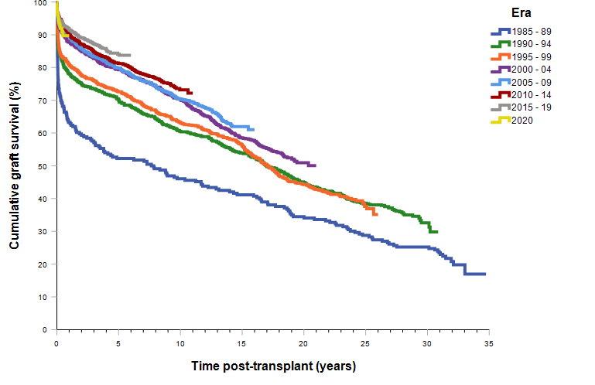
Graft (deceased and living donors) survival curve by era of transplant
Notes:
Figure 52. Graft (deceased and living donors) survival curve by era of transplant

Slide 12
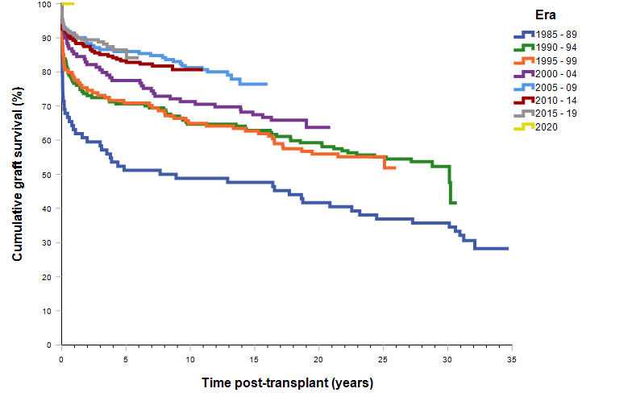
Paediatric graft (deceased and living donors) survival curve by era of transplant
Notes:
Figure 53. Paediatric graft (deceased and living donors) survival curve by era of transplant

Slide 13
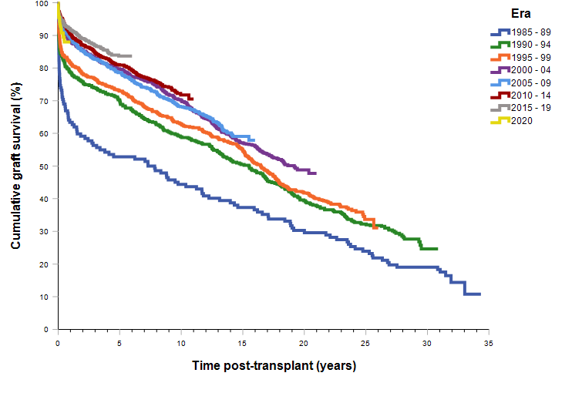
Adult graft (deceased and living donors) survival curve by era of transplant
Notes:
Figure 54. Adult graft (deceased and living donors) survival curve by era of transplant

Slide 14
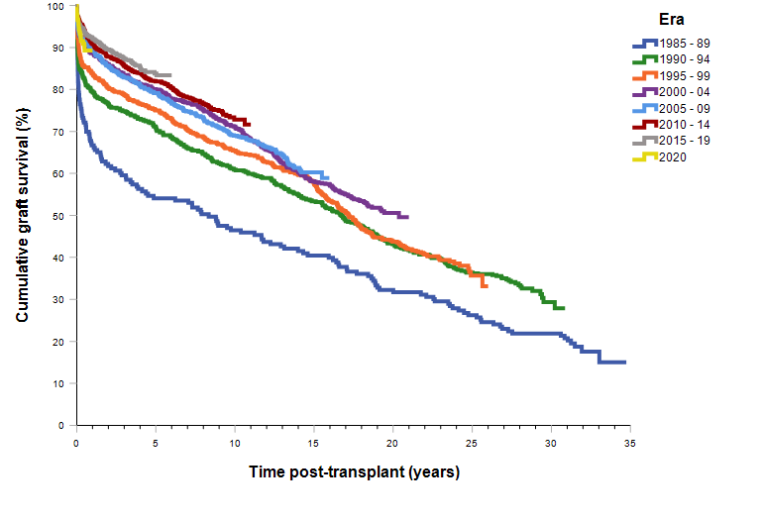
Whole graft survival curve by era of transplant
Notes:
Figure 55. Whole graft survival curve by era of transplant

Slide 15
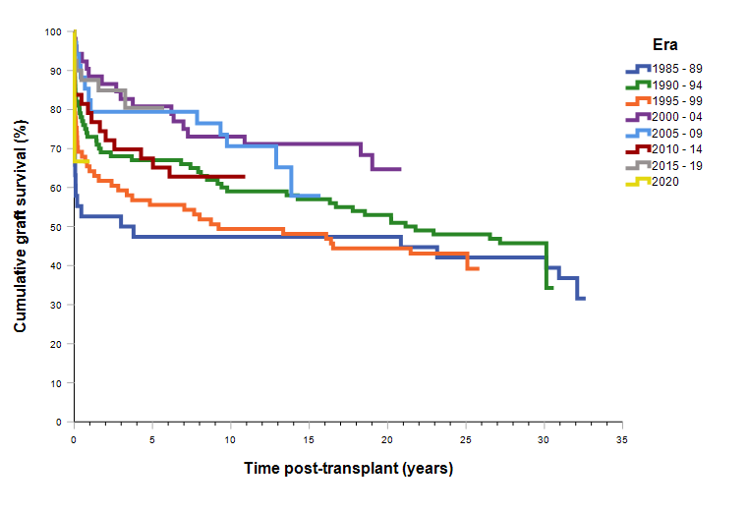
Reduced graft survival curve by era of transplant
Notes:
Figure 56. Reduced graft survival curve by era of transplant

Slide 16
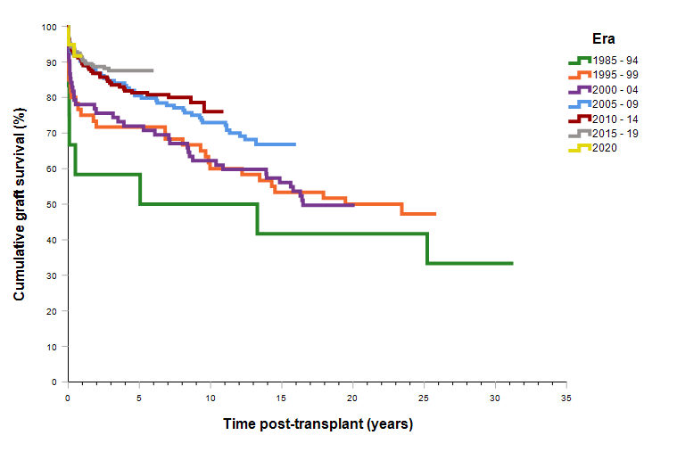
Split graft (deceased donor) survival curve by era of transplant
Notes:
Figure 57. Split graft (deceased donor) survival curve by era of transplant

Slide 17
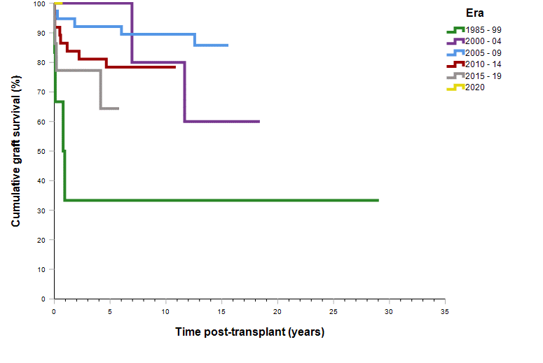
Living donor graft survival curve by era of transplant
Notes:
Figure 58. Living donor graft survival curve by era of transplant

Slide 18
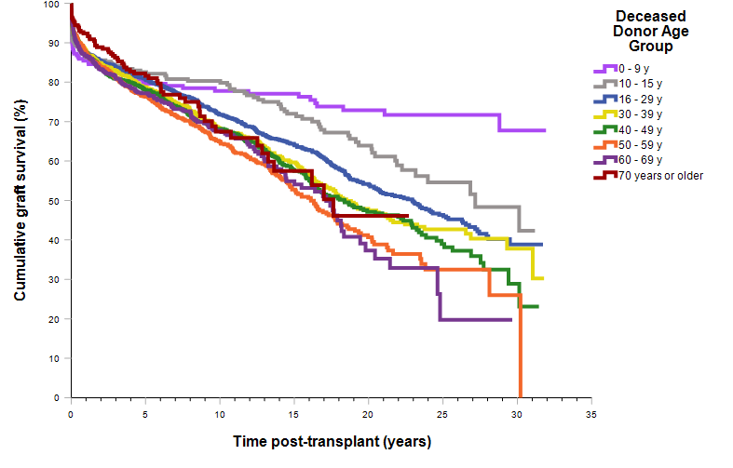
Graft survival curve by deceased donor age
Notes:
Figure 59. Graft survival curve by deceased donor age

Slide 19
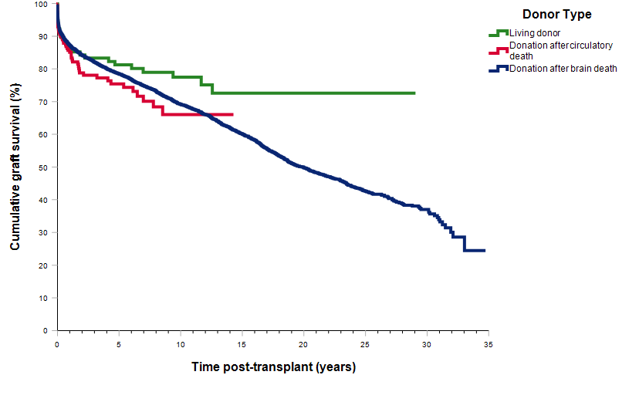
Graft survival curve by donor type – all grafts
Notes:
Figure 60. Graft survival curve by donor type – all grafts

Slide 20
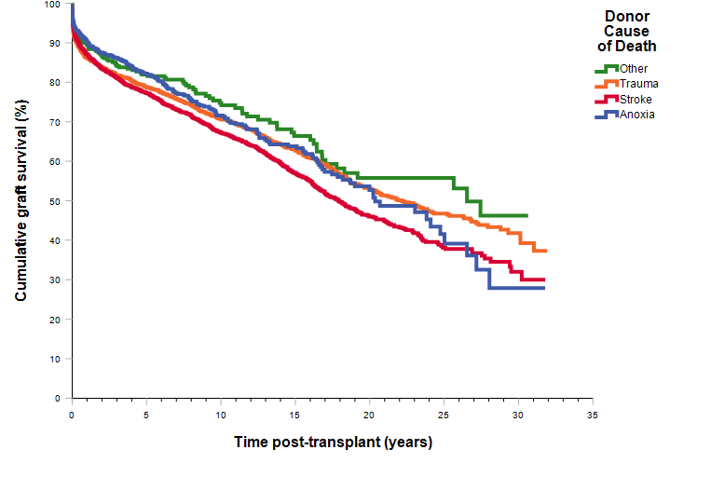
Graft survival curve by donor cause of death
Notes:
Figure 61. Graft survival curve by donor cause of death

Slide 21
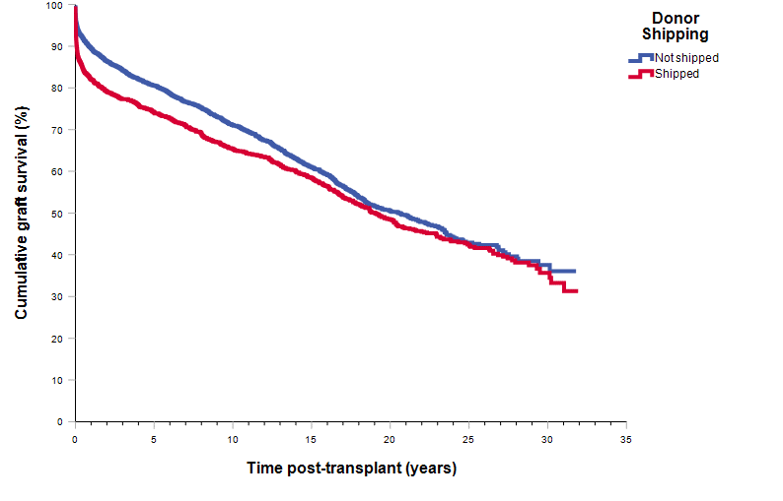
Graft survival curve by organ shipping
Notes:
Figure 62. Graft survival curve by organ shipping

Slide 22
Graft survival curve by cold ischaemia time
Notes:
Figure 63. Graft survival curve by cold ischaemia time

Slide 23
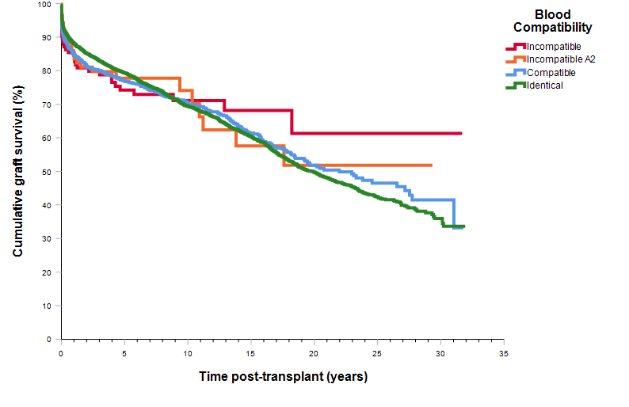
Graft survival curve by blood group compatibility
Notes:
Figure 64. Graft survival curve by blood group compatibility

Slide 24
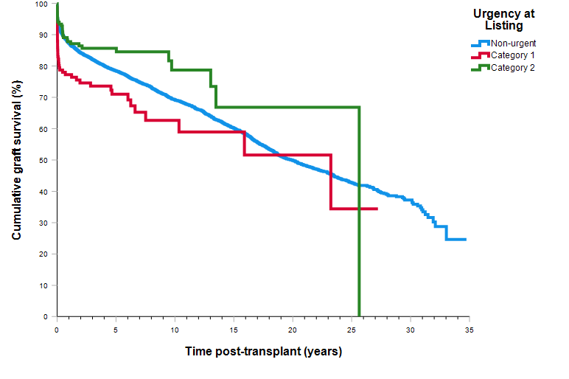
Graft survival curve by recipient urgency at listing
Notes:
Figure 65. Graft survival curve by recipient urgency at listing

Slide 25
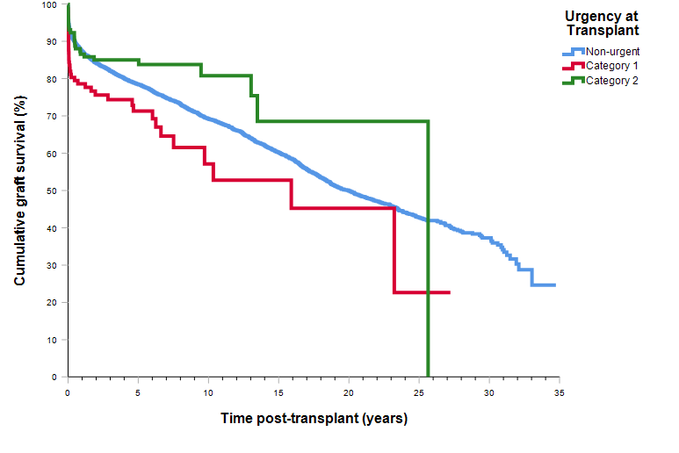
Graft survival curve by recipient urgency at transplant
Notes:
Figure 66. Graft survival curve by recipient urgency at transplant

