Slide 1
33rd Annual Report on Liver and Intestinal Transplantation Activity in Australia and New Zealand Data to 31 December 2021

Slide 2
11. Patient Survival

Slide 3
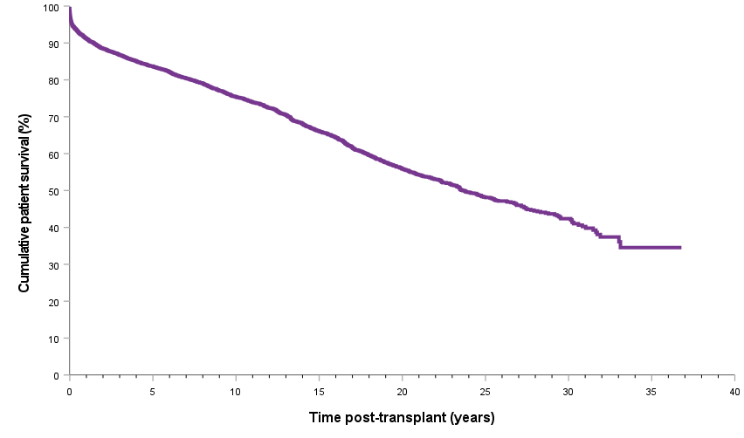
Patient survival curve
Notes:
Figure 26. Patient survival curve

Slide 4
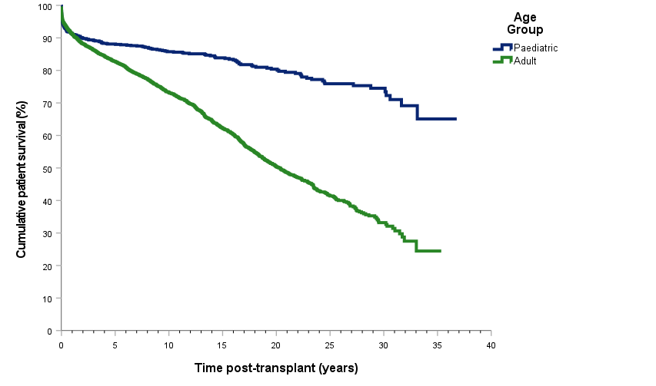
Patient survival curve by age category
Notes:
Figure 27. Patient survival curve by age category

Slide 5
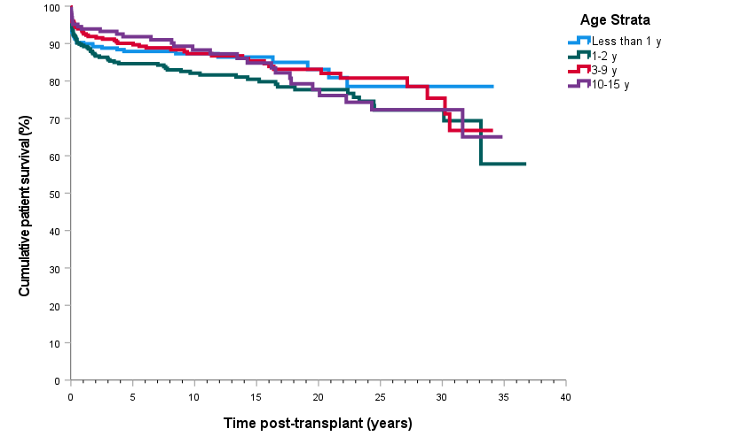
Paediatric patient survival curve by age strata
Notes:
Figure 28. Paediatric patient survival curve by age strata

Slide 6
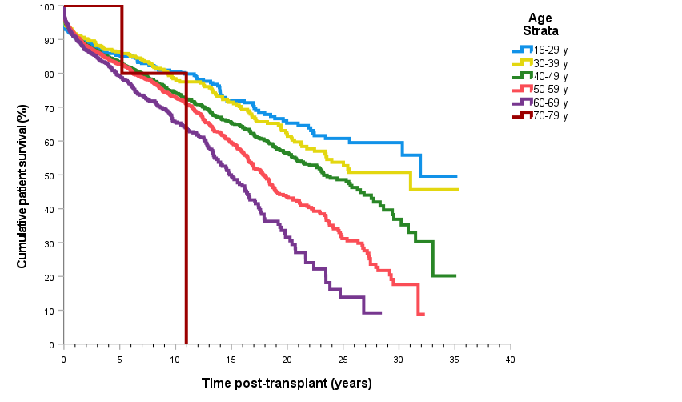
Adult patient survival curve by age strata
Notes:
Figure 29. Adult patient survival curve by age strata

Slide 7
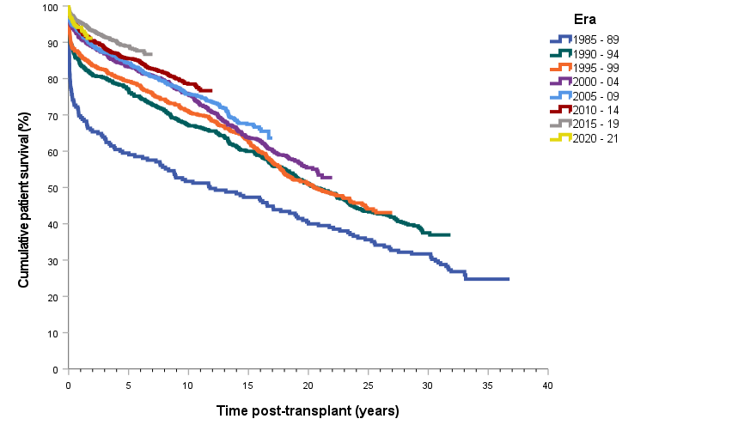
Patient survival curve by era of transplant
Notes:
Figure 30. Patient survival curve by era of transplant

Slide 8
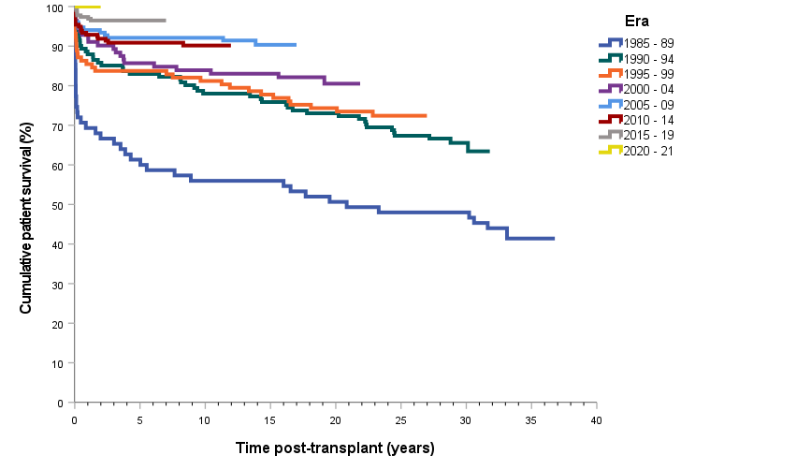
Paediatric patient survival curve by era of transplant
Notes:
Figure 31. Paediatric patient survival curve by era of transplant

Slide 9
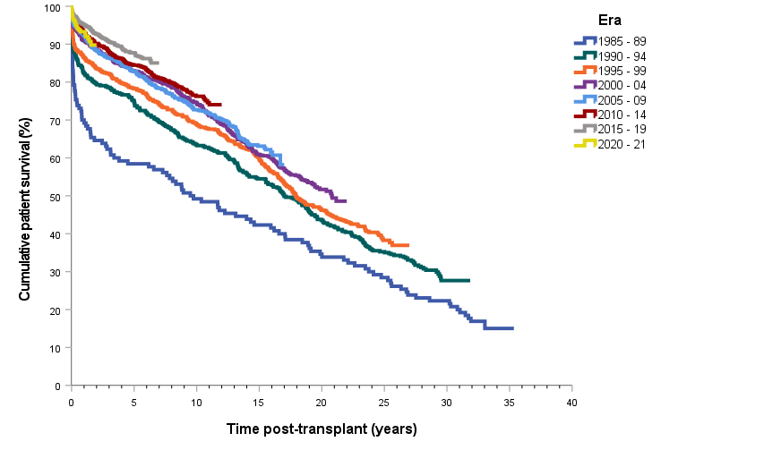
Adult patient survival curve by era of transplant
Notes:
Figure 32. Adult patient survival curve by era of transplant

Slide 10
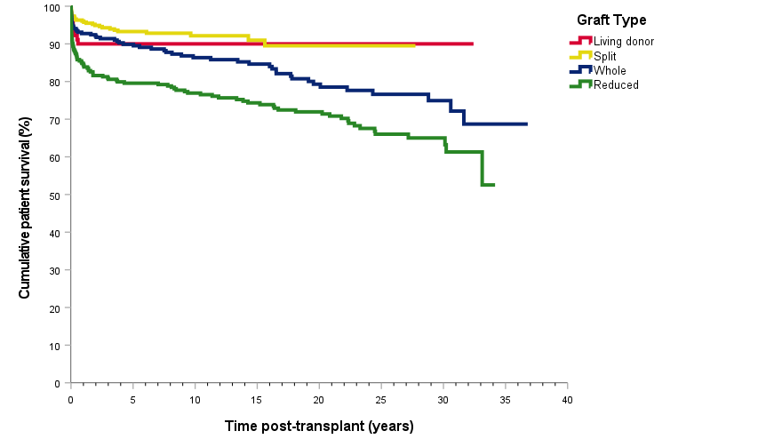
Paediatric patient survival curve by type of primary graft
Notes:
Figure 33. Paediatric patient survival curve by type of primary graft

Slide 11
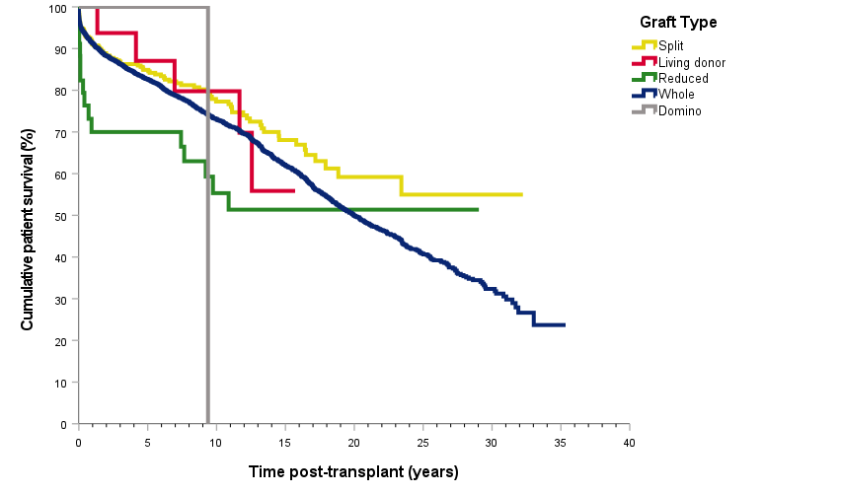
Adult patient survival curve by type of primary graft
Notes:
Figure 34. Adult patient survival curve by type of primary graf

Slide 12
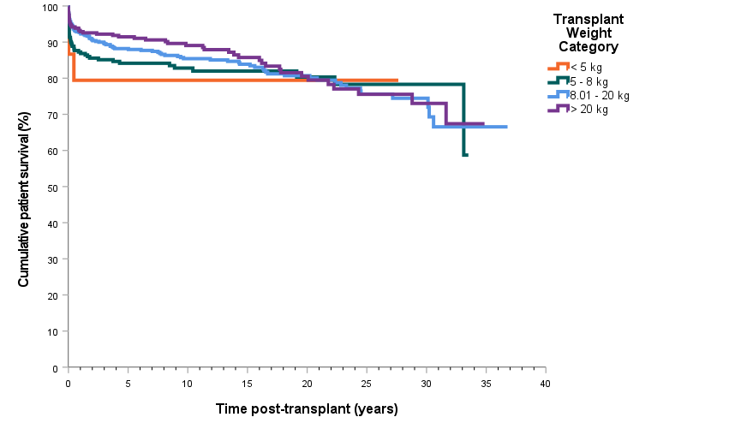
Paediatric patient survival curve by transplant weight
Notes:
Figure 35. Paediatric patient survival curve by transplant weight

Slide 13
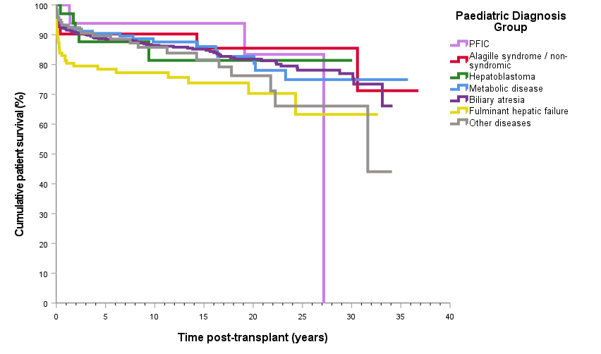
Paediatric patient survival curve by primary disease
Notes:
Figure 36. Paediatric patient survival curve by primary disease

Slide 14
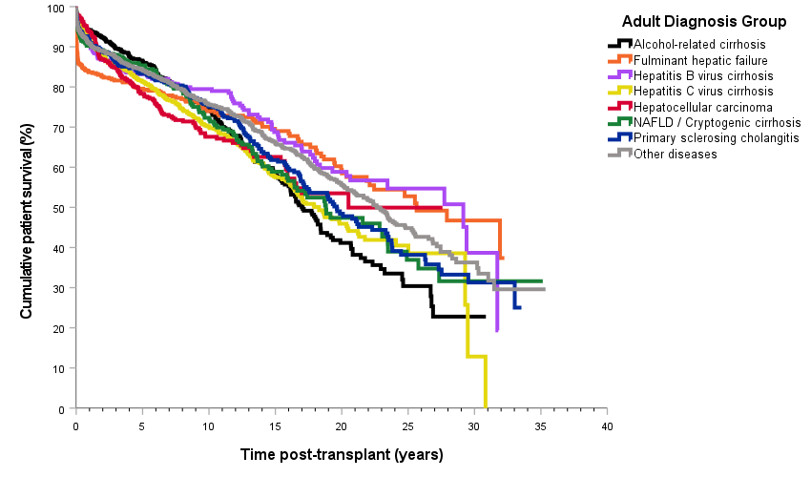
Adult patient survival curve by primary disease
Notes:
Figure 37. Adult patient survival curve by primary disease

Slide 15
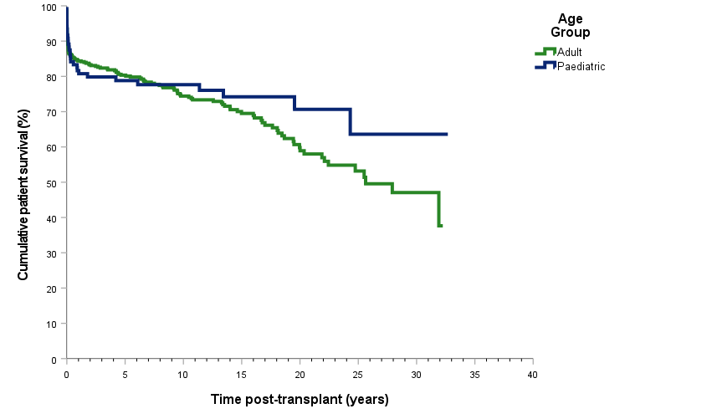
Patient survival curve by age group with fulminant hepatic failure – all diagnoses
Notes:
Figure 38. Patient survival curve by age group with fulminant hepatic failure – all diagnoses

Slide 16
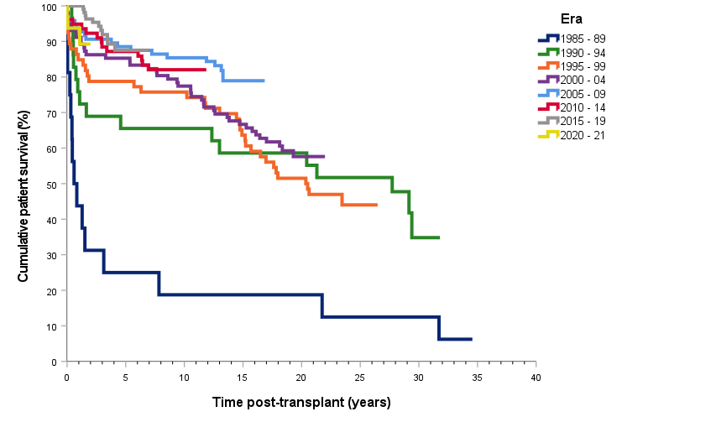
Adult patient survival curve by transplant era with hepatitis B virus cirrhosis – all diagnoses
Notes:
Figure 39. Adult patient survival curve by transplant era with hepatitis B virus cirrhosis – all diagnoses

Slide 17
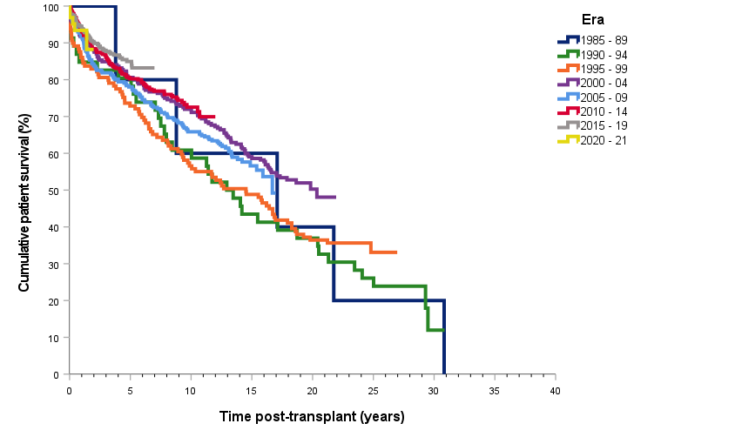
Patient survival curve by transplant era with hepatitis C virus cirrhosis – all diagnoses
Notes:
Figure 40. Patient survival curve by transplant era with hepatitis C virus cirrhosis – all diagnoses

Slide 18
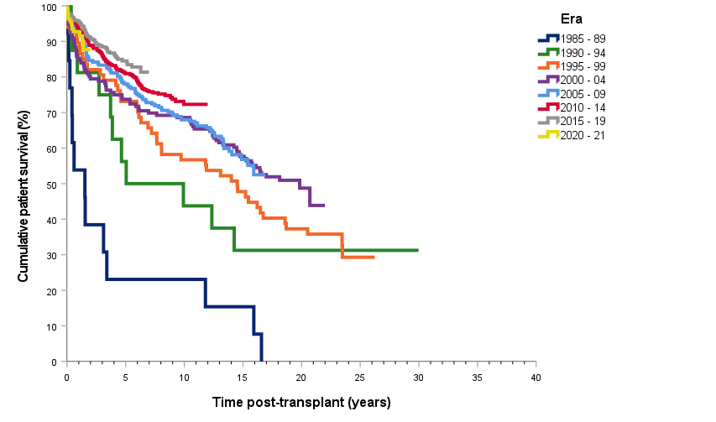
Patient survival curve with a diagnosis of hepatocellular carcinoma by transplant era – all diagnoses
Notes:
Figure 41. Patient survival curve with a diagnosis of hepatocellular carcinoma by transplant era – all diagnoses

Slide 19
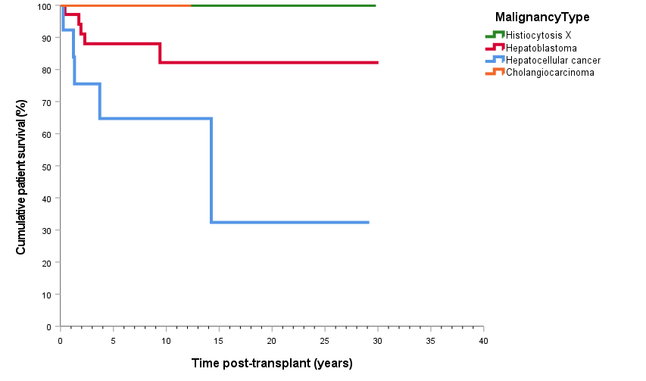
Paediatric patient survival curve with a malignancy diagnosis – all diagnoses
Notes:
Figure 42. Paediatric patient survival curve with a malignancy diagnosis – all diagnoses

Slide 20
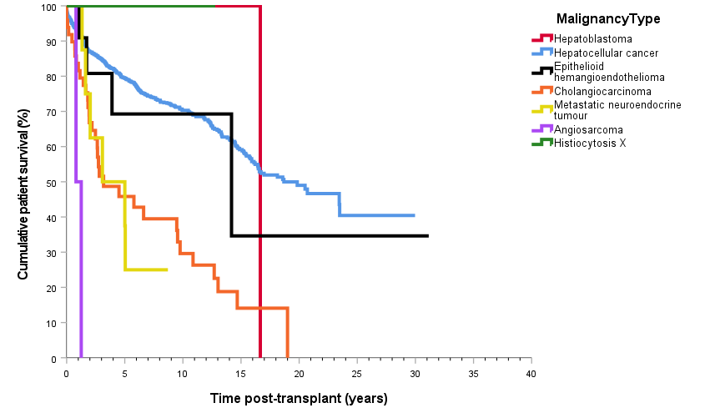
Adult patient survival curve with a malignancy diagnosis – all diagnoses
Notes:
Figure 43. Adult patient survival curve with a malignancy diagnosis – all diagnoses

