Slide 1

33rd Annual Report on
Liver and Intestinal Transplantation Activity in Australia and New Zealand
Data to 31 December 2021

Slide 2
13 Indication for Retransplantation

Slide 3
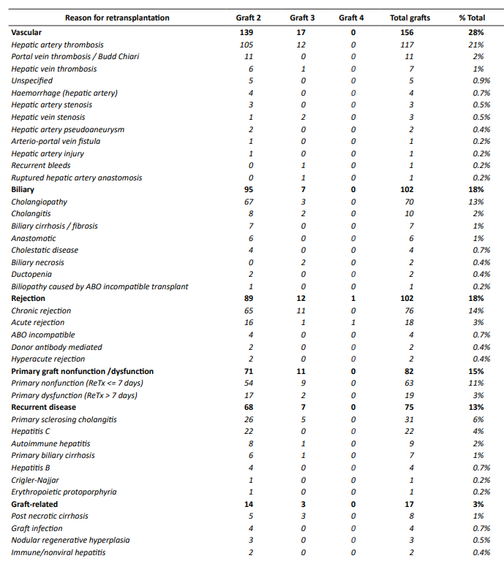
Reason for retransplantation - 1
Notes:
Table 50. Reason for retransplantation - 1

Slide 4
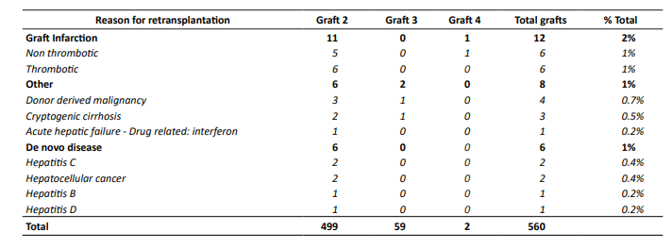
Reason for retransplantation - 2
Notes:
Table 50. Reason for retransplantation - 2

Slide 5
Time to graft failure by reason for retransplantation
Notes:
Figure 66. Time to graft failure by reason for retransplantation

Slide 6
Reason for retransplantation following paediatric graft failure
Notes:
Table 51. Reason for retransplantation following paediatric graft failure - 1

Slide 7
Paediatric time to graft failure by reason for retransplantation
Notes:
Figure 67. Paediatric time to graft failure by reason for retransplantation

Slide 8
Reason for retransplantation following adult graft failure
Notes:
Table 52. Reason for retransplantation following adult graft failure - 1

Slide 9
Adult time to graft failure by reason for retransplantation
Notes:
Figure 68. Adult time to graft failure by reason for retransplantation

Slide 10
14 Cause of Patient Death

Slide 11
Cause of death by categories – all patients
Notes:
Figure 69. Cause of death by categories

Slide 12
Paediatric cause of death
Notes:
Figure 70. Paediatric cause of death

Slide 13
Adult cause of death
Notes:
Figure 71. Adult cause of death

Slide 14
Cause of death by age group – 1
Notes:
Table 53. Cause of death by age group – 1

Slide 15
Cause of death by age group – 2
Abbreviation: NASH, non-alcoholic steatohepatitis; OTC, Ornithine transcarbamylase
Notes:
Table 53. Cause of death by age group – 2

Slide 16
Cause of death by time to death post-transplant
– all patients
Notes:
Figure 72. Cause of death by time to death post-transplant – all patients

Slide 17
Paediatric cause of death by time to death post-transplant
Notes:
Figure 73. Paediatric cause of death by time to death post-transplant

Slide 18
Adult cause of death by time to death post-transplant
Notes:
Figure 75. Adult cause of death by time to death post-transplant

