Slide 1

33rd Annual Report on
Liver and Intestinal Transplantation Activity in Australia and New Zealand
Data to 31 December 2021

Slide 2
15 Liver Transplantation and Cancer
Notes:
15 Liver Transplantation and Cancer

Slide 3
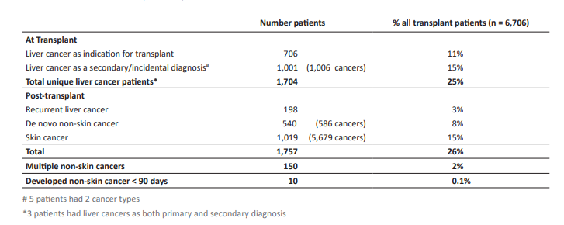
Cancer in liver transplant recipients
Notes:
Table 54. Cancer in liver transplant recipients

Slide 4
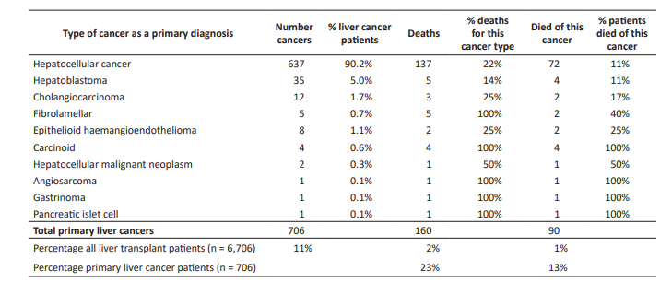
Type of liver cancers as a primary diagnosis
Notes:
Table 55. Type of liver cancers as a primary diagnosis

Slide 5
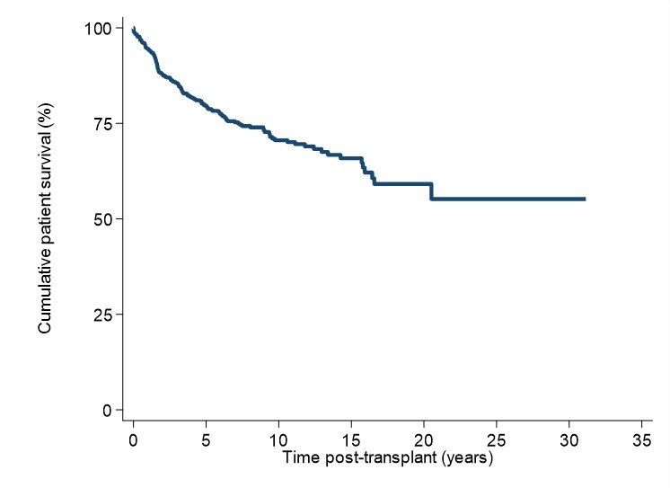
Patient survival curve for patients with a primary diagnosis of liver cancer
Notes:
Figure 75. Patient survival curve for patients with a primary diagnosis of liver cancer

Slide 6
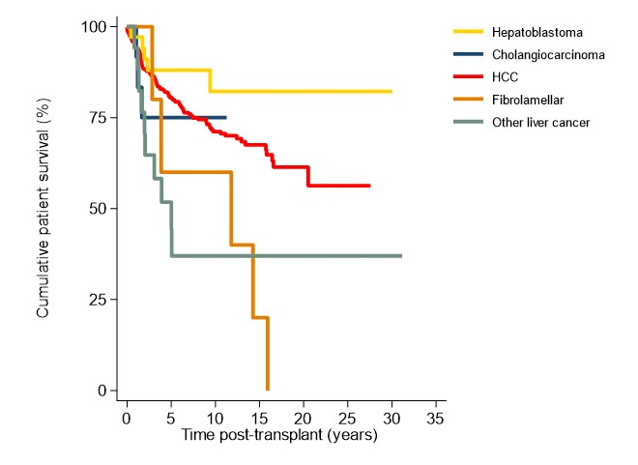
Patient survival curve for patients with a primary diagnosis of liver cancer by type of cancer
Notes:
Figure 76. Patient survival curve for patients with a primary diagnosis of liver cancer by type of cancer

Slide 7
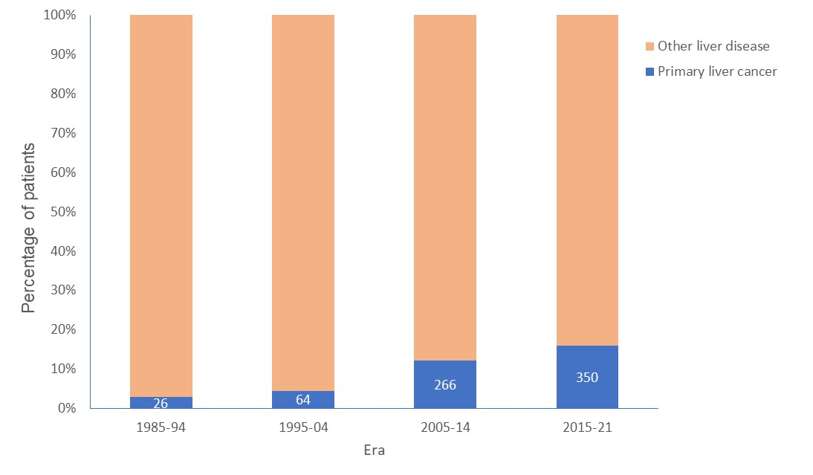
Incidence of patients with liver cancer as a primary diagnosis by era
Notes:
Figure 77. Incidence of patients with liver cancer as a primary diagnosis by era

Slide 8
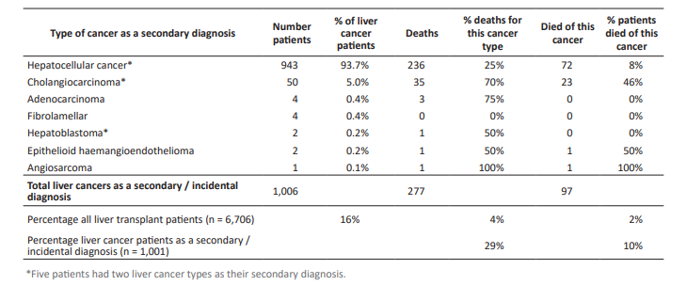
Type of liver cancers as a secondary / incidental diagnosis
Notes:
Table 58. Type of liver cancers as a secondary / incidental diagnosis

Slide 9
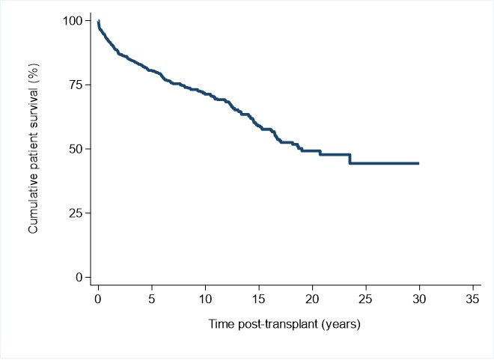
Patient survival curve for patients with a secondary / incidental diagnosis of liver cancer
Notes:
Figure 78. Patient survival curve for patients with a secondary / incidental diagnosis of liver cancer

Slide 10
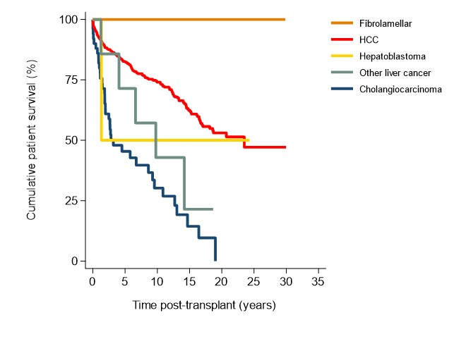
Patient survival curve for patients with secondary / incidental diagnosis of liver cancer by type of cancer
Notes:
Figure 79. Patient survival curve for patients with secondary / incidental diagnosis of liver cancer by type of cancer

Slide 11
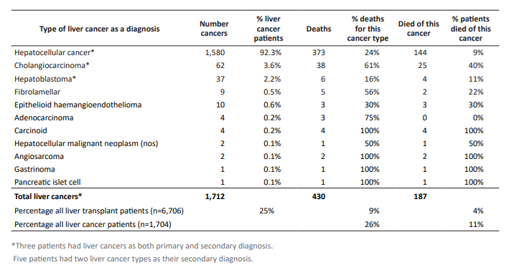
Types of liver cancer (primary or secondary / incidental diagnosis) at transplantation
Notes:
Table 61. Types of liver cancer (primary or secondary / incidental diagnosis) at transplantation

Slide 12
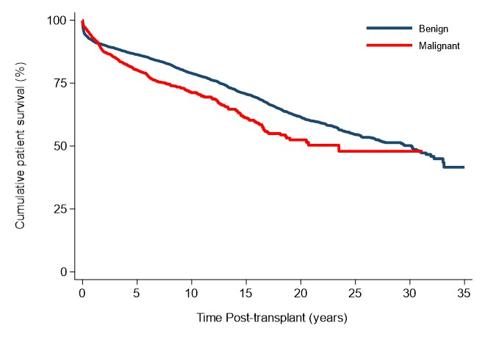
Patient survival – pretransplant benign disease versus pretransplant liver malignancy
Notes:
Figure 80. Patient survival – pretransplant benign disease versus pretransplant liver malignancy

Slide 13
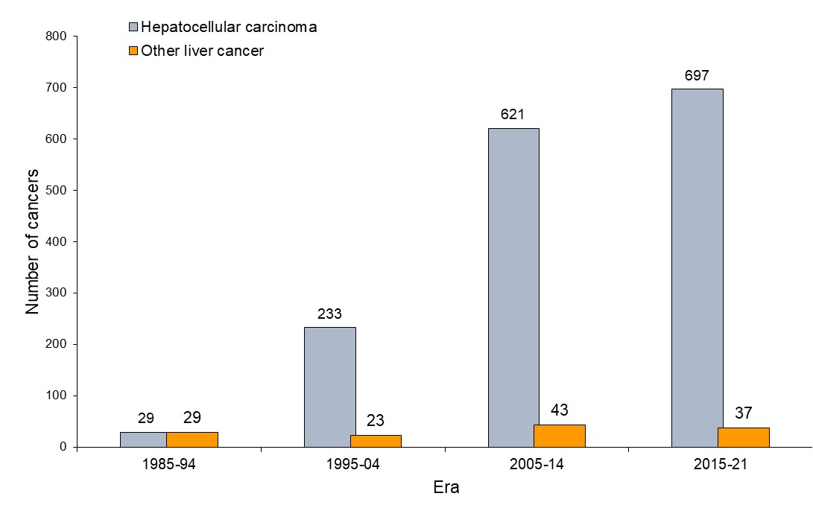
Hepatocellular carcinoma versus other liver cancers at transplantation by era
Notes:
Figure 81. Hepatocellular carcinoma versus other liver cancers at transplantation by era

Slide 14
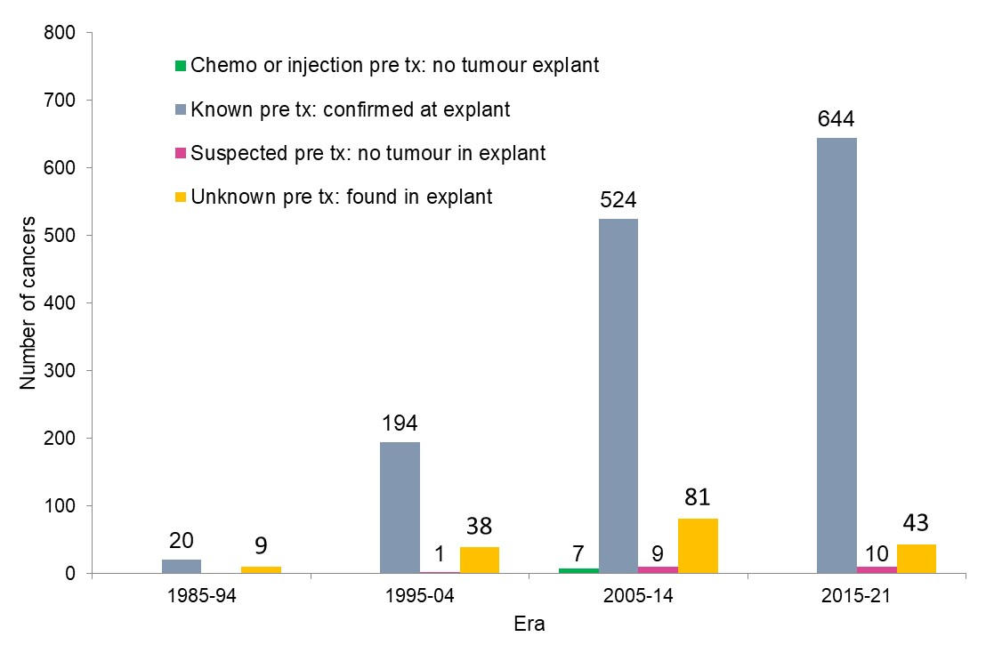
Hepatocellular carcinoma status at transplant by era
Notes:
Figure 82. Hepatocellular carcinoma status at transplant by era

Slide 15
Patient survival of hepatocellular carcinoma by era
Notes:
Figure 83. Patient survival of hepatocellular carcinoma by era

Slide 16
Patient survival of hepatocellular carcinoma status at transplant
Notes:
Figure 84. Patient survival of hepatocellular carcinoma status at transplant

Slide 17
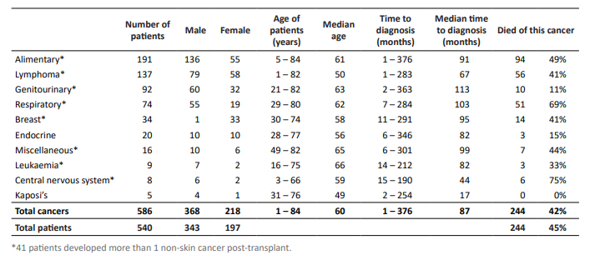
De novo non-skin cancer types
Notes:
Table 65. De novo non-skin cancer types

Slide 18
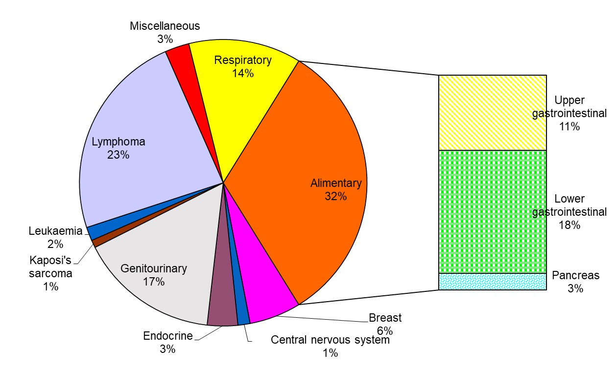
De novo non-skin cancer types
Notes:
Figure 85. De novo non-skin cancer types

Slide 19
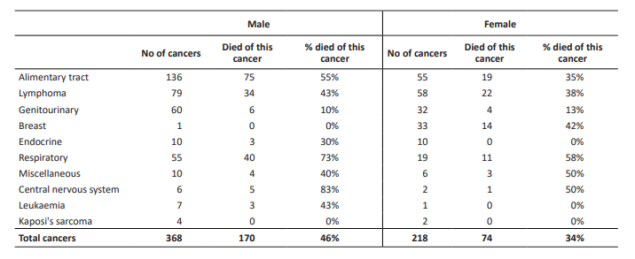
De novo non-skin cancer types
– gender versus death outcome
Notes:
Table 66. De novo non-skin cancer types – gender versus death outcome

Slide 20
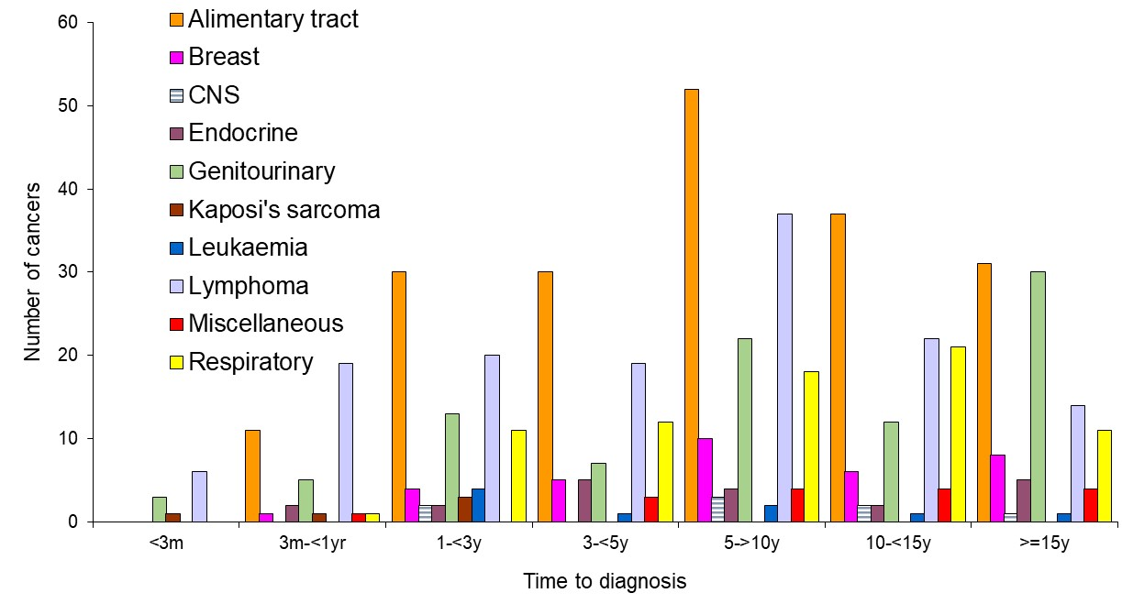
Time to diagnosis of de novo non-skin cancer
Notes:
20
Figure 86. Time to diagnosis of de novo non-skin cancer

Slide 21
Time to diagnosis of any non-skin cancer by age category
Notes:
21
Figure 87. Time to diagnosis of any non-skin cancer by age category

Slide 22
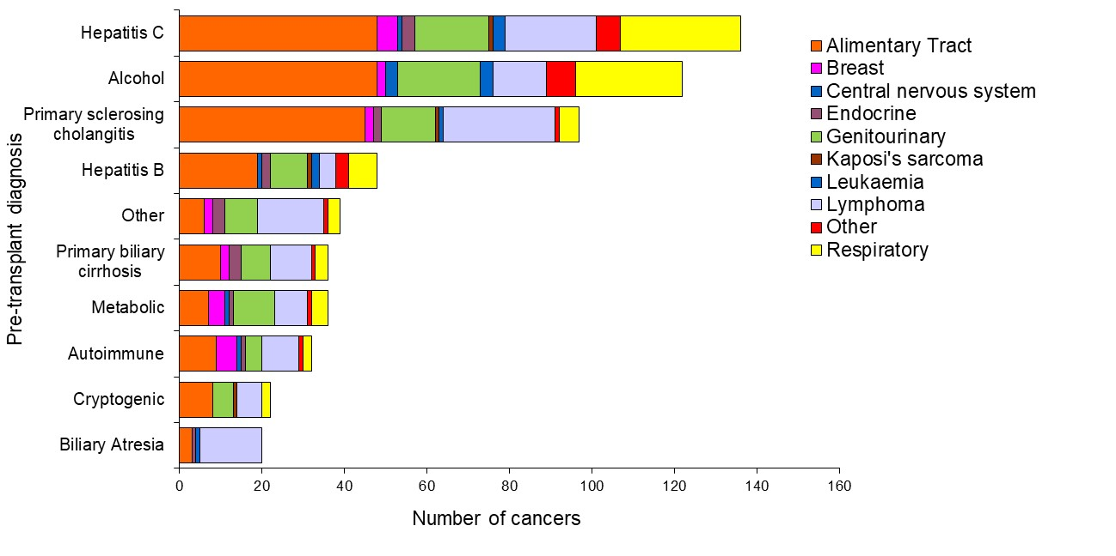
Pretransplant diagnosis and de novo non-skin cancer types
Notes:
Figure 88. Pretransplant diagnosis and de novo non-skin cancer types

Slide 23
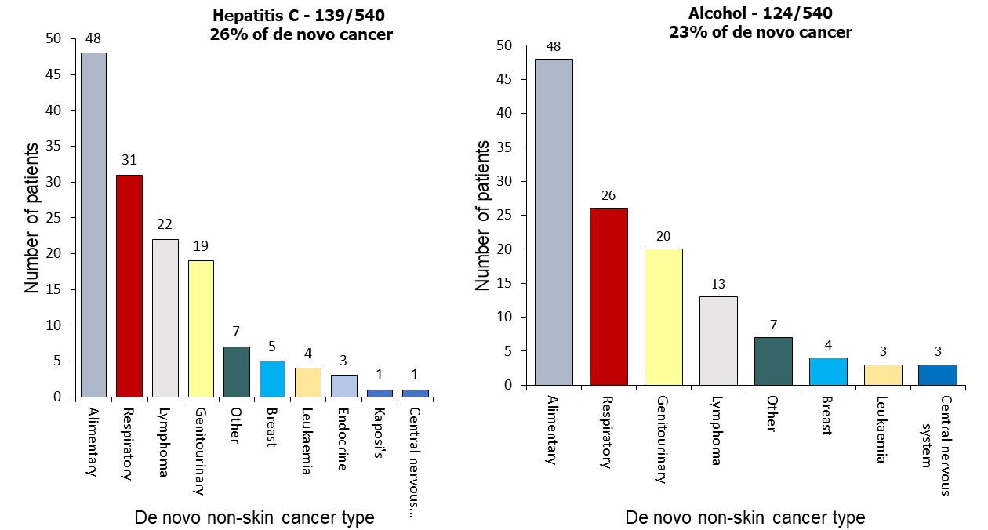
Hepatitis C virus and alcohol diagnosis and types of de novo skin cancer
Notes:
Figure 89a. Hepatitis C virus and alcohol diagnosis and types of de novo skin cancer

Slide 24
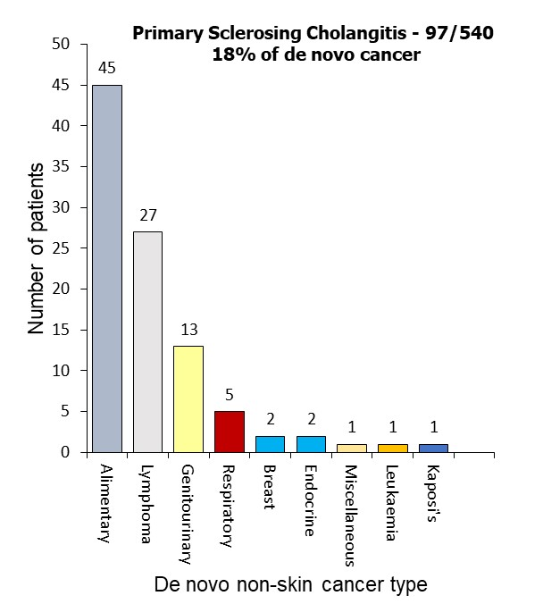
Hepatitis C virus and alcohol diagnosis and types of de novo skin cancer
Notes:
Figure 89b. Primary sclerosing cholangitis diagnosis and types of de novo skin cancer

Slide 25
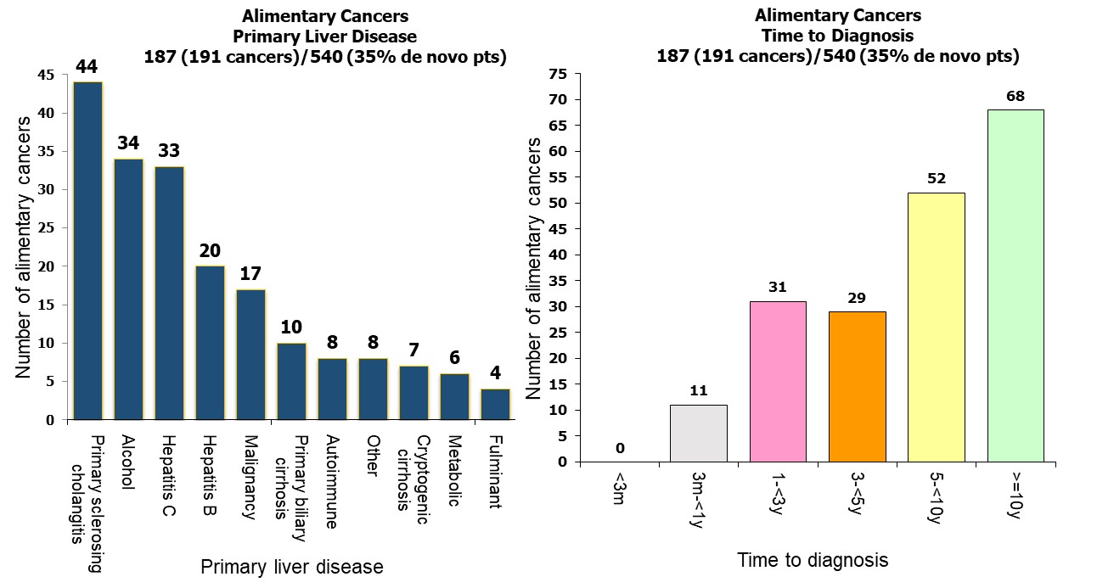
Pretransplant diagnosis and de novo alimentary cancers
Notes:
Figure 90. Pretransplant diagnosis and de novo alimentary cancers

Slide 26
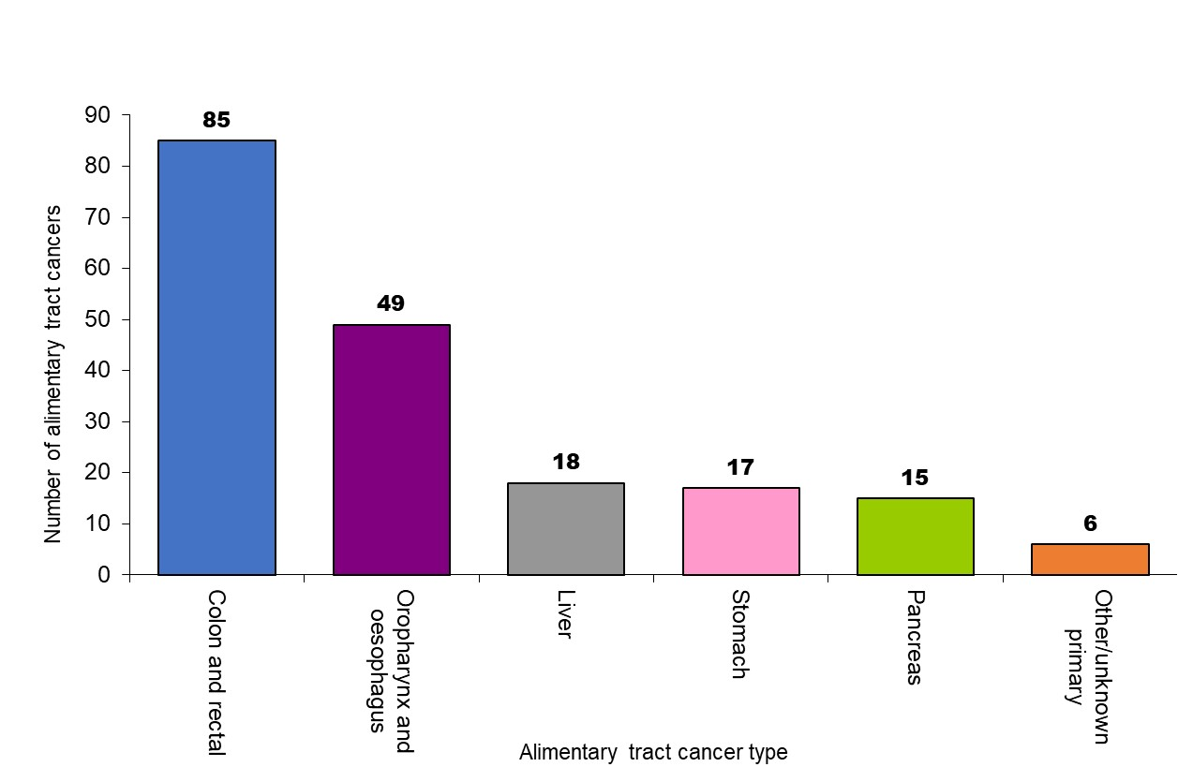
Incidence of de novo alimentary tract cancers by type
Notes:
Figure 91. Incidence of de novo alimentary tract cancers by type

Slide 27
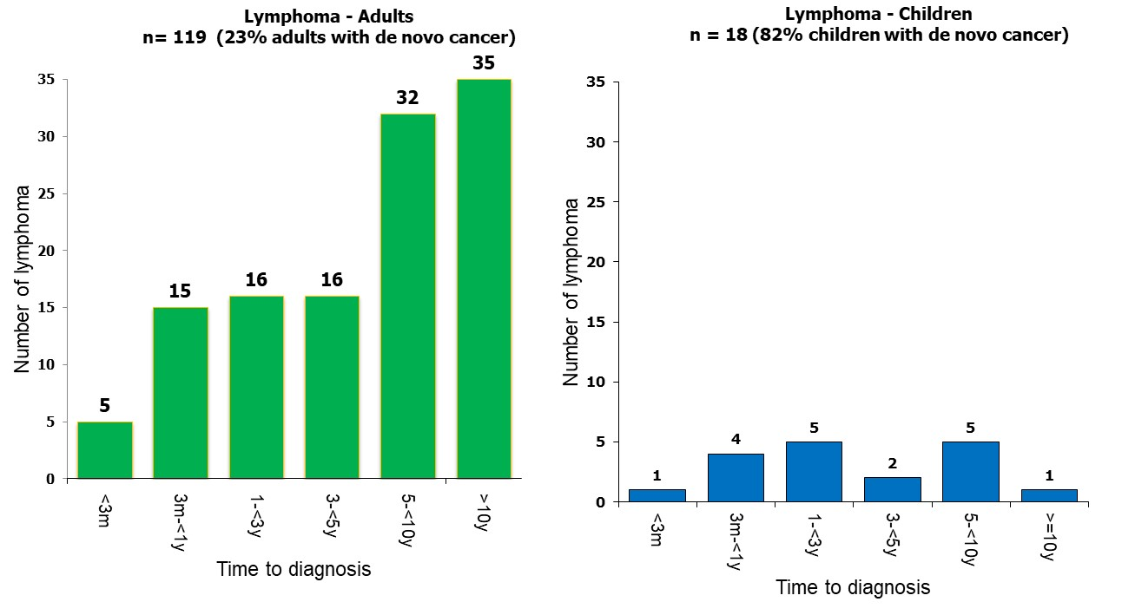
Time to diagnosis of de novo lymphoma by age category
Notes:
Figure 92. Time to diagnosis of de novo lymphoma by age category

Slide 28
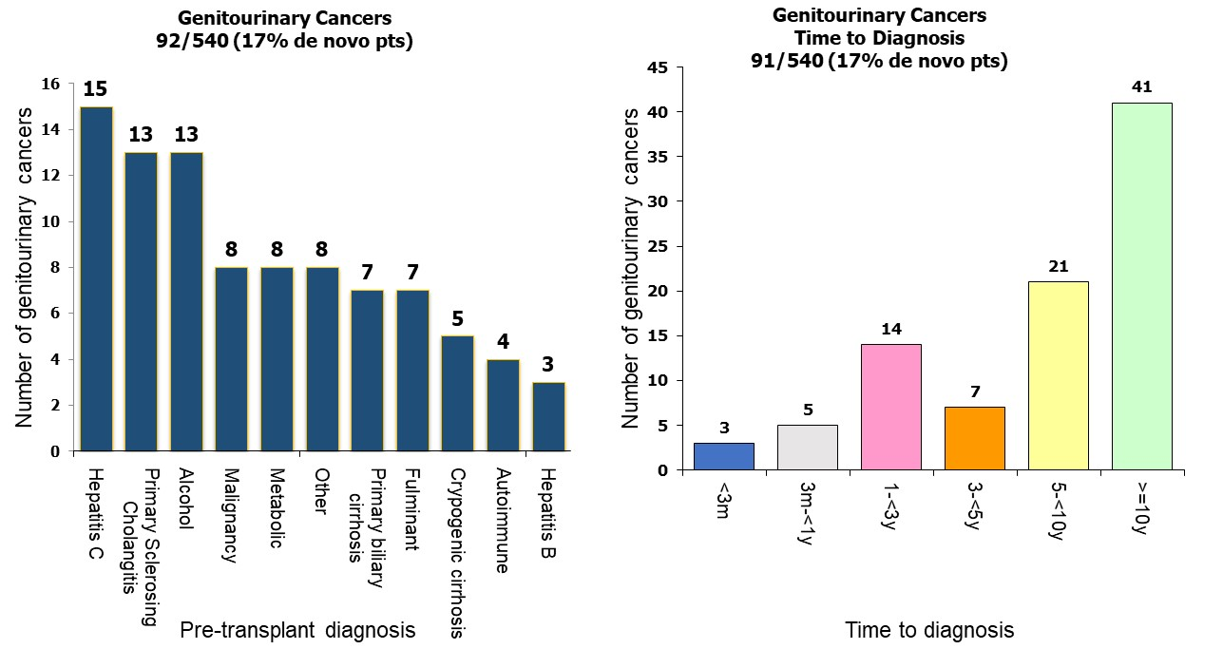
Pretransplant diagnosis and de novo genitourinary cancers
Notes:
Figure 93. Pretransplant diagnosis and de novo genitourinary cancers

Slide 29
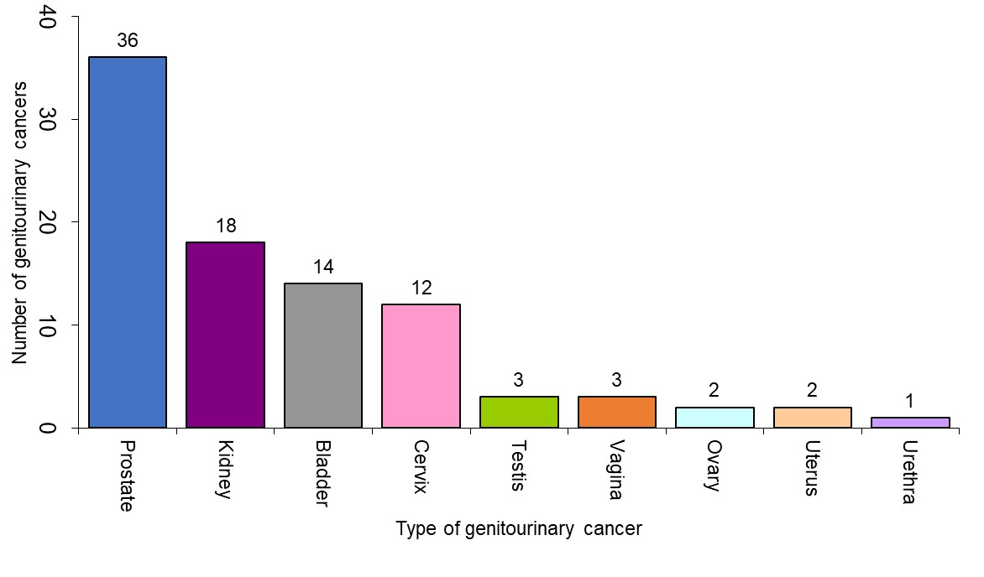
Incidence of de novo genitourinary tract cancers by type
Notes:
Figure 94. Incidence of de novo genitourinary tract cancers by type

Slide 30
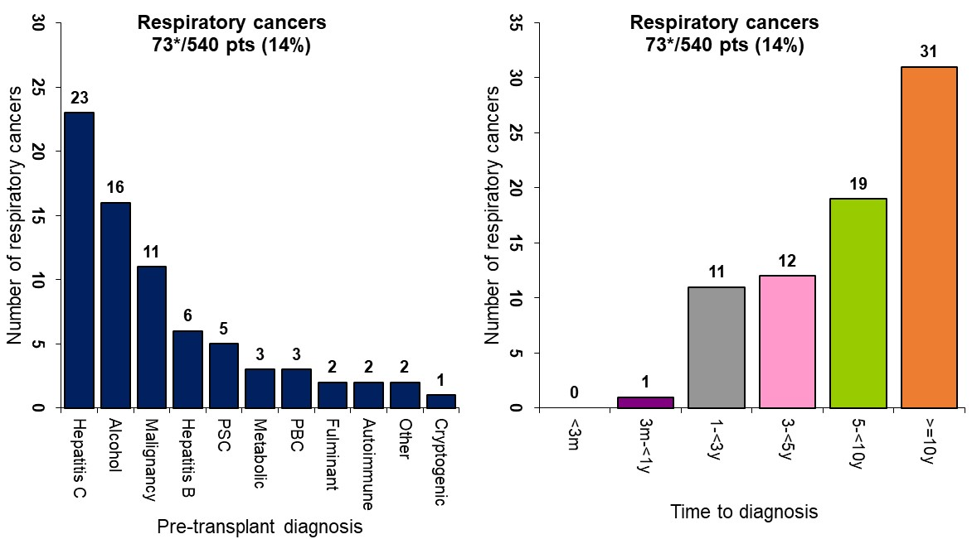
Pretransplant diagnosis and de novo respiratory cancers
* 1 patient had 2 respiratory cancers
Notes:
Figure 95. Pretransplant diagnosis and de novo respiratory cancers

Slide 31
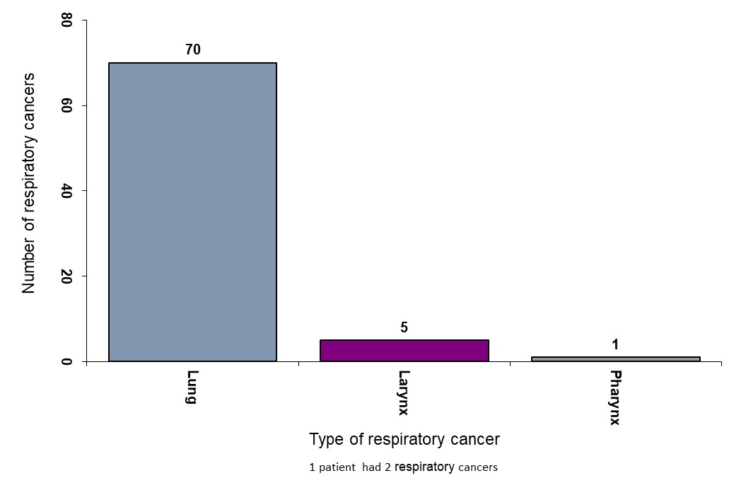
Incidence of de novo respiratory tract cancers by type
Notes:
Figure 96. Incidence of de novo respiratory tract cancers by type

Slide 32
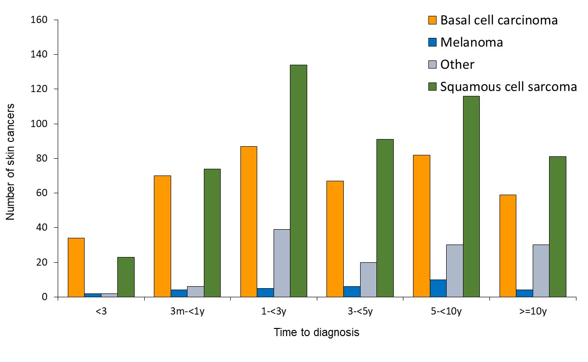
Time to first skin cancer development post-transplant by type of skin cancer
Notes:
Figure 97. Time to first skin cancer development post-transplant by type of skin cancer

Slide 33
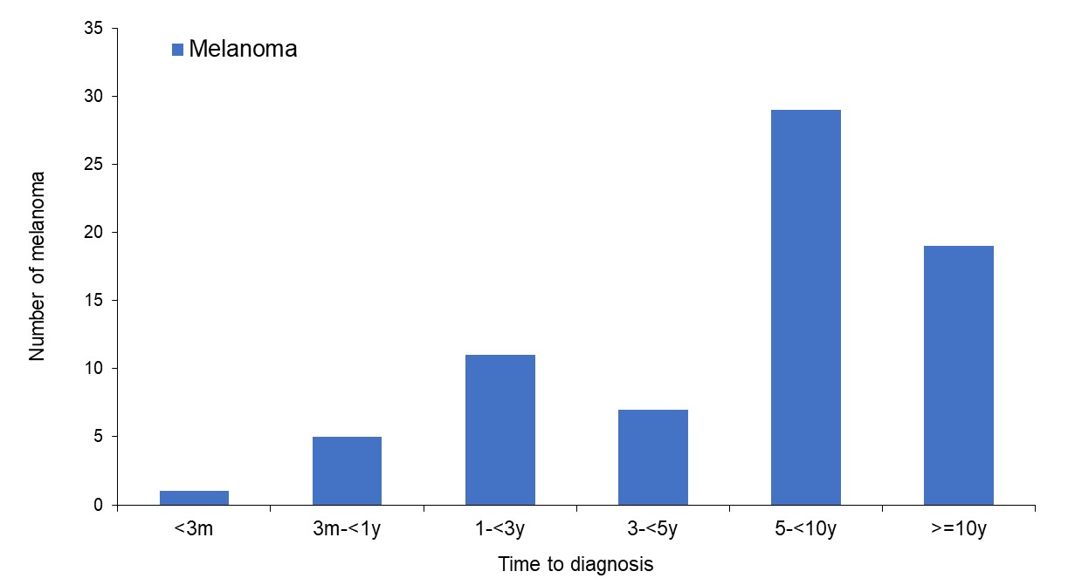
Time to first melanoma development post-transplant
Notes:
Figure 98. Time to first melanoma development post-transplant
Note: This includes patients who developed melanoma after a non-melanoma skin cancer (first skin cancer)

Slide 34
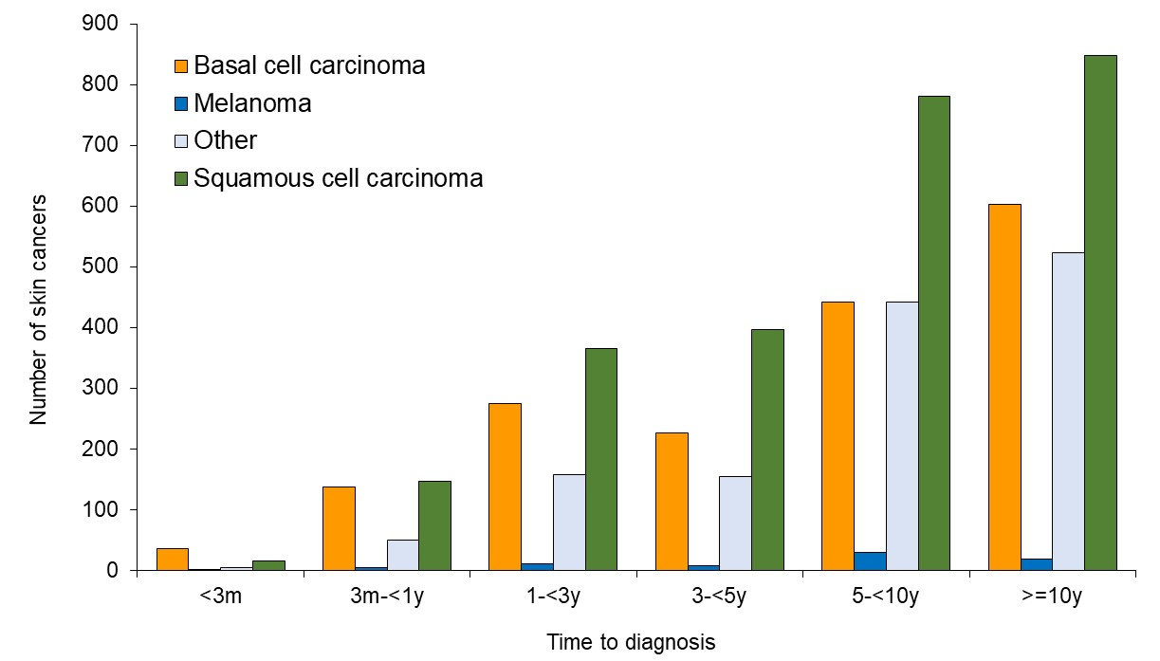
Time to any skin cancer development post-transplant
Notes:
Figure 99. Time to any skin cancer development post-transplant

Slide 35
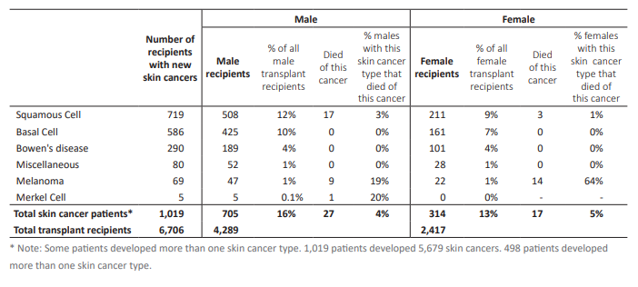
Skin cancer development post-transplant
Notes:
Table 67. Skin cancer development post-transplant

Slide 36
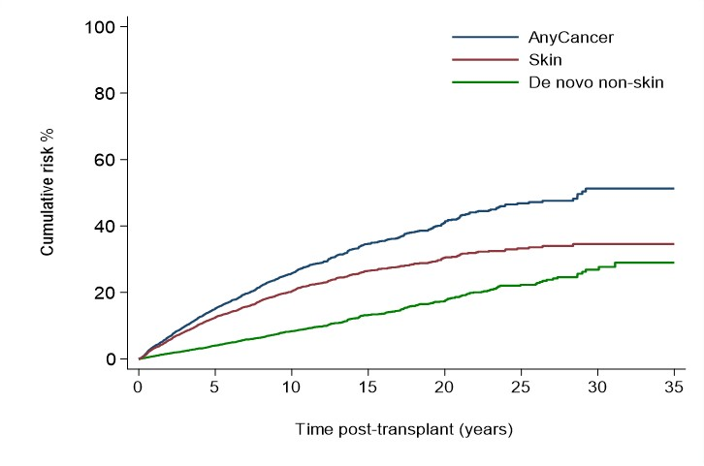
Cumulative risk of diagnosis of skin or non-skin cancer following liver transplantation
Notes:
Figure 100. Cumulative risk of diagnosis of skin or non-skin cancer following liver transplantation

