Slide 1

33rd Annual Report on
Liver and Intestinal Transplantation Activity in Australia and New Zealand
Data to 31 December 2021

Slide 2
16 Intestinal Transplantation

Slide 3
Waiting list trends over time for intestinal transplantation
Notes:
Figure 101. Waiting list trends over time for intestinal transplantation

Slide 4
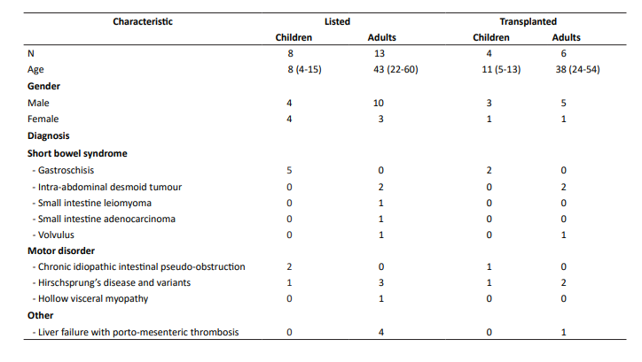
Demographic characteristics and diagnoses of children and adults listed and transplanted for intestinal transplantation
Data are shown as number or median (range).
Notes:
Table 69. Demographic characteristics and diagnoses of children and adults listed and transplanted for intestinal transplantation. Data are shown as number or median (range).

Slide 5
Patient survival after intestinal transplantation
Notes:
Figure102. Patient survival after intestinal transplantation

Slide 6
Graft survival after intestinal transplantation
Notes:
Figure 103. Graft survival after intestinal transplantation

