Slide 1
33rd Annual Report on Liver and Intestinal Transplantation Activity in Australia and New Zealand Data to 31 December 2021

Slide 2
Section 5. Liver Transplant Waiting List

Slide 3
Liver transplant waiting list activity – all patients
Notes:
Figure 1. Liver transplant waiting list activity – all patients

Slide 4
Paediatric liver transplant waiting list activity
Notes:
Figure 2. Paediatric liver transplant waiting list activity

Slide 5
Adult liver transplant waiting list activity
Notes:
Figure 3. Adult liver transplant waiting list activity

Slide 6
Time on waiting list by year of delisting
Notes:
Figure 4. Time on waiting list by year of delisting

Slide 7
Urgent category 1 waiting list outcomes
Notes:
Figure 5. Urgent category 1 waiting list outcomes

Slide 8
Urgent category 2 waiting list outcomes
Notes:
Figure 6. Urgent category 2 waiting list outcomes

Slide 9
Section 6. Deceased Liver Donors

Slide 10
Deceased donors and grafts transplanted by year
Notes:
Figure 7. Deceased donors and grafts transplanted by year

Slide 11
Transplants utilising normothermic machine perfusion with donor source type
Notes:
Figure 8. Transplants utilising normothermic machine perfusion with donor source type

Slide 12
Transplants with donor source type and use of normothermic machine perfusion
Abbreviation: DCD, donation after circulatory death; DBD, donation after brain death; NMP, normothermic machine perfusion
Notes:
Table 1. Transplants with donor source type and use of normothermic machine perfusion

Slide 13
Median age of deceased donors by transplant era
Notes:
Figure 9. Median age of deceased donors by transplant era

Slide 14
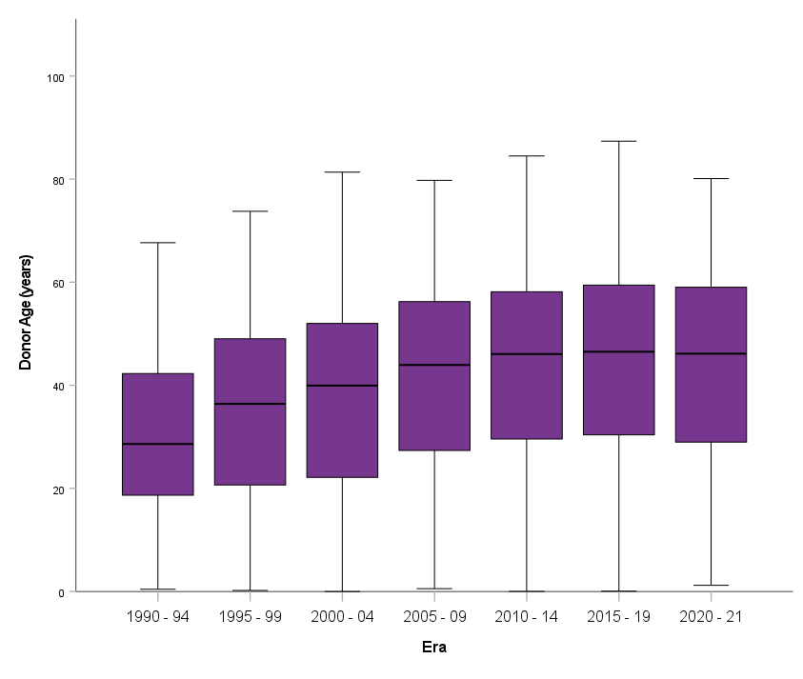
Deceased donor age by transplant era
Notes:
Figure 10. Deceased donor age by transplant era

Slide 15
Section 7. Living Liver Donors

Slide 16
Living liver donor demographics
Notes:
Table 2. Living liver donor demographics

Slide 17
8 Liver Transplantation in 2021

Slide 18
Patient demographics by age group (Transplanted in 2021)
Abbreviation: ANZ, Australia or New Zealand; m, month; y, year
Notes:
Table 3. Patient demographics by age group (2021)

Slide 19
9 Liver Transplantation from 1985 – 2021

Slide 20
Cumulative number of liver transplants and new patients transplanted
Notes:
Figure 11. Cumulative number of liver transplants and new patients transplanted

Slide 21
Liver transplant rate and total Australia & New Zealand population
Notes:
Figure 12. Liver transplant rate and total Australia and New Zealand population

Slide 22
Patient demographics by age group (1985 – 2021)
Abbreviation: ANZ, Australia or New Zealand; m, month; y, year
Notes:
Table 4. Patient demographics by age group (1985 – 2021)

Slide 23
Number of patients transplanted by age group by year of first transplant
Notes:
Figure 13. Number of patients transplanted by age group by year of first transplant

Slide 24
Recipient age strata at first Australian or New Zealand transplant (1985 –2021)
Notes:
Figure 14. Recipient age strata at first Australian or New Zealand transplant (1985 – 2021)

Slide 25
Recipient age strata by transplant era
Notes:
Figure 15. Recipient age strata (percentages) by transplant era

Slide 26
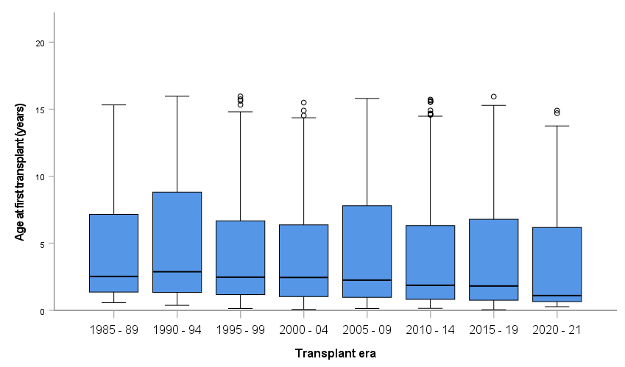
Paediatric age at first transplant by transplant era
Notes:
Figure 16. Paediatric age at first transplant by transplant era
Box and whisker plot: median, interquartile range, 1.5 times interquartile range and outliers shown

Slide 27
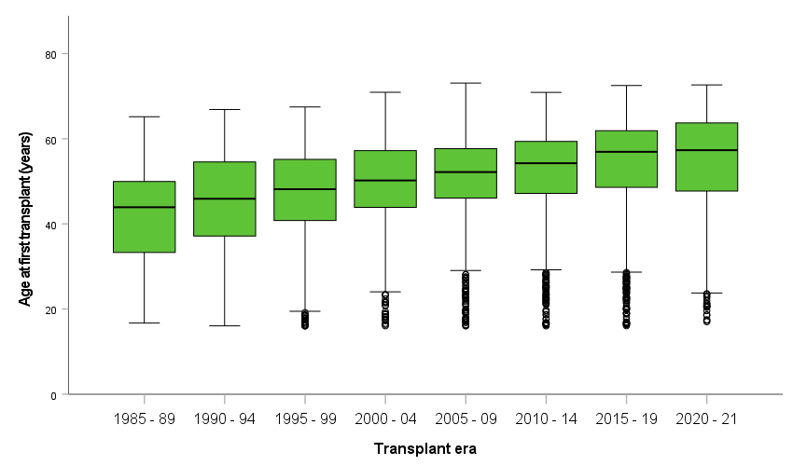
Adult age at first transplant by transplant era
Notes:
Figure 17. Adult age at first transplant by transplant era
Box and whisker plot: median, interquartile range, 1.5 times interquartile range and outliers shown

Slide 28
Transplants by age group (1985 – 2021)
Notes:
Table 5. Transplants by age group (1985 – 2021)

Slide 29
Cumulative number of liver transplants per year by age category
Notes:
Figure 18. Cumulative number of liver transplants per year by age category

Slide 30
Number of liver transplants per year by recipient age category
Notes:
Figure 19. Number of liver transplants per year by recipient age category

Slide 31
Type of graft for paediatric recipients – all years
Notes:
Figure 20. Type of graft for paediatric recipients – all years

Slide 32
Type of graft for adult recipients – all years
* Includes domino grafts
Notes:
Figure 21. Type of graft for adult recipients – all years

Slide 33
10 Diagnoses at First Transplant

Slide 34
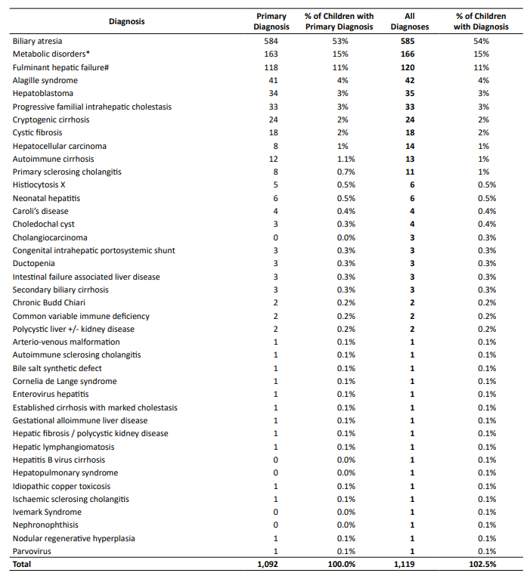
Diagnoses in children
Notes:
Table 6. Primary diagnosis in children

Slide 35
Paediatric primary diagnosis
Notes:
Figure 22. Paediatric (< 16 years) primary diagnosis

Slide 36
All paediatric diagnoses
Notes:
Figure 23. All paediatric diagnoses

Slide 37
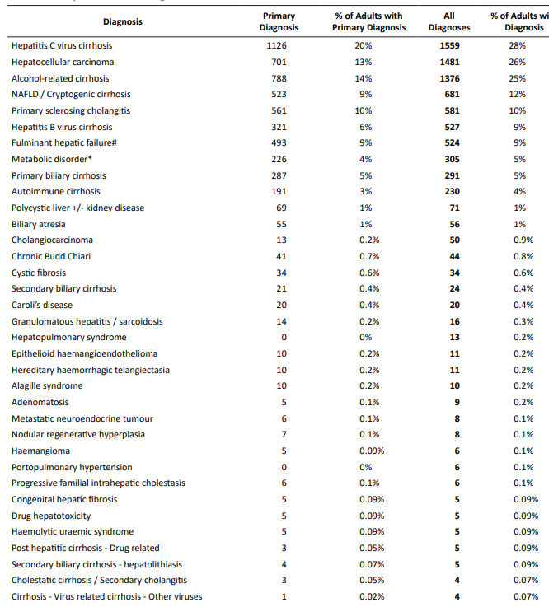
Diagnoses in adults
Notes:
Table 7. Primary diagnosis in adults

Slide 38
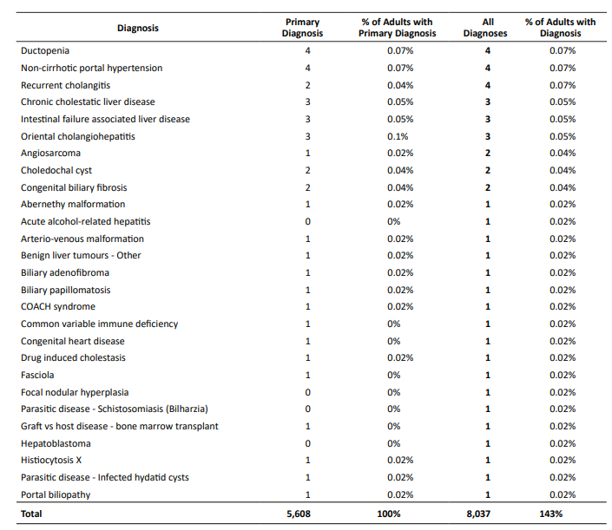
Diagnoses in adults - continued
Notes:
Table 7. Primary diagnosis in adults

Slide 39
Adult primary diagnosis over time
Notes:
Figure 24. Primary diagnosis trend in adults

Slide 40
All diagnoses trend in adults
Notes:
Figure 25. All diagnoses trend in adults

Slide 41
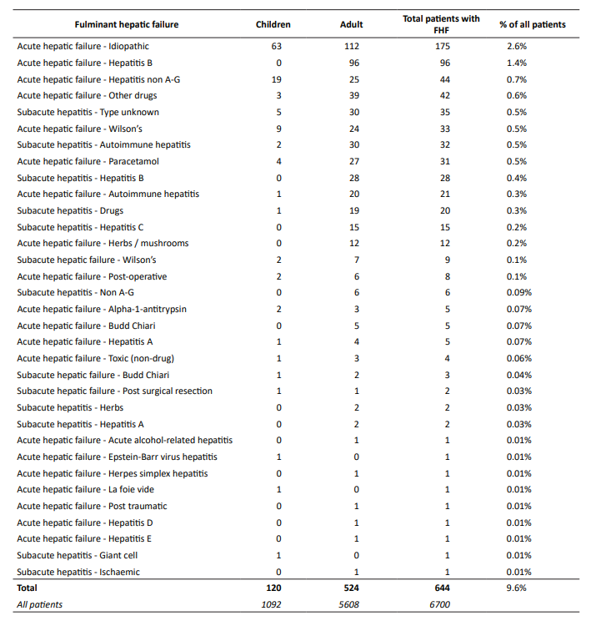
Breakdown of fulminant hepatic failure category by age group
Notes:
Table 8. Detailed breakdown of fulminant hepatic failure category by age group – all diagnoses

Slide 42
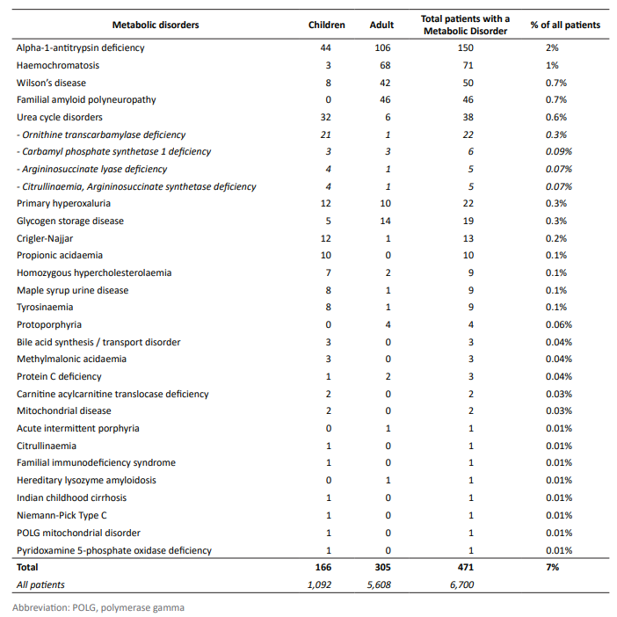
Breakdown of metabolic disorders category by age group
Notes:
Table 9. Detailed breakdown of metabolic disorders category by age group – all diagnoses

