Slide 1
34th Annual Report on
Liver and Intestinal Transplantation Activity in Australia and New Zealand
Data to 31 December 2022

Slide 2
Section 11. Incidental Liver Cancer Found at Explant

Slide 3
Incidental cancers found at explant in children
Incidental cancers – children | Number incidental cancers | % incidental cancers | Deaths | % deaths for this cancer type | Died of this cancer | % patients died of this cancer
Hepatocellular carcinoma | 3 | 60% | 1 | 33% | 0 | 0%
Hepatoblastoma | 1 | 20% | 1 | 100% | 0 | 0%
Cholangiocarcinoma | 1 | 20% | 0 | 0% | 0 | 0%
Total incidental liver cancers in children | 5
Total children with one or more incidental liver cancers* | 4 |  | 2 | 50% | 0 | 0%
% paediatric liver transplant patients (n=1,132) |  | 0.4% |  | 0.2% |  | 0%
Notes:
Table 10. Incidental cancers found at explant in children

Slide 4
Incidental cancers found at explant in adults
Incidental cancers – adults | Number incidental cancers | % incidental cancers | Deaths | % deaths for this cancer type | Died of this cancer | % patients died of this cancer
Hepatocellular carcinoma* | 177 | 76.6% | 68 | 38% | 13 | 7%
Cholangiocarcinoma* | 43 | 18.6% | 31 | 72% | 19 | 44%
Adenocarcinoma | 7 | 3.0% | 6 | 86% | 3 | 43%
Angiosarcoma | 2 | 0.4% | 2 | 100% | 2 | 100%
Epithelioid haemangioendothelioma | 1 | 0.4% | 0 | 0% | 0 | 0%
Fibrolamellar | 1 | 0.4% | 0 | 0% | 0 | 0%
Metastatic neuroendocrine tumour | 1 | 0.4% | 0 | 0% | 0 | 0%
Total incidental liver cancers in adults | 232
Total adults with one or more incidental liver cancers* | 231 |  | 107 | 46% | 37 | 16%
% adult liver transplant patients (n=5,857) |  | 3.9% |  | 1.8% |  | 0.6%
Notes:
Table 11. Incidental cancers found at explant in adults

Slide 5
Liver cancer known prior to transplant versus incidental liver cancer by transplant year
Notes:
Figure 26. Liver cancer known prior to transplant versus incidental liver cancer by transplant year

Slide 6
Section 13. De Novo Cancer Development and Liver Cancer Recurrence After Liver Transplantation

Slide 7
De novo non-skin cancer types
 | Number of cancers | Male | Female | Age patients (years) | Median Age | Time to diagnosis (months) | Median time to diagnosis (months) | Died of This Cancer
Alimentary* | 200 | 146 | 54 | 5 – 84 | 61 | 1 – 376 | 91 | 106 | 53%
Lymphoma* | 151 | 87 | 64 | 1– 82 | 51 | 1 – 283 | 64 | 64 | 42%
Genitourinary* | 104 | 69 | 35 | 21 – 82 | 63 | 2 – 363 | 119 | 15 | 14%
Respiratory* | 84 | 61 | 23 | 29 – 80 | 62 | 7 – 284 | 103 | 62 | 74%
Breast* | 38 | 1 | 37 | 30 – 74 | 58 | 11 – 291 | 95 | 14 | 37%
Endocrine | 21 | 12 | 9 | 28 – 77 | 56 | 6 – 346 | 82 | 5 | 24%
Miscellaneous* | 22 | 13 | 9 | 49 – 82 | 64 | 6 – 301 | 121 | 12 | 55%
Leukaemia* | 12 | 9 | 3 | 16 – 75 | 59 | 14– 212 | 30 | 4 | 33%
CNS | 9 | 6 | 3 | 3 – 75 | 66 | 15 – 190 | 85 | 7 | 78%
Kaposi’s | 6 | 5 | 1 | 31 – 76 | 48 | 2 – 254 | 17 | 1 | 17%
Total cancers | 647 | 409 | 238 | 1 – 84 | 60 | 1 – 376 | 87
Total patients | 599 | 384 | 215 |  |  |  |  | 290 | 48%
*Forty-three patients had two or more de novo non-skin malignancies
Notes:
Table 12. De novo non-skin cancer types

Slide 8
De novo non-skin cancer types
Notes:
Figure 27. De novo non-skin cancer types

Slide 9
Time to diagnosis of de novo non-skin cancer
Notes:
Figure 28. Time to diagnosis of de novo non-skin cancer

Slide 10
De novo non-skin cancer types that developed within 90 days of transplantation
De novo non-skin cancer type | Developed within 90 days of transplantation
Lymphoma/PTLD | 6
Colon | 3
Kaposi’s sarcoma/HHV8 | 2
Prostate | 2
Renal cell | 2
Angiosarcoma | 1
Cervix | 1
Gastro-intestinal stromal tumour | 1
Leukaemia | 1
Ovary | 1
Total | 20
Notes:
Table 13. De novo non-skin cancer types that developed within 90 days of transplantation

Slide 11
Time to diagnosis of any non-skin cancer by age category
Notes:
Figure 29. Time to diagnosis of any non-skin cancer by age category

Slide 12
Pretransplant diagnosis and de novo non-skin cancer types
Notes:
Figure 30. Pretransplant diagnosis and de novo non-skin cancer types
All listing diagnoses (1-4) included, not just primary diagnosis

Slide 13
Pre-transplant diagnosis and de novo non-skin cancer types
Listing diagnoses (diag 1 - 4) | Alimentary tract | Lymphoma | Genito-urinary | Respiratory | Breast | Miscellaneous | Endocrine | Leukaemia | CNS | Kaposi's sarcoma | Total de novo cancers | % of patients with diagnosis | Patients with Listing Diagnosis
PSC | 49 | 30 | 14 | 6 | 2 | 2 | 2 | 2 | 0 | 1 | 108 | 18% | 617
Autoimmune | 8 | 10 | 4 | 2 | 6 | 2 | 1 | 0 | 1 | 0 | 34 | 14% | 249
PBC | 10 | 10 | 7 | 5 | 2 | 1 | 3 | 0 | 0 | 0 | 38 | 13% | 299
Alcohol | 54 | 13 | 26 | 30 | 6 | 6 | 3 | 2 | 3 | 0 | 143 | 10% | 1,451
Hepatitis C | 52 | 25 | 22 | 36 | 7 | 8 | 3 | 4 | 1 | 2 | 160 | 10% | 1,589
Hepatitis B | 18 | 5 | 8 | 7 | 0 | 2 | 2 | 2 | 2 | 0 | 46 | 8% | 546
Metabolic | 7 | 9 | 10 | 5 | 4 | 0 | 1 | 0 | 1 | 0 | 37 | 8% | 487
FHF | 10 | 12 | 8 | 4 | 9 | 2 | 2 | 0 | 0 | 1 | 48 | 7% | 676
Cryptogenic cirrhosis | 6 | 6 | 4 | 3 | 0 | 0 | 0 | 0 | 0 | 1 | 20 | 3% | 765
Biliary atresia | 2 | 17 | 0 | 0 | 0 | 0 | 1 | 2 | 0 | 0 | 22 | 3% | 660
Other | 8 | 22 | 14 | 5 | 6 | 1 | 2 | 1 | 1 | 1 | 61
Notes:
Table 14. Pre-transplant diagnosis and de novo non-skin cancer types
All listing diagnoses (1-4) included, not just primary diagnosis

Slide 14
Hepatitis C virus, alcohol diagnosis and types of de novo skin cancer
Notes:
Figure 31. Hepatitis C virus, alcohol diagnosis and types of de novo skin cancer

Slide 15
Primary sclerosing cholangitis and types of de novo skin cancer
Notes:
Figure 31. Primary sclerosing cholangitis and types of de novo skin cancer

Slide 16
Pretransplant diagnosis and de novo alimentary cancers
Notes:
Figure 32. Pretransplant diagnosis and de novo alimentary cancers

Slide 17
Incidence of de novo alimentary tract cancers by type
Notes:
Figure 33. Incidence of de novo alimentary tract cancers by type

Slide 18
Time to diagnosis of de novo lymphoma by age category
Notes:
Figure 34. Time to diagnosis of de novo lymphoma by age category

Slide 19
Pretransplant diagnosis and de novo genitourinary cancers
Notes:
Figure 35. Pretransplant diagnosis and de novo genitourinary cancers

Slide 20
Incidence of de novo genitourinary tract cancers by type
Notes:
Figure 36. Incidence of de novo genitourinary tract cancers by type

Slide 21
Pretransplant diagnosis and de novo respiratory cancers
Notes:
Figure 37. Pretransplant diagnosis and de novo respiratory cancers

Slide 22
Incidence of de novo respiratory tract cancers by type
Notes:
Figure 38. Incidence of de novo respiratory tract cancers by type

Slide 23
Time to first skin cancer development post-transplant by type of skin cancer
Notes:
Figure 39

Slide 24
Time to first melanoma development post-transplant
Notes:
Figure 40. Time to first melanoma development post-transplant
Note: This includes patients who developed melanoma after a non-melanoma skin cancer (first skin cancer)

Slide 25
Time to all skin cancer lesions development post-transplant
Notes:
Figure 41. Time to all skin cancer lesions development post-transplant

Slide 26
Skin Cancer Development Post-Transplant
 | Number of patients that developed one or more skin cancers | Male |  |  |  | Female
 |  | Male recipients | % of all male transplant recipients | Died of this cancer | % males with this skin cancer type that died of this cancer | Female recipients | % of all female transplant recipients | Died of this cancer | % females with this skin cancer type that died of this ca
Squamous Cell | 741 | 521 | 12% | 18 | 3% | 220 | 9% | 5 | 2%
Basal Cell | 610 | 441 | 10% | 0 | 0% | 169 | 7% | 0 | 0%
Bowen's disease | 297 | 194 | 4% | 0 | 0% | 103 | 4% | 0 | 0%
Miscellaneous | 97 | 60 | 1% | 0 | 0% | 29 | 1% | 0 | 0%
Melanoma | 77 | 53 | 1% | 9 | 17% | 24 | 1% | 7 | 29%
Merkel Cell | 7 | 7 | 0.2% | 2 | 29% | 0 | 0% | 0 | 0%
Total skin cancer patients* | 1,057 | 728 | 16% | 29 | 4% | 329 | 13% | 12 | 4%
Total transplant recipients | 6,989 | 4,461 |  |  |  | 2,528
Notes:
Table 15. Skin Cancer Development Post-Transplant

Slide 27
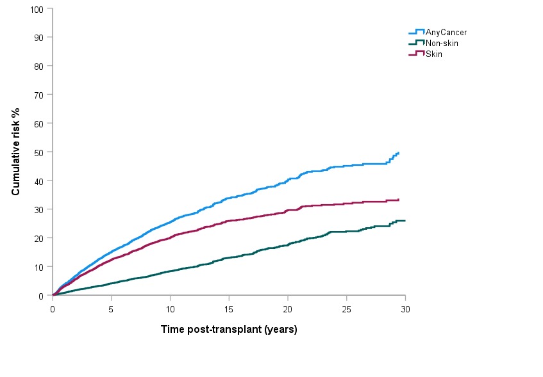
Cumulative risk of diagnosis of skin or non-skin cancer following liver transplantation
Notes:
Figure 42. Cumulative risk of diagnosis of skin or non-skin cancer following liver transplantation

Slide 28
Liver cancer recurrence in liver cancer patients
De novo cancer group | Time post-transplant (years)
 | 0 | 1 | 5 | 10 | 15 | 20 | 25 | 30
Any de novo cancer | 0% | 3% | 15% | 26% | 34% | 40% | 45% | 50%
De novo skin cancer | 0% | 3% | 12% | 20% | 26% | 30% | 32% | 34%
De novo non-skin cancer | 0% | 1% | 4% | 8% | 13% | 17% | 22% | 26%
Notes:
Table 17. Liver cancer recurrence in liver cancer patients

