Slide 1
34th Annual Report on
Liver and Intestinal Transplantation Activity in Australia and New Zealand
Data to 31 December 2022

Slide 2
Section 14. Patient Survival

Slide 3
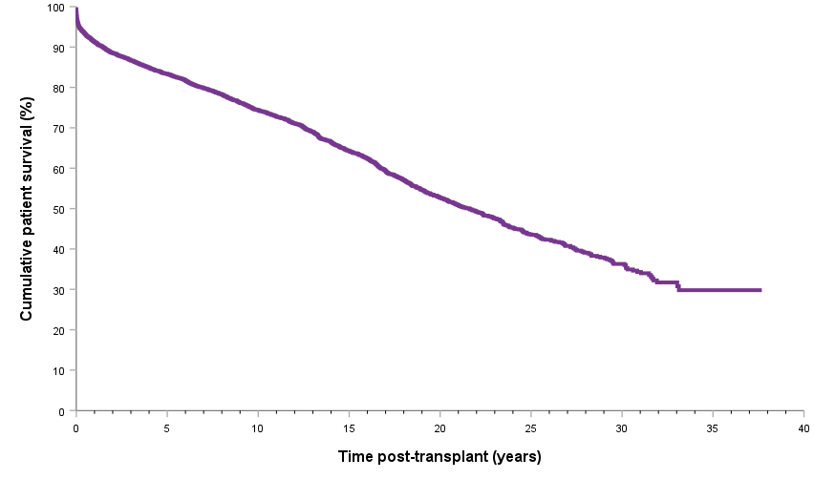
Patient survival curve
Notes:
Figure 43. Patient survival curve

Slide 4
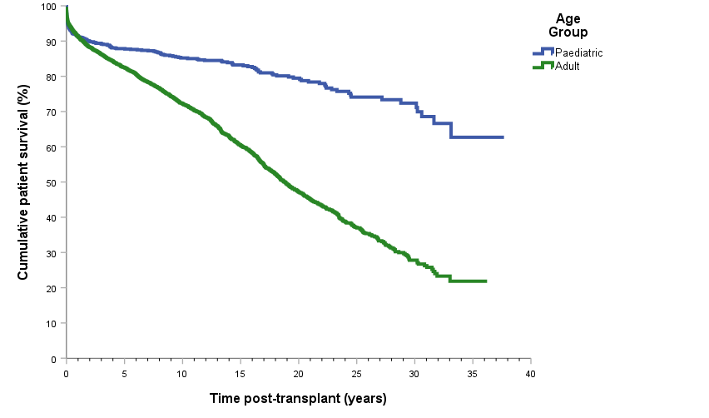
Patient survival curve by age category
Notes:
Figure 44. Patient survival curve by age category

Slide 5
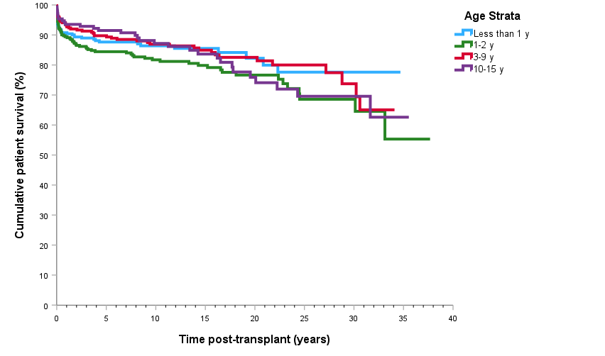
Paediatric patient survival curve by age strata
Notes:
Figure 45. Paediatric patient survival curve by age strata

Slide 6
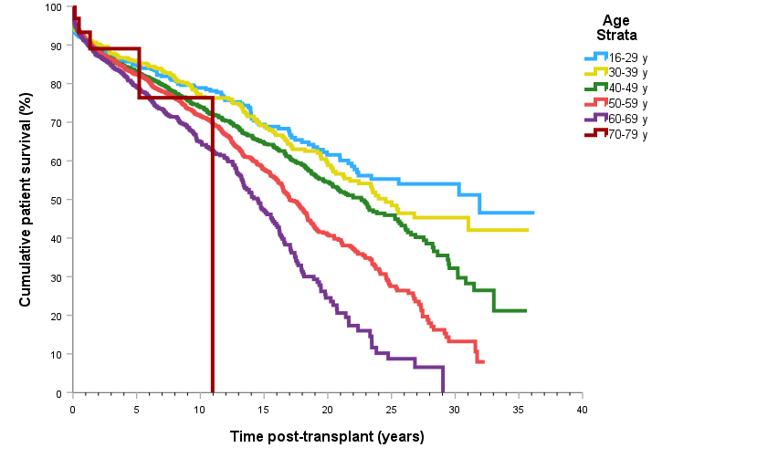
Adult patient survival curve by age strata
Notes:
Figure 46. Adult patient survival curve by age strata

Slide 7
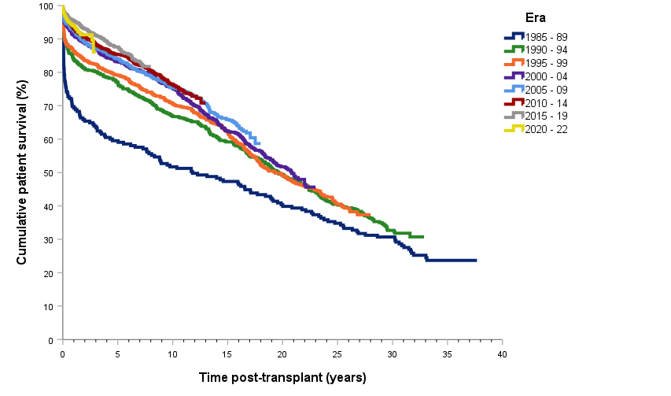
Patient survival curve by era of transplant
Notes:
Figure 47. Patient survival curve by era of transplant

Slide 8
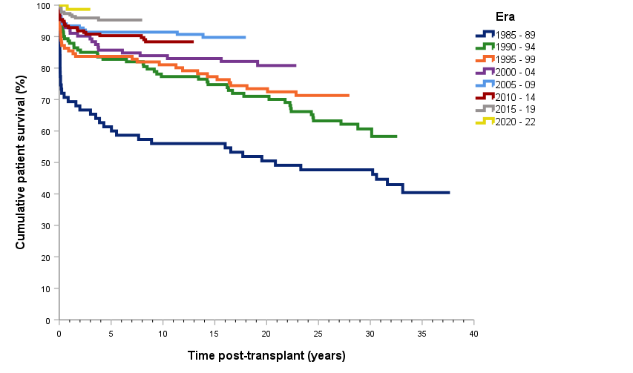
Paediatric patient survival curve by era of transplant
Notes:
Figure 48. Paediatric patient survival curve by era of transplant

Slide 9
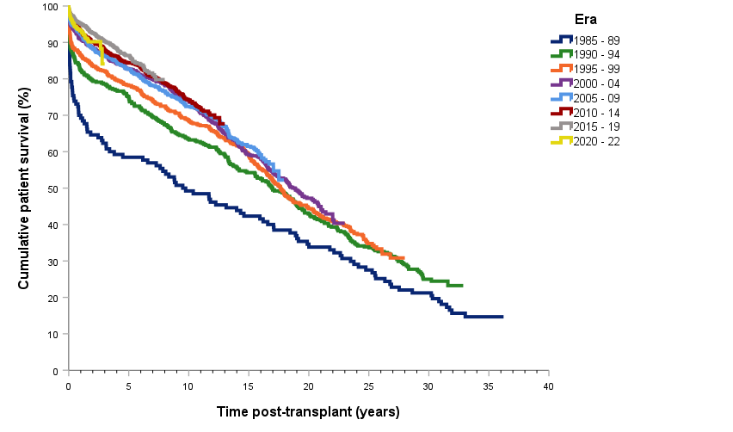
Adult patient survival curve by era of transplant
Notes:
Figure 49. Adult patient survival curve by era of transplant

Slide 10
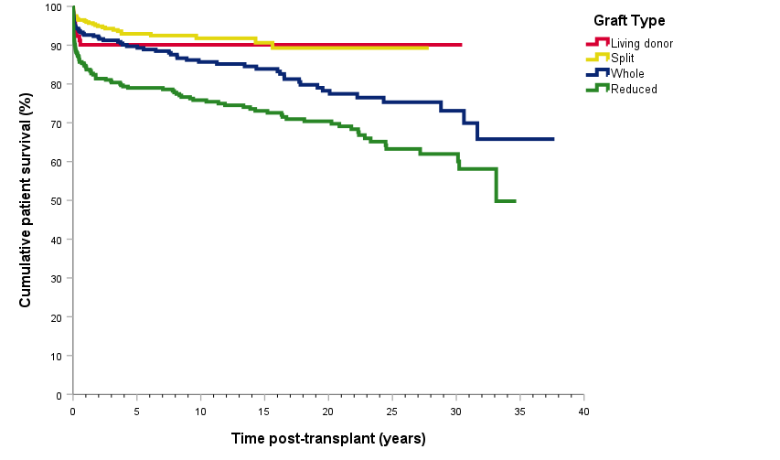
Paediatric patient survival curve by type of primary graft
Notes:
Figure 50. Paediatric patient survival curve by type of primary graft

Slide 11
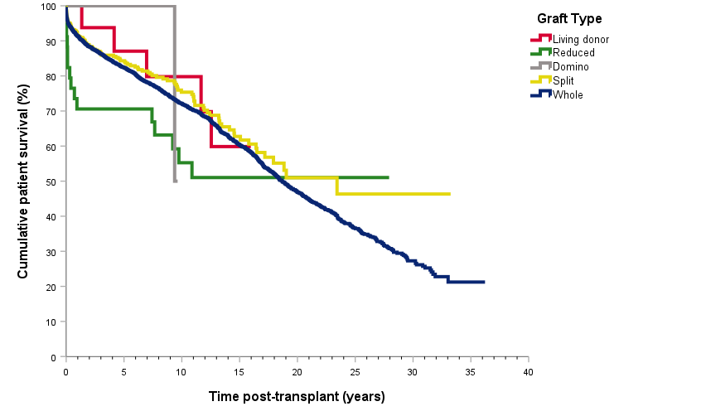
Adult patient survival curve by type of primary graft
Notes:
Figure 51. Adult patient survival curve by type of primary graft

Slide 12
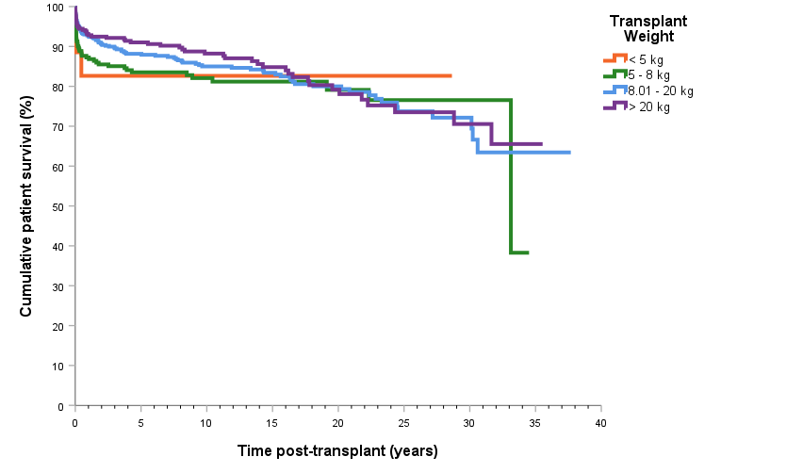
Paediatric patient survival curve by transplant weight
Notes:
Figure 52. Paediatric patient survival curve by transplant weight

Slide 13
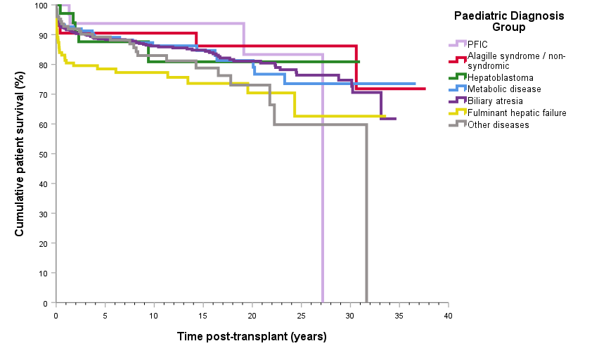
Paediatric patient survival curve by primary disease
Notes:
Figure 53. Paediatric patient survival curve by primary disease

Slide 14
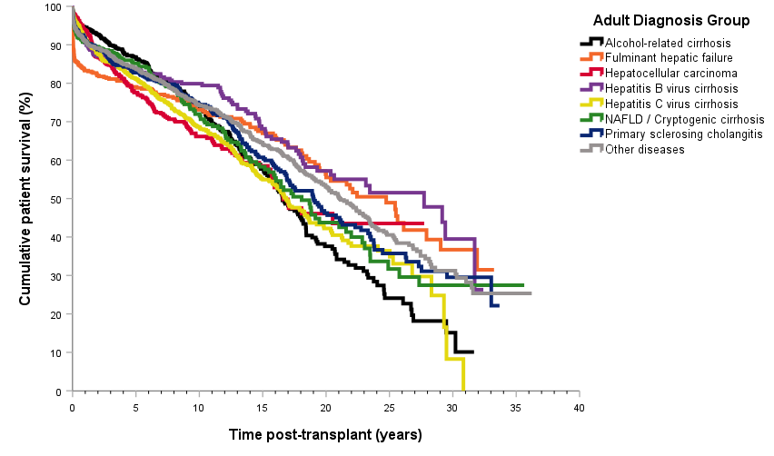
Adult patient survival curve by primary disease
Notes:
Figure 54. Adult patient survival curve by primary disease

Slide 15
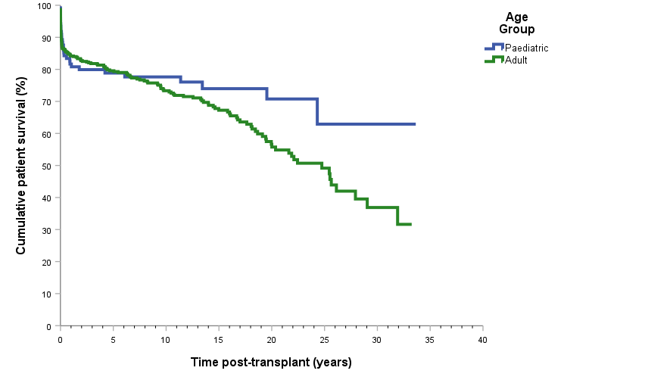
Patient survival curve by age group with fulminant hepatic failure – all diagnoses
Notes:
Figure 55. Patient survival curve by age group with fulminant hepatic failure – all diagnoses

Slide 16
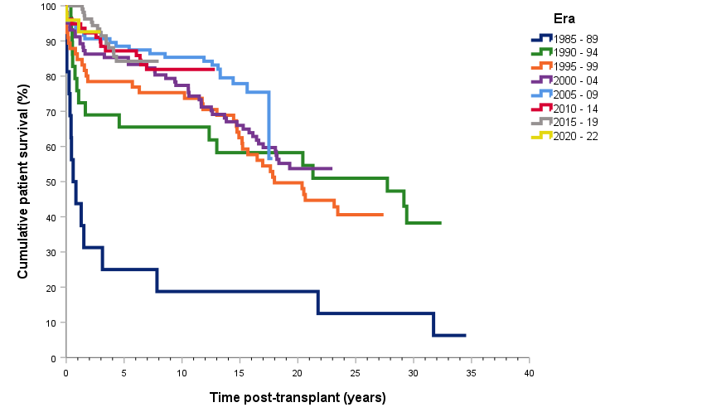
Patient survival curve by transplant era with hepatitis B virus cirrhosis – all diagnoses
Notes:
Figure 56. Patient survival curve by transplant era with hepatitis B virus cirrhosis – all diagnoses

Slide 17
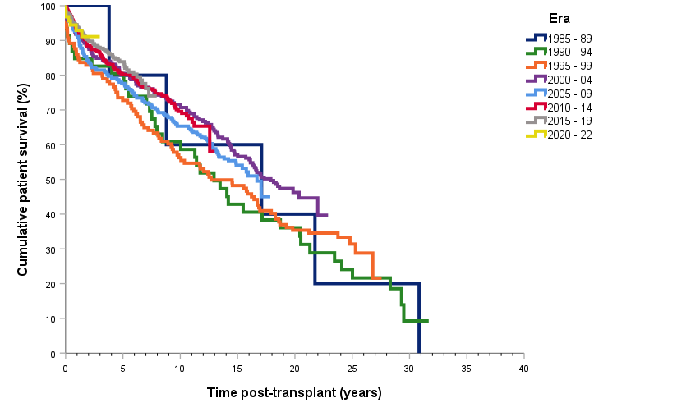
Patient survival curve by transplant era with hepatitis C virus cirrhosis – all diagnoses
Notes:
Figure 57. Patient survival curve by transplant era with hepatitis C virus cirrhosis – all diagnoses

Slide 18
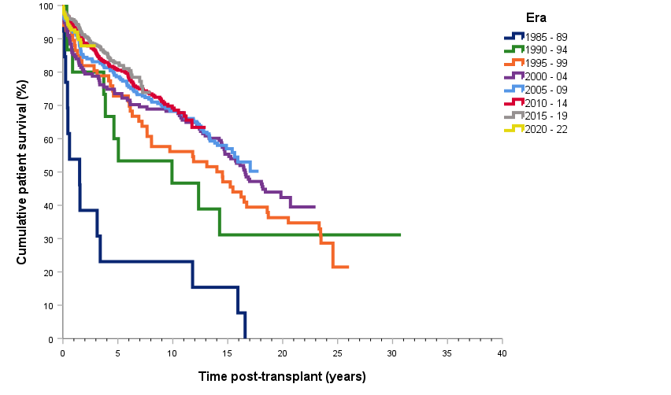
Patient survival curve with a diagnosis of hepatocellular carcinoma by transplant era – all diagnoses
Notes:
Figure 58. Patient survival curve with a diagnosis of hepatocellular carcinoma by transplant era – all diagnoses

Slide 19
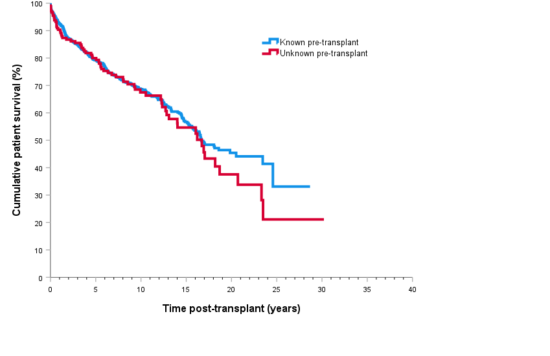
Survival of patients by hepatocellular carcinoma status at transplant
Notes:
Figure 59. Survival of patients by hepatocellular carcinoma status at transplant

Slide 20
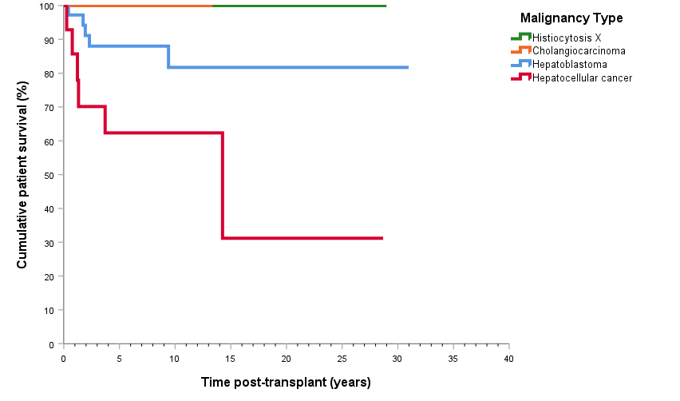
Paediatric patient survival curve with a malignancy diagnosis – all diagnoses
Notes:
Figure 60. Paediatric patient survival curve with a malignancy diagnosis – all diagnoses

Slide 21
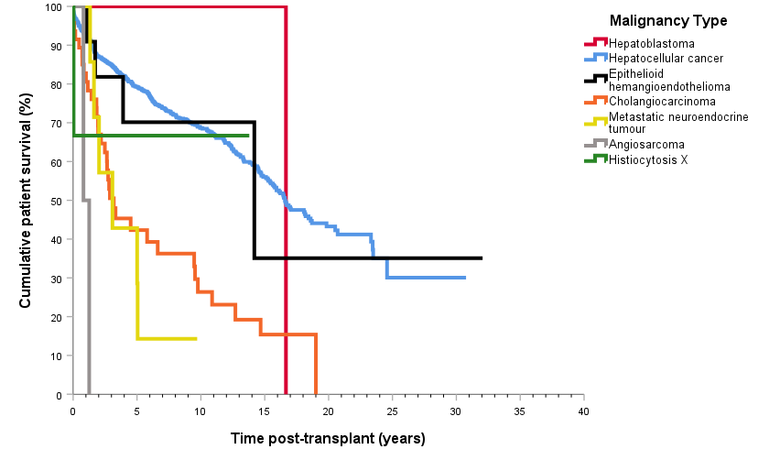
Adult patient survival curve with a malignancy diagnosis – all diagnoses
Notes:
Figure 61. Adult patient survival curve with a malignancy diagnosis – all diagnoses

Slide 22
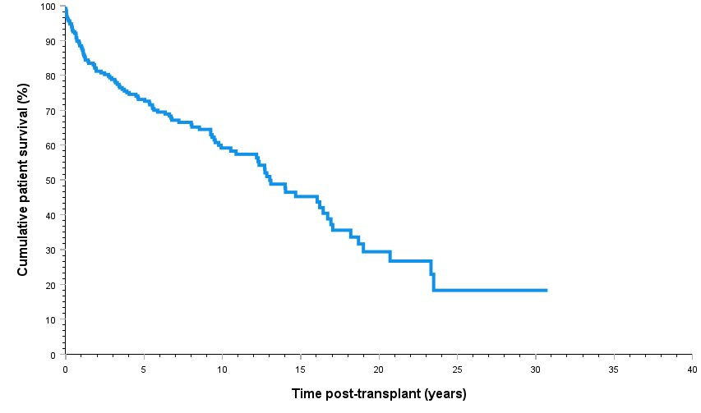
Patient Survival for Adult Patients with Incidental Liver Cancer
Notes:
Figure 62. Patient Survival for Adult Patients with Incidental Liver Cancer

Slide 23
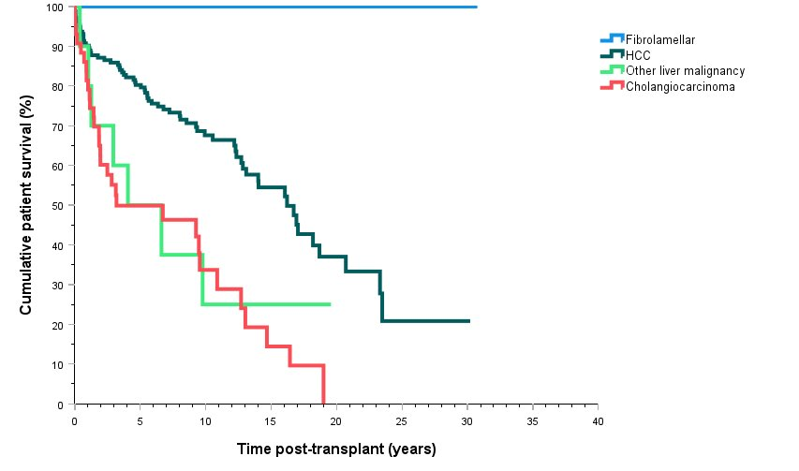
Patient Survival for Adult Patients by Type of Incidental Liver Cancer
Notes:
Figure 63. Patient Survival for Adult Patients by Type of Incidental Liver Cancer

