Slide 1
34th Annual Report on
Liver and Intestinal Transplantation Activity in Australia and New Zealand
Data to 31 December 2022

Slide 2
Section 15. Graft Survival

Slide 3
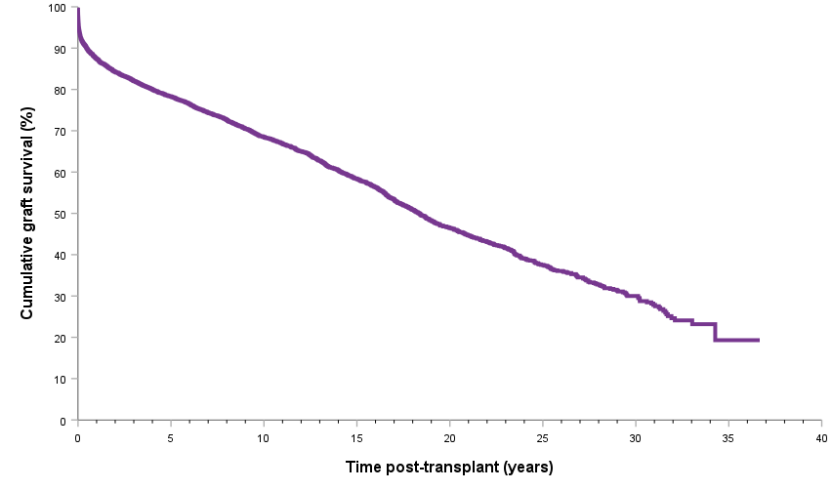
Graft survival curve for all grafts
Notes:
Figure 64. Graft survival curve for all grafts

Slide 4
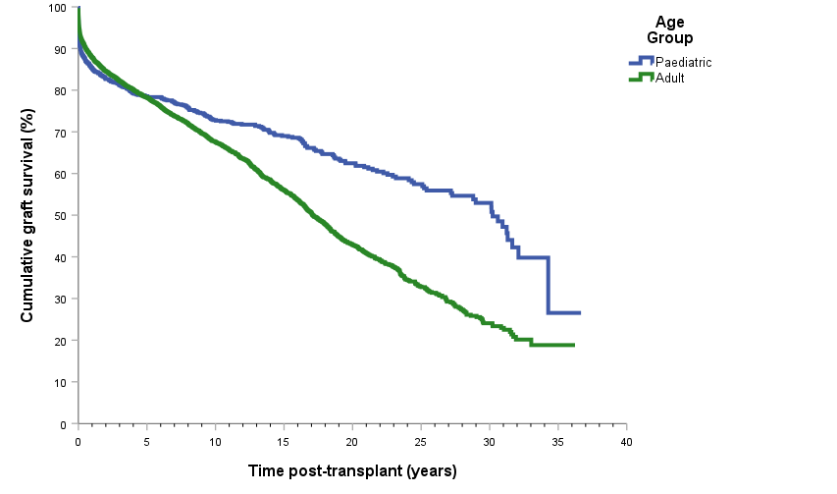
Graft survival curve for all grafts by age group
Notes:
Figure 65. Graft survival curve for all grafts by age group

Slide 5
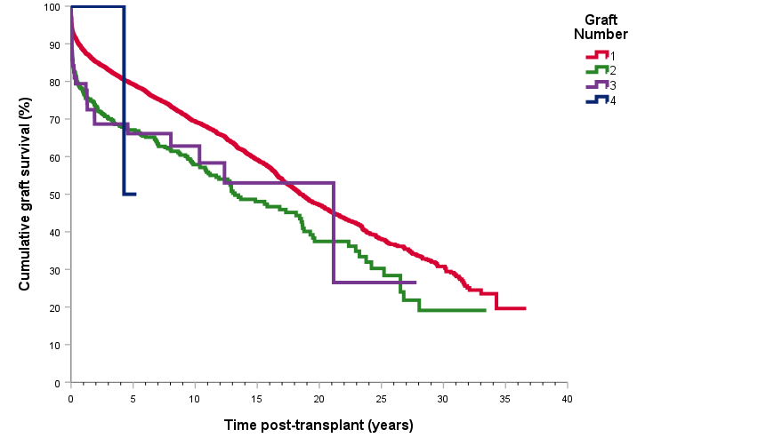
Graft survival curve for all grafts by graft number
Notes:
Figure 66. Graft survival curve for all grafts by graft number

Slide 6
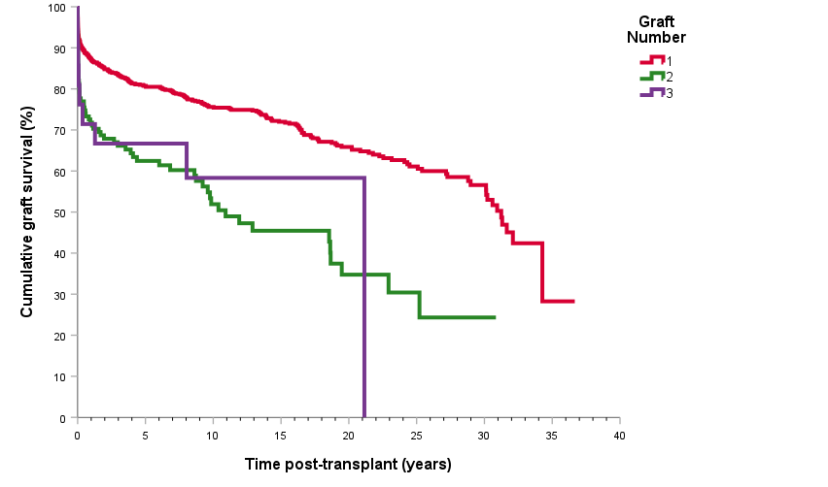
Graft survival curve for paediatric recipients by graft number
Notes:
Figure 67. Graft survival curve for paediatric recipients by graft number

Slide 7
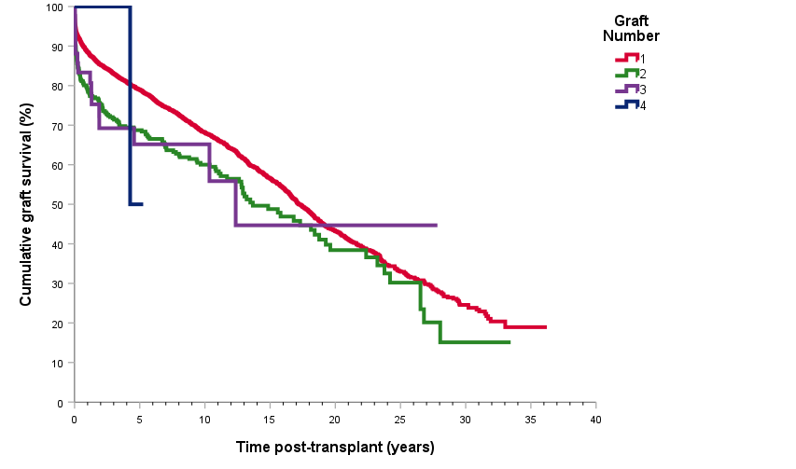
Graft survival curve for adults by graft number
Notes:
Figure 68. Graft survival curve for adults by graft number

Slide 8
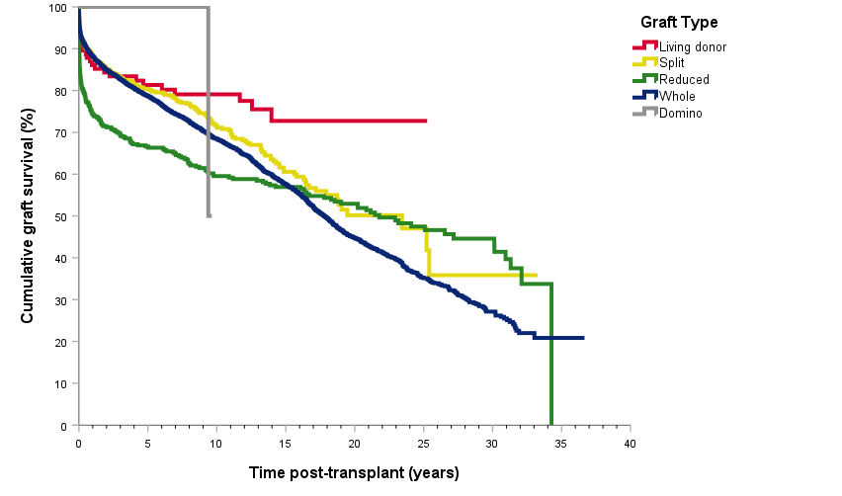
Graft survival curve for type of graft
Notes:
Figure 69. Graft survival curve for type of graft

Slide 9
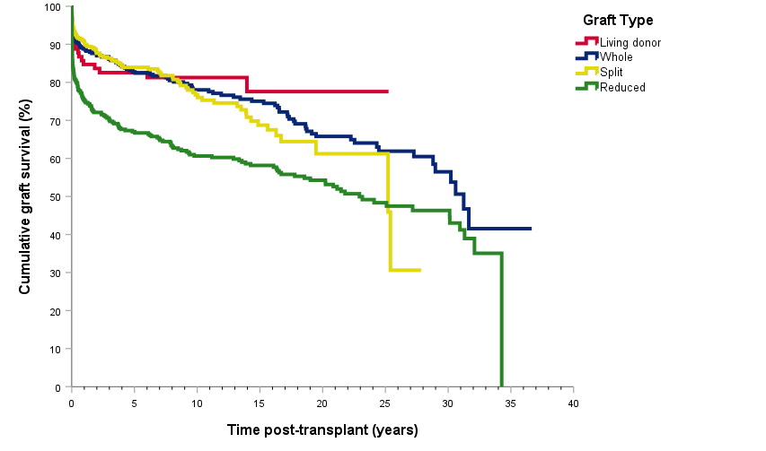
Paediatric graft survival curve for type of graft
Notes:
Figure 70. Paediatric graft survival curve for type of graft

Slide 10
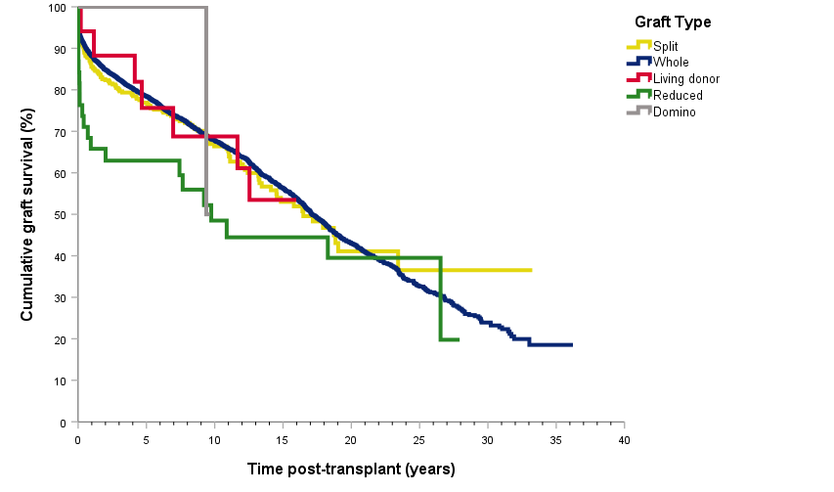
Adult graft survival curve for type of graft, all grafts
Notes:
Figure 71. Adult graft survival curve for type of graft, all grafts

Slide 11
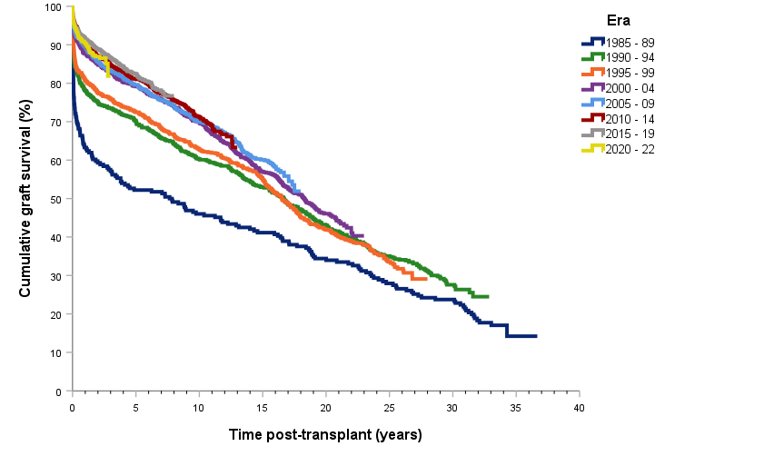
Graft survival curve by era of transplant
Notes:
Figure 72. Graft (deceased and living donors) survival curve by era of transplant

Slide 12
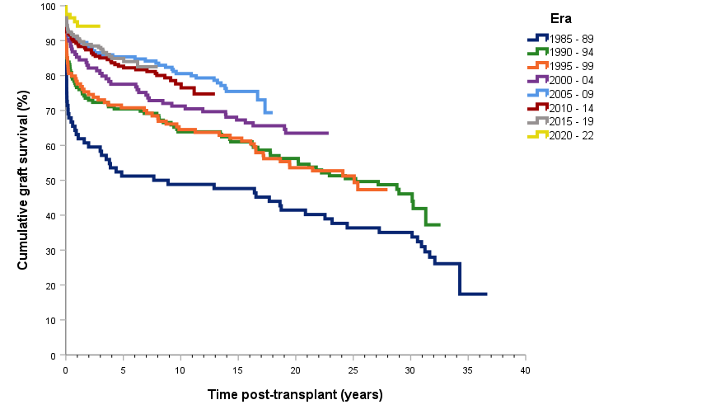
Paediatric graft survival curve by era of transplant
Notes:
Figure 73. Paediatric graft (deceased and living donors) survival curve by era of transplant

Slide 13
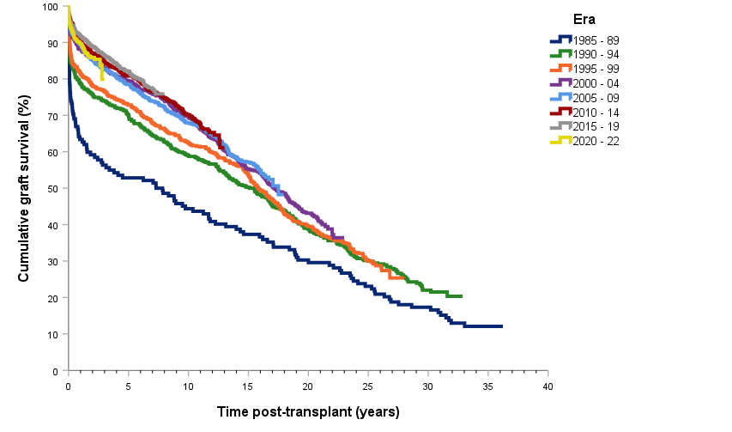
Adult graft survival curve by era of transplant
Notes:
Figure 74. Adult graft (deceased and living donors) survival curve by era of transplant

Slide 14
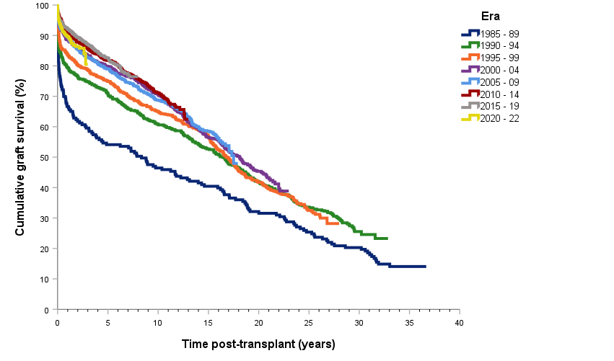
Whole graft survival curve by era of transplant
Notes:
Figure 75. Whole graft survival curve by era of transplant

Slide 15
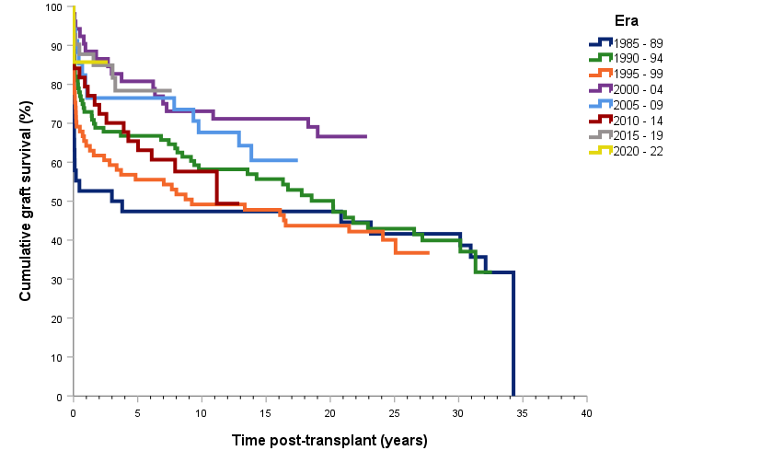
Reduced graft survival curve by era of transplant
Notes:
Figure 76. Reduced graft survival curve by era of transplant

Slide 16
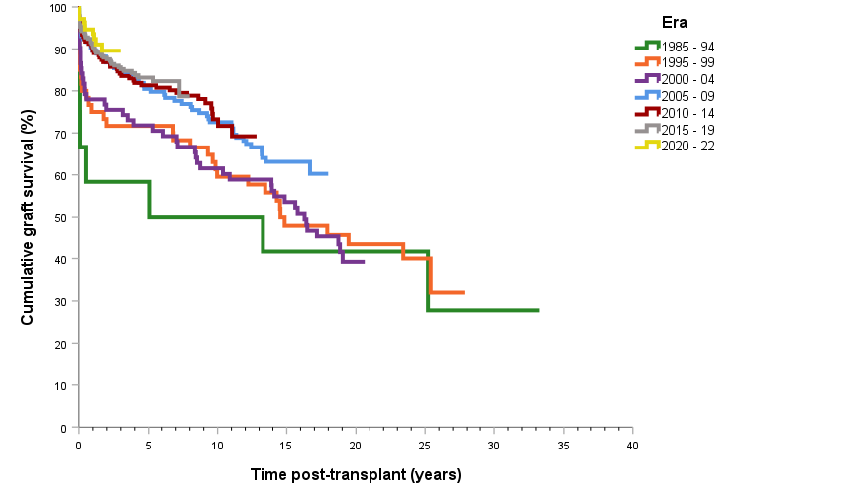
Split graft survival curve by era of transplant
Notes:
Figure 77. Split graft (deceased donor) survival curve by era of transplant

Slide 17
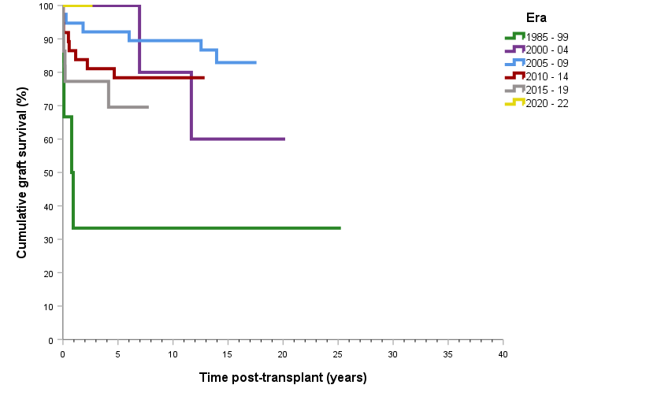
Living donor (excluding domino) graft survival curve by era of transplant
Notes:
Figure 78. Living donor (excluding domino) graft survival curve by era of transplant

Slide 18
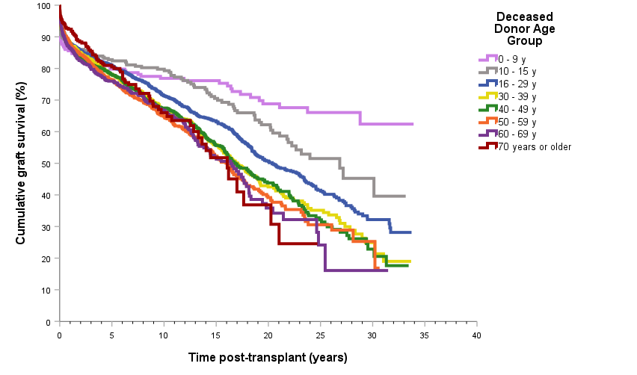
Graft survival curve by deceased donor age
Notes:
Figure 79. Graft survival curve by deceased donor age

Slide 19
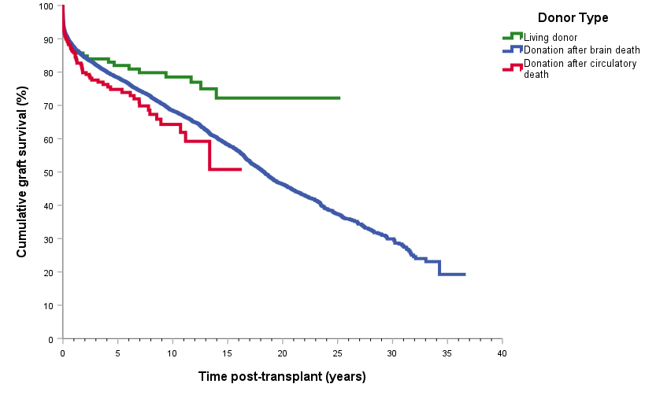
Graft survival curve by donor type – all grafts
Notes:
Figure 80. Graft survival curve by donor type – all grafts

Slide 20
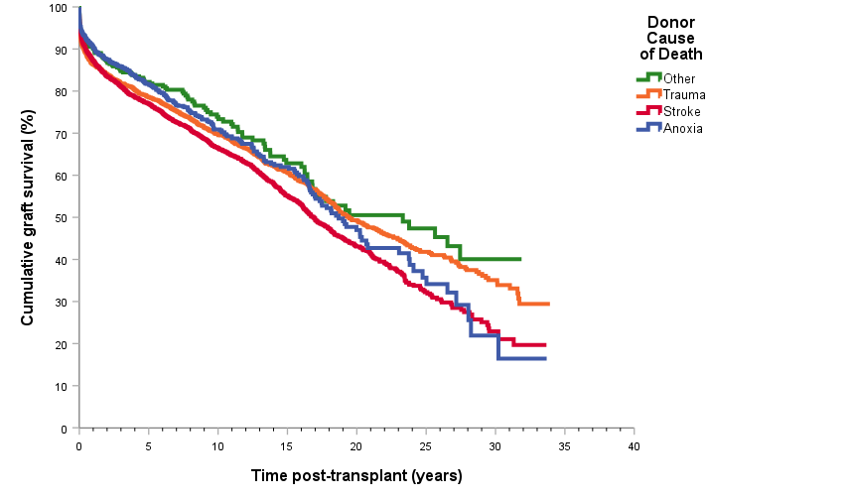
Graft survival curve by donor cause of death
Notes:
Figure 81. Graft survival curve by donor cause of death

Slide 21
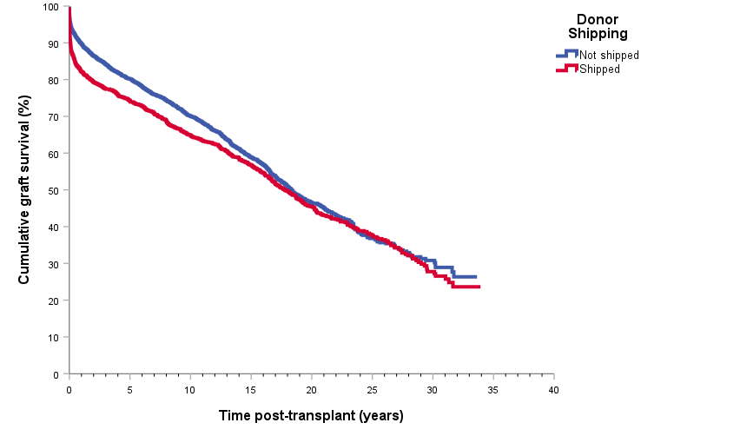
Graft survival curve by organ shipping
Notes:
Figure 82. Graft survival curve by organ shipping

Slide 22
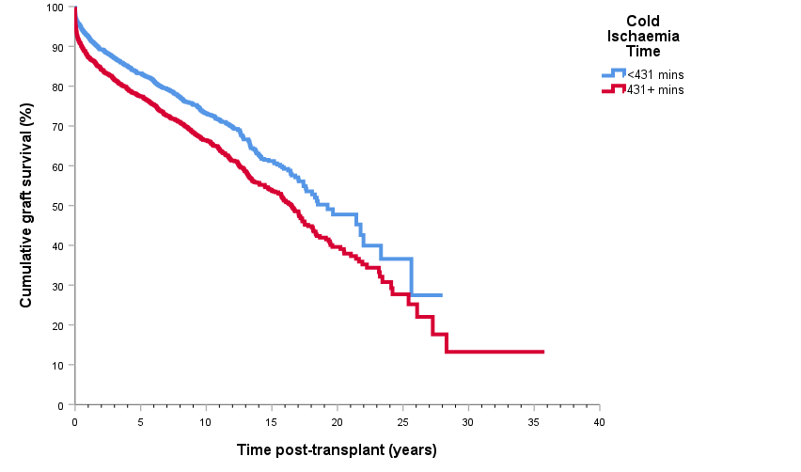
Graft survival curve by cold ischaemia time
Notes:
Figure 83. Graft survival curve by cold ischaemia time

Slide 23
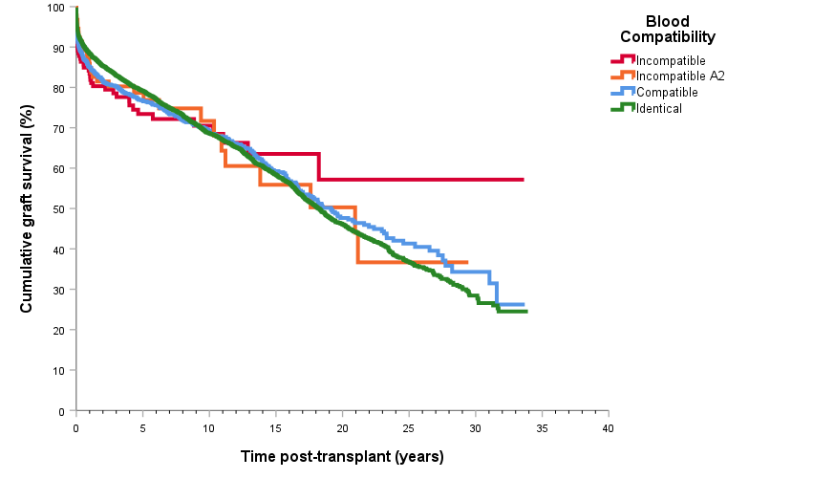
Graft survival curve by blood group compatibility
Notes:
Figure 84. Graft survival curve by blood group compatibility

Slide 24
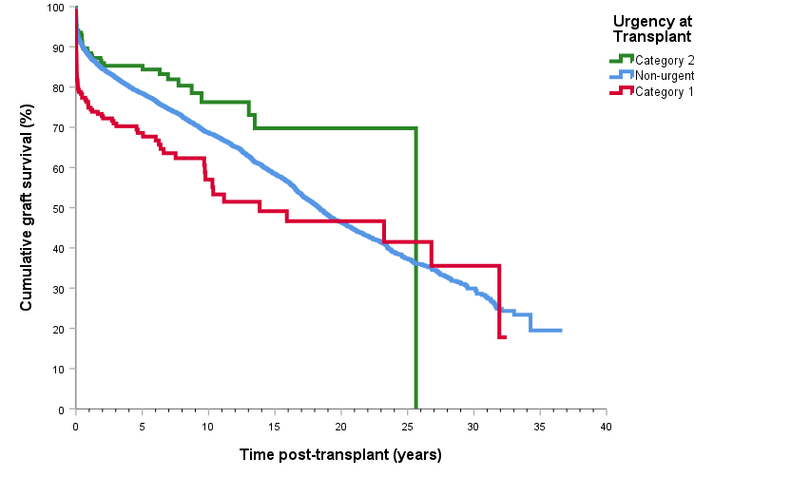
Graft survival curve by recipient urgency at transplant
Notes:
Figure 85. Graft survival curve by recipient urgency at transplant

