Slide 1
34th Annual Report on
Liver and Intestinal Transplantation Activity in Australia and New Zealand
Data to 31 December 2022

Slide 2
Section 18 Intestinal Transplantation

Slide 3
Waiting list trends over time for intestinal transplantation
Notes:
Figure 95. Waiting list trends over time for intestinal transplantation

Slide 4
Demographic characteristics and diagnoses for intestinal transplantation
Characteristic | Listed |  | Transplanted
 | Children | Adults | Children | Adults
N | 8 | 13 | 5 | 7
Age | 8 (4-15) | 43 (22-60) | 10 (5-13) | 32 (24-54)
Gender
Male | 4 | 10 | 3 | 5
Female | 4 | 3 | 2 | 2
Diagnosis
Short bowel syndrome
- Gastroschisis | 5 | 0 | 3 | 0
- Intra-abdominal desmoid tumour | 0 | 2 | 0 | 2
- Small intestine leiomyoma | 0 | 1 | 0 | 0
- Small intestine adenocarcinoma | 0 | 1 | 0 | 0
- Volvulus | 0 | 1 | 0 | 1
Motor disorder
- Chronic idiopathic intestinal pseudo-obstruction | 2 | 2 | 1 | 1
- Hirschsprung’s disease and variants | 1 | 1 | 1 | 1
- Hollow visceral myopathy | 0 | 1 | 0 | 1
Other
- Liver failure with porto-mesenteric thrombosis | 0 | 4 | 0 | 1
Notes:
Table 65. Demographic characteristics and diagnoses of children and adults listed and transplanted for intestinal transplantation.

Slide 5
Organs transplanted with intestinal transplants
Transplanted Organ | Children | Adults | Total transplants
Small intestine, stomach, pancreas, colon | 0 | 1 | 1
Small intestine, liver, stomach, pancreas | 1 | 1 | 2
Small intestine, liver, pancreas | 2 | 3 | 5
Small intestine, liver, pancreas, colon | 1 | 0 | 1
Small intestine, liver, pancreas, kidney | 0 | 1 | 1
Small intestine, colon | 1 | 0 | 1
Small intestine, kidney | 0 | 1 | 1
Total | 5 | 7 | 12
Notes:
Table 66. Organs transplanted with intestinal transplants

Slide 6
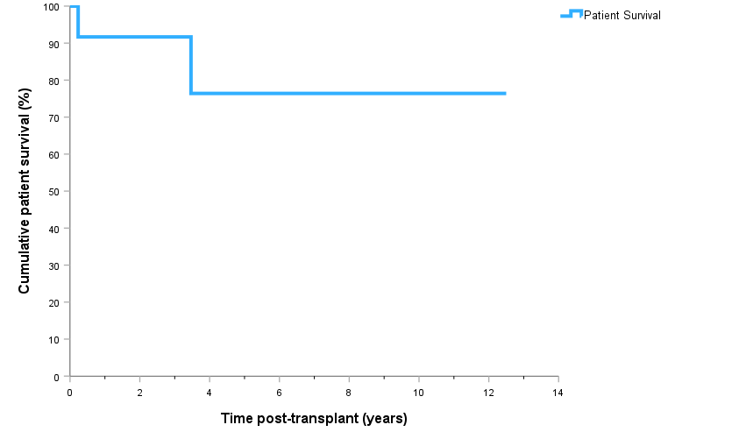
Patient survival after intestinal transplantation
Notes:
Figure 96. Patient survival after intestinal transplantation

Slide 7
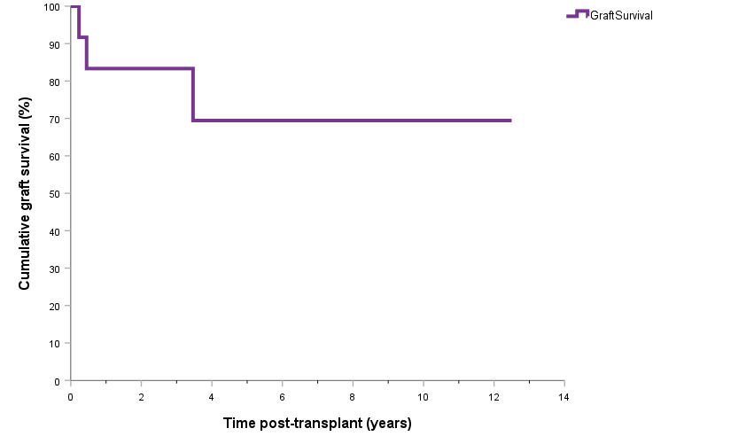
Graft survival after intestinal transplantation
Notes:
Figure 97. Graft survival after intestinal transplantation

