Slide 1
35th Annual Report on
Liver and Intestinal Transplantation Activity in Australia and New Zealand
Data to 31 December 2023

Slide 2
Section 11. Incidental Liver Cancer Found at Explant

Slide 3
Incidental cancers found at explant in children
Incidental cancers – children | Number incidental cancers | % incidental cancers | Deaths | % deaths for this cancer type | Died of this cancer | % patients died of this cancer
Hepatocellular carcinoma | 3 | 60% | 1 | 33% | 0 | 0%
Hepatoblastoma | 1 | 20% | 1 | 100% | 0 | 0%
Cholangiocarcinoma | 1 | 20% | 0 | 0% | 0 | 0%
Total incidental liver cancers in children | 5
Total children with one or more incidental liver cancers* | 4 |  | 2 | 50% | 0 | 0%
% paediatric liver transplant patients (n=1,172) |  | 0.3% |  | 0.2% |  | 0%
Notes:
Table 10. Incidental cancers found at explant in children

Slide 4
Incidental cancers found at explant in adults
Incidental cancers – adults | Number incidental cancers | % incidental cancers | Deaths | % deaths for this cancer type | Died of this cancer | % patients died of this cancer
Hepatocellular carcinoma* | 177 | 75.0% | 68 | 38% | 13 | 7%
Cholangiocarcinoma* | 46 | 19.5% | 32 | 72% | 20 | 43%
Adenocarcinoma | 8 | 3.4% | 6 | 86% | 3 | 38%
Angiosarcoma | 2 | 0.8% | 1 | 50% | 1 | 50%
Epithelioid haemangioendothelioma | 1 | 0.4% | 0 | 0% | 0 | 0%
Fibrolamellar | 1 | 0.4% | 0 | 0% | 0 | 0%
Metastatic neuroendocrine tumour | 1 | 0.4% | 0 | 0% | 0 | 0%
Total incidental liver cancers in adults | 236
Total adults with one or more incidental liver cancers* | 235 |  | 107 | 46% | 37 | 16%
% adult liver transplant patients (n=6,136) |  | 3.8% |  | 1.7% |  | 0.6%
Notes:
Table 11. Incidental cancers found at explant in adults

Slide 5
Liver cancer known prior to transplant versus incidental liver cancer by transplant year
Notes:
Figure 26. Liver cancer known prior to transplant versus incidental liver cancer by transplant year

Slide 6
Section 13. De Novo Cancer Development and Liver Cancer Recurrence After Liver Transplantation

Slide 7
De novo non-skin cancer types
 | Number of cancers | Male | Female | Median Age | Age patients (years) | Time to diagnosis (months) | Median time to diagnosis (months) | Died of This Cancer
Alimentary* | 209 | 155 | 54 | 61 | 5 – 84 | 1 – 372 | 93 | 109 | 52%
Lymphoma* | 156 | 91 | 65 | 51 | 1– 82 | 1 – 324 | 66 | 65 | 42%
Genitourinary* | 109 | 72 | 37 | 63 | 21 – 82 | 1 – 444 | 117 | 16 | 15%
Respiratory* | 88 | 64 | 24 | 62 | 29 – 83 | 7 – 294 | 102 | 65 | 74%
Breast* | 40 | 1 | 39 | 58 | 30 – 74 | 11 – 288 | 98 | 14 | 35%
Endocrine | 19 | 10 | 9 | 56 | 32 – 77 | 10 – 343 | 110 | 4 | 21%
Miscellaneous* | 18 | 10 | 8 | 65 | 55 – 76 | 5 – 298 | 114 | 8 | 44%
Leukaemia* | 10 | 8 | 2 | 66 | 3 – 66 | 1 – 188 | 27 | 4 | 40%
CNS | 9 | 6 | 3 | 59 | 16 – 78 | 13 – 210 | 93 | 7 | 78%
Kaposi’s | 6 | 5 | 1 | 49 | 31 – 64 | 1 – 35 | 10 | 1 | 17%
Total cancers | 664 | 422 | 242 | 60 | 1 – 84 | 1 – 372 | 88
Total patients | 614 | 396 | 218 |  |  |  |  | 293 | 48%
*Thirty-nine patients had two or more de novo non-skin malignancies
Notes:
Table 12. De novo non-skin cancer types

Slide 8
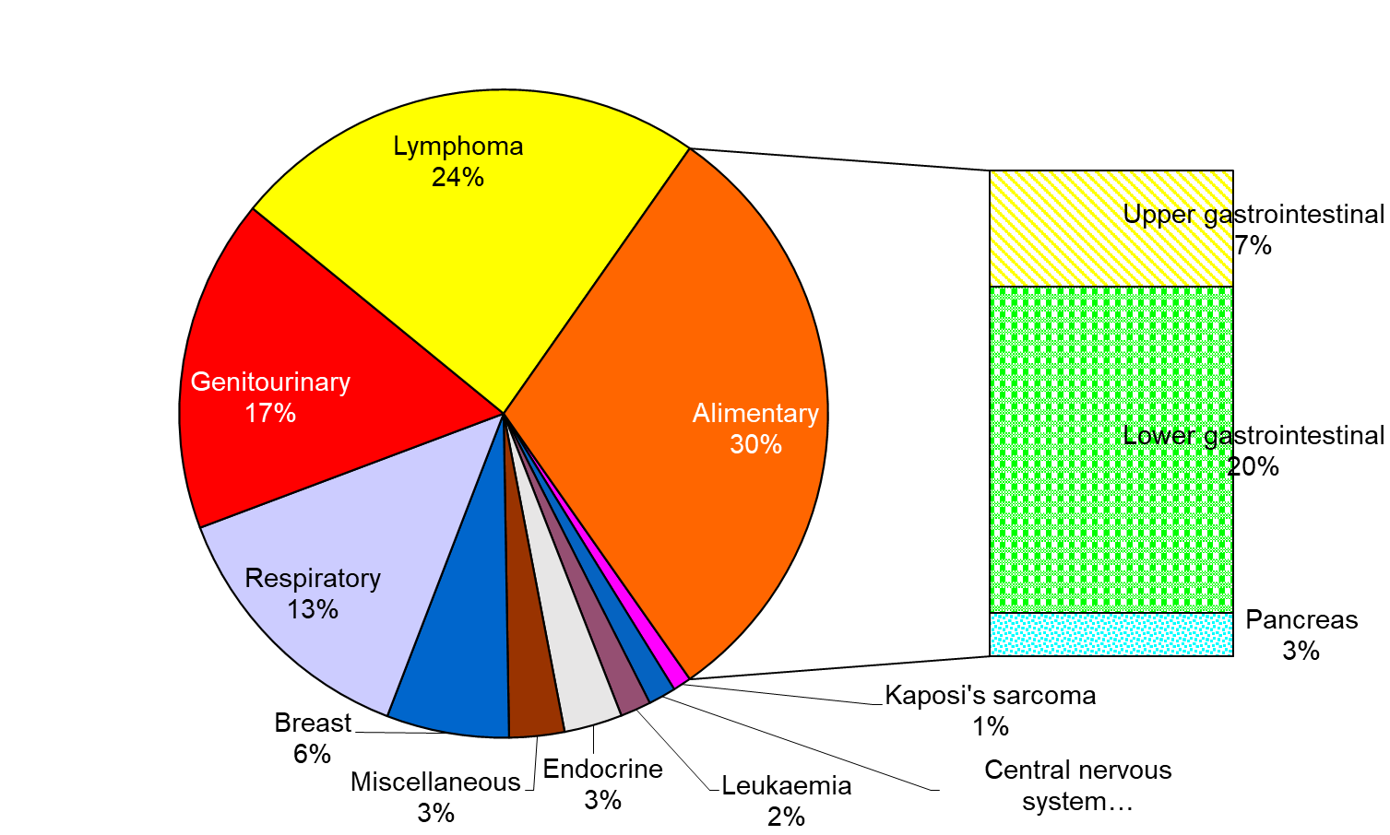
De novo non-skin cancer types
Notes:
Figure 27. De novo non-skin cancer types

Slide 9
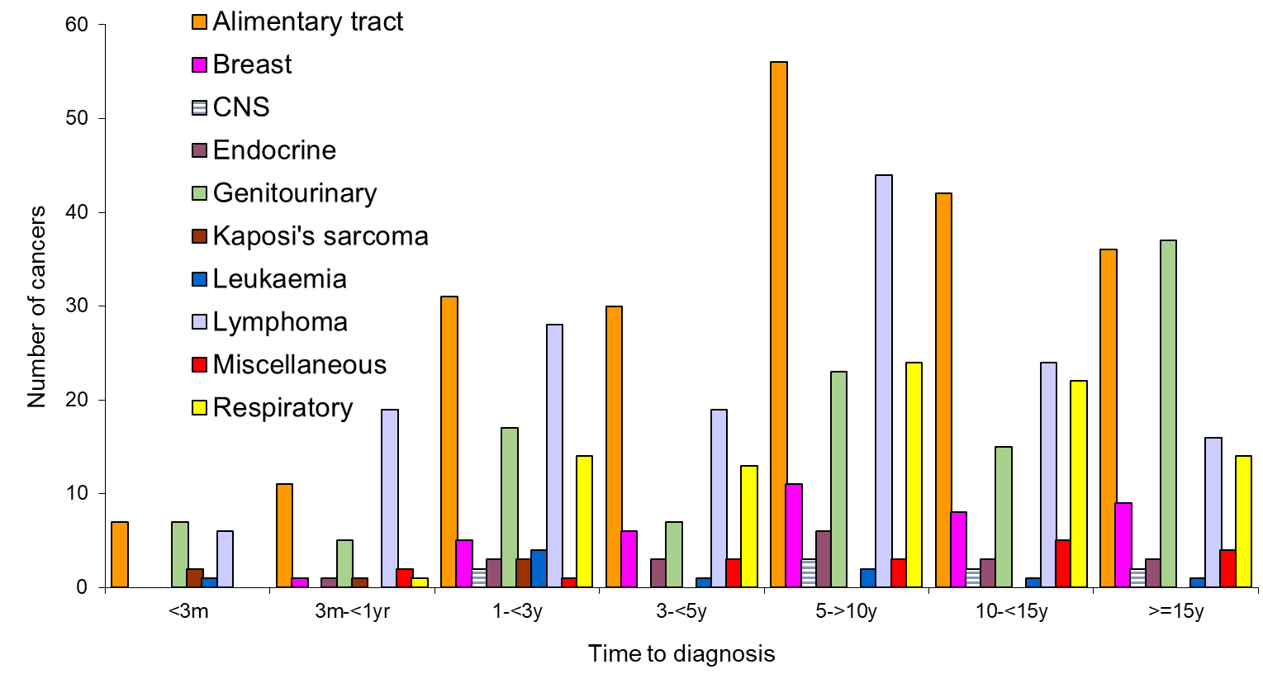
Time to diagnosis of de novo non-skin cancer
Notes:
Figure 28. Time to diagnosis of de novo non-skin cancer

Slide 10
De novo non-skin cancer types that developed within 90 days of transplantation
De novo non-skin cancer type | Developed within 90 days of transplantation
Lymphoma/PTLD | 6
Colon | 3
Kaposi’s sarcoma/HHV8 | 2
Prostate | 2
Renal cell | 3
Angiosarcoma | 1
Cervix | 1
Gastro-intestinal stromal tumour | 1
Leukaemia | 1
Ovary | 1
Pancreas | 1
Schwannomma | 1
Total | 23
Notes:
Table 13. De novo non-skin cancer types that developed within 90 days of transplantation

Slide 11
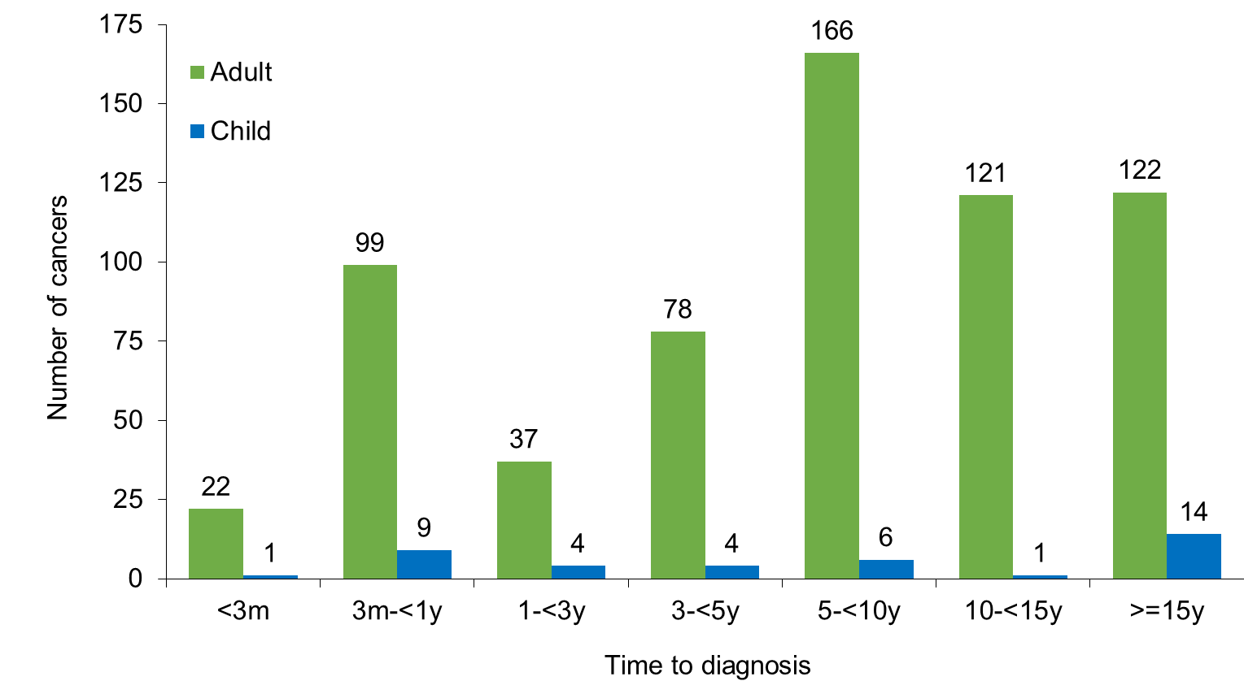
Time to diagnosis of any non-skin cancer by age category
Notes:
Figure 29. Time to diagnosis of any non-skin cancer by age category

Slide 12
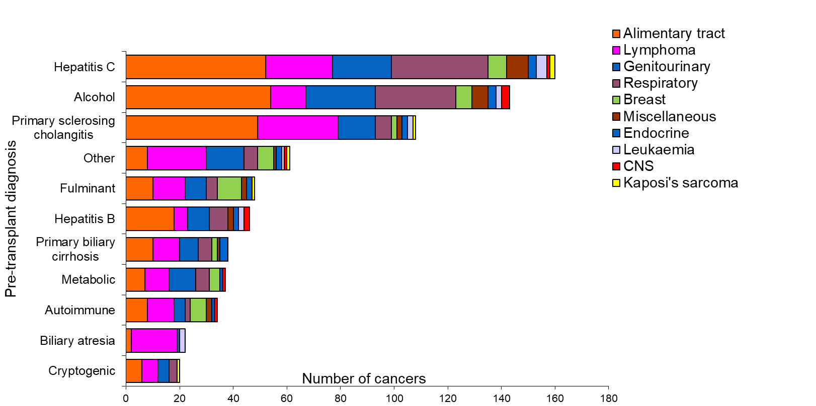
Pretransplant diagnosis and de novo non-skin cancer types
Notes:
Figure 30. Pretransplant diagnosis and de novo non-skin cancer types
All listing diagnoses (1-4) included, not just primary diagnosis

Slide 13
Pre-transplant diagnosis and de novo non-skin cancer types
Listing Diagnosis | Alimentary tract | Lymphoma | Genitourinary | Respiratory | Breast | Endocrine | Leukaemia | CNS | Kaposi's sarcoma | Miscellaneous | Total de novo cancers | % of patients with diagnosis | Patients with Listing Diagnosis
PSC | 50 | 30 | 14 | 5 | 2 | 2 | 1 | 0 | 1 | 3 | 108 | 17% | 629
Malignancy | 20 | 26 | 21 | 39 | 5 | 2 | 7 | 1 | 0 | 4 | 125 | 14% | 908
Autoimmune | 9 | 10 | 4 | 2 | 6 | 1 | 0 | 1 | 0 | 2 | 35 | 13% | 276
Alcohol | 54 | 13 | 26 | 31 | 5 | 3 | 3 | 3 | 0 | 10 | 148 | 10% | 1515
Hepatitis C | 57 | 28 | 22 | 36 | 8 | 3 | 4 | 1 | 2 | 6 | 167 | 10% | 1738
Hepatitis B | 19 | 6 | 11 | 8 | 0 | 0 | 2 | 1 | 0 | 4 | 51 | 9% | 572
Cryptogenis cirrhosis | 7 | 6 | 5 | 3 | 0 | 0 | 0 | 0 | 1 | 0 | 22 | 8% | 266
PBC | 10 | 10 | 8 | 5 | 2 | 3 | 0 | 0 | 0 | 1 | 39 | 8% | 510
FHF | 9 | 12 | 8 | 4 | 9 | 1 | 0 | 1 | 1 | 2 | 47 | 7% | 636
Biliary atresia | 2 | 18 | 0 | 1 | 1 | 1 | 1 | 0 | 0 | 0 | 24 | 3% | 693
Metabolic | 10 | 11 | 11 | 5 | 4 | 1 | 2 | 1 | 0 | 1 | 46 | 3% | 1454
Other | 10 | 22 | 14 | 6 | 6 | 1 | 1 | 1 | 1 | 1 | 63 | 7% | 876
Notes:
Table 14. Pre-transplant diagnosis and de novo non-skin cancer types
All listing diagnoses (1-4) included, not just primary diagnosis

Slide 14
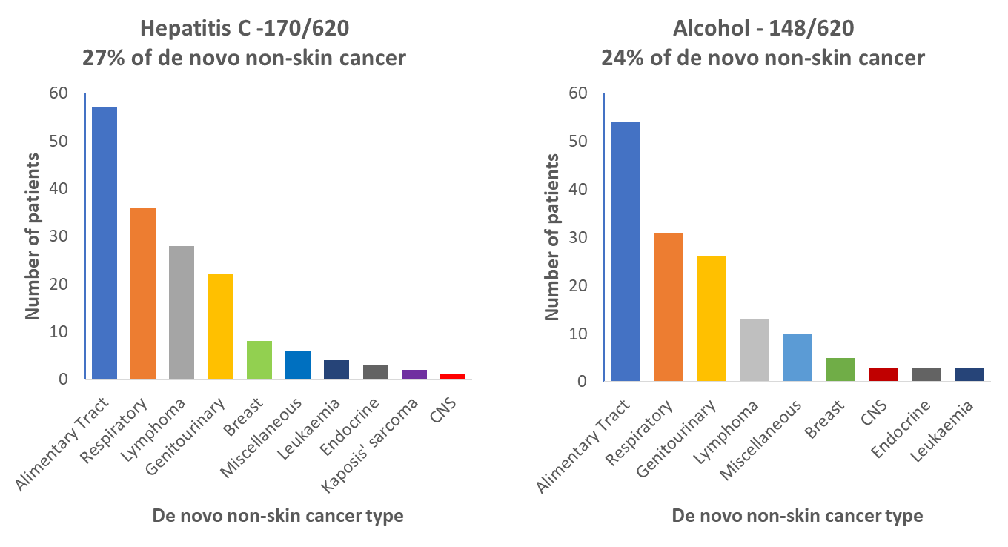
Hepatitis C virus, alcohol diagnosis and types of de novo skin cancer
Notes:
Figure 31. Hepatitis C virus, alcohol diagnosis and types of de novo skin cancer

Slide 15
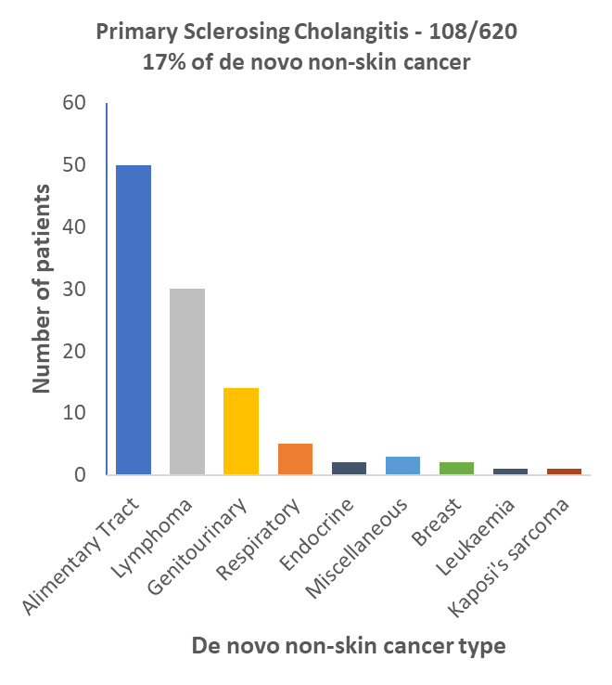
Primary sclerosing cholangitis and types of de novo skin cancer
Notes:
Figure 31. Primary sclerosing cholangitis and types of de novo skin cancer

Slide 16
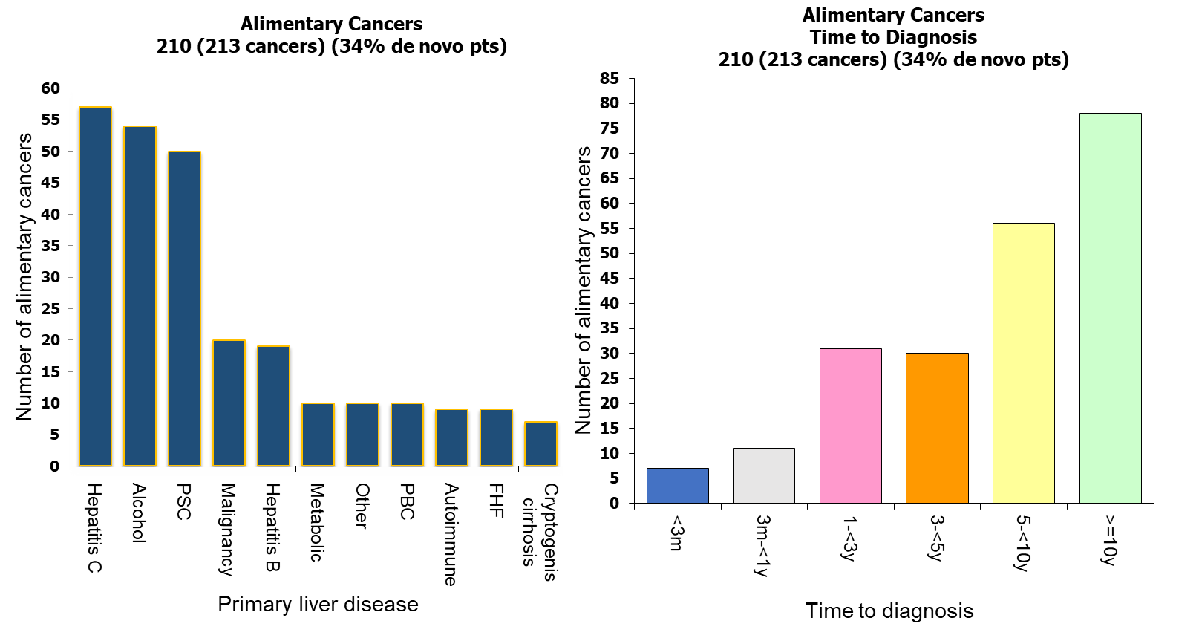
Pretransplant diagnosis and de novo alimentary cancers
Notes:
Figure 32. Pretransplant diagnosis and de novo alimentary cancers

Slide 17
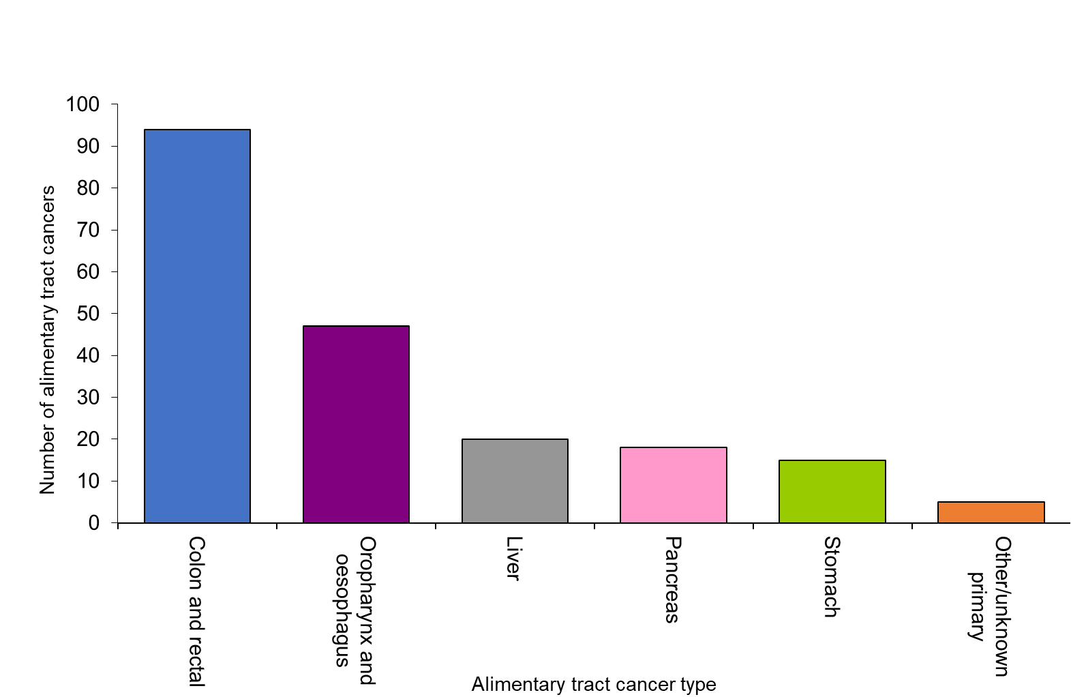
Incidence of de novo alimentary tract cancers by type
Notes:
Figure 33. Incidence of de novo alimentary tract cancers by type

Slide 18
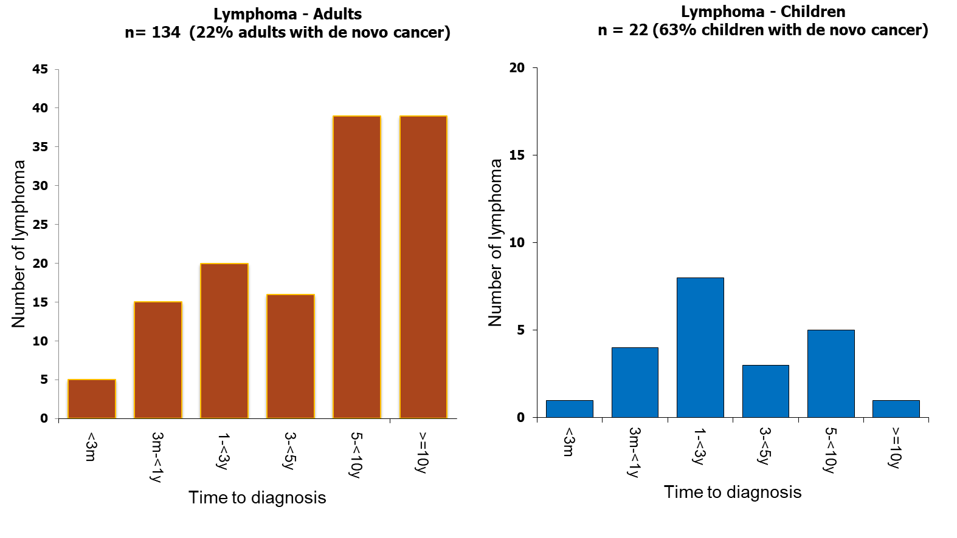
Time to diagnosis of de novo lymphoma by age category
Notes:
Figure 34. Time to diagnosis of de novo lymphoma by age category

Slide 19
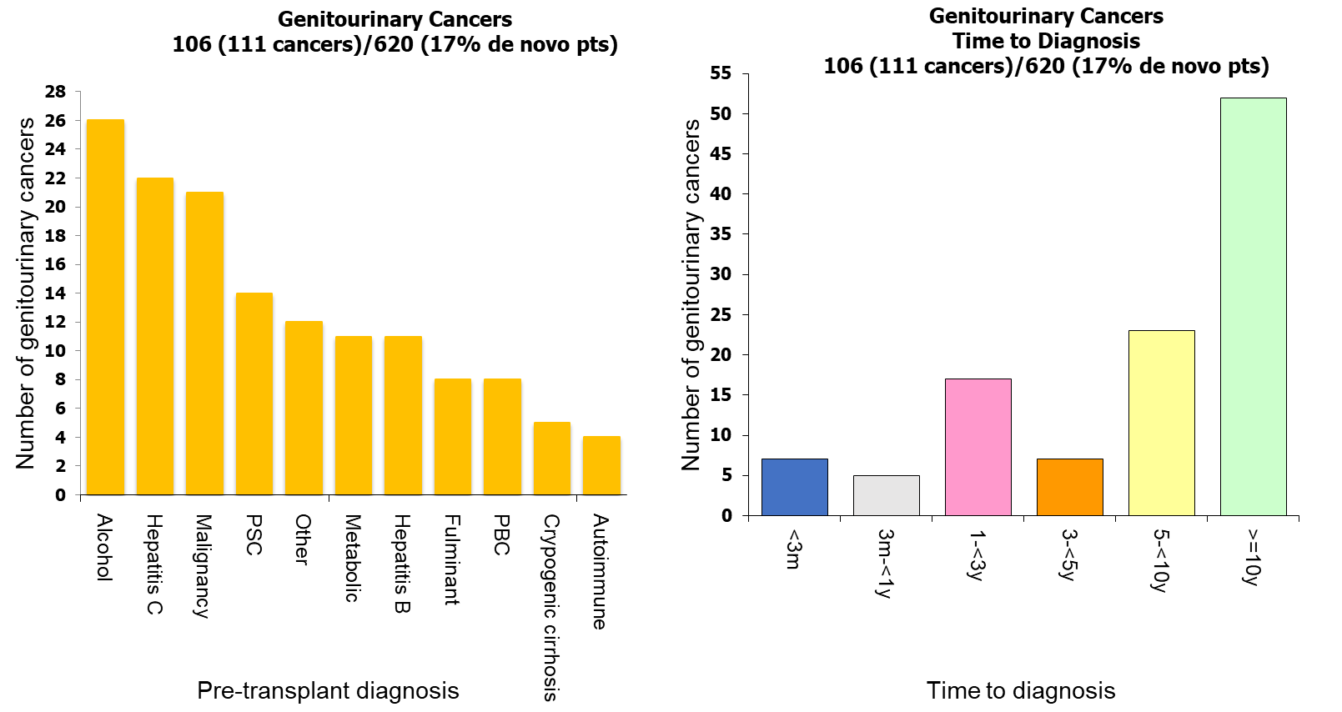
Pretransplant diagnosis and de novo genitourinary cancers
Notes:
Figure 35. Pretransplant diagnosis and de novo genitourinary cancers

Slide 20
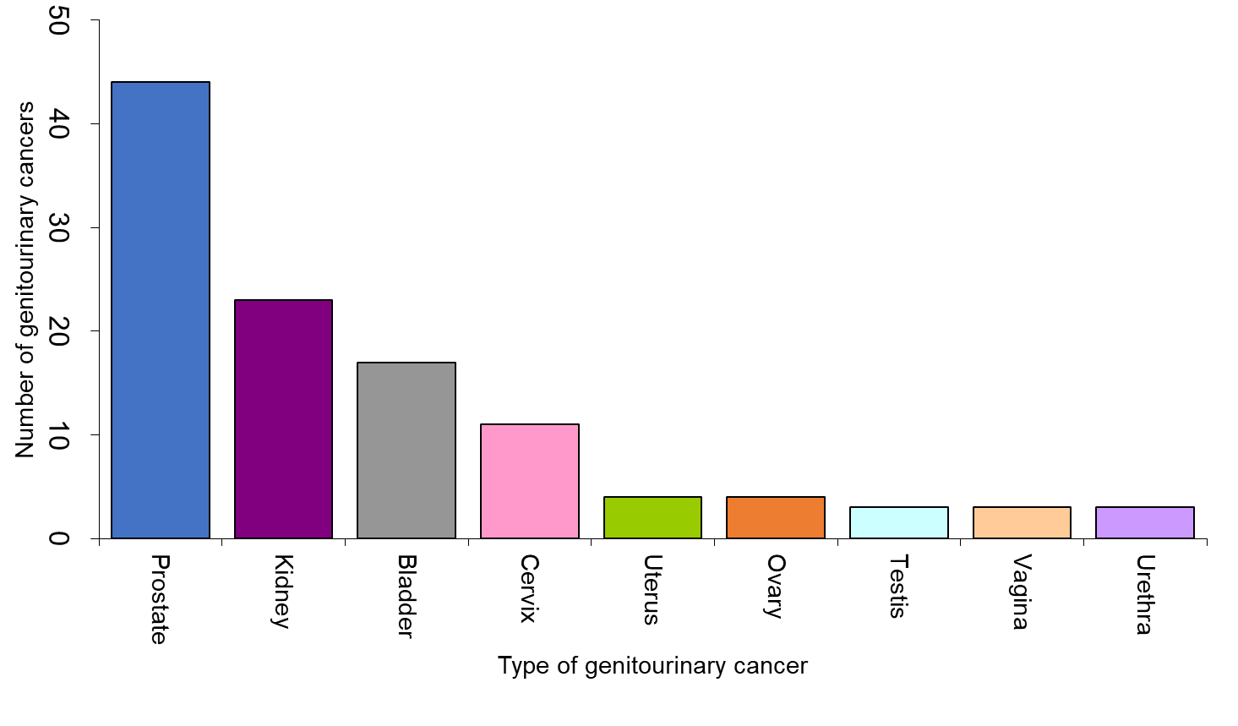
Incidence of de novo genitourinary tract cancers by type
Notes:
Figure 36. Incidence of de novo genitourinary tract cancers by type

Slide 21
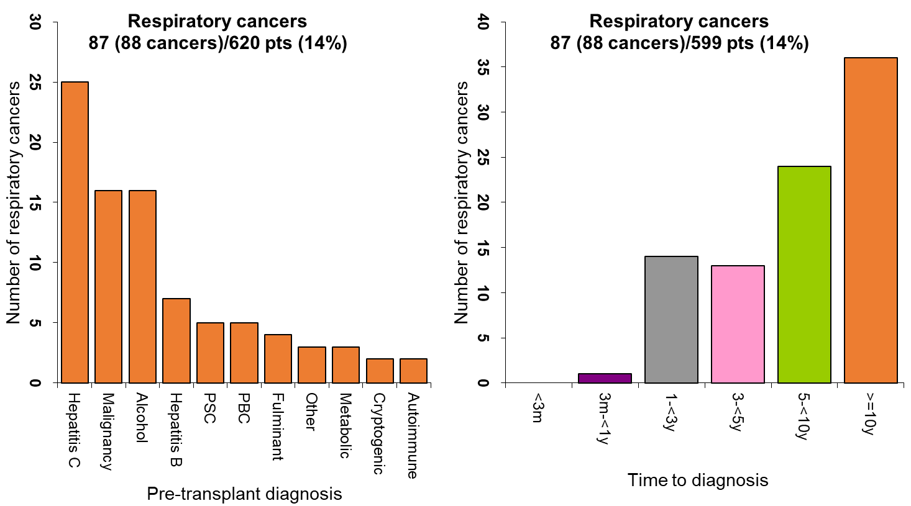
Pretransplant diagnosis and de novo respiratory cancers
Notes:
Figure 37. Pretransplant diagnosis and de novo respiratory cancers

Slide 22
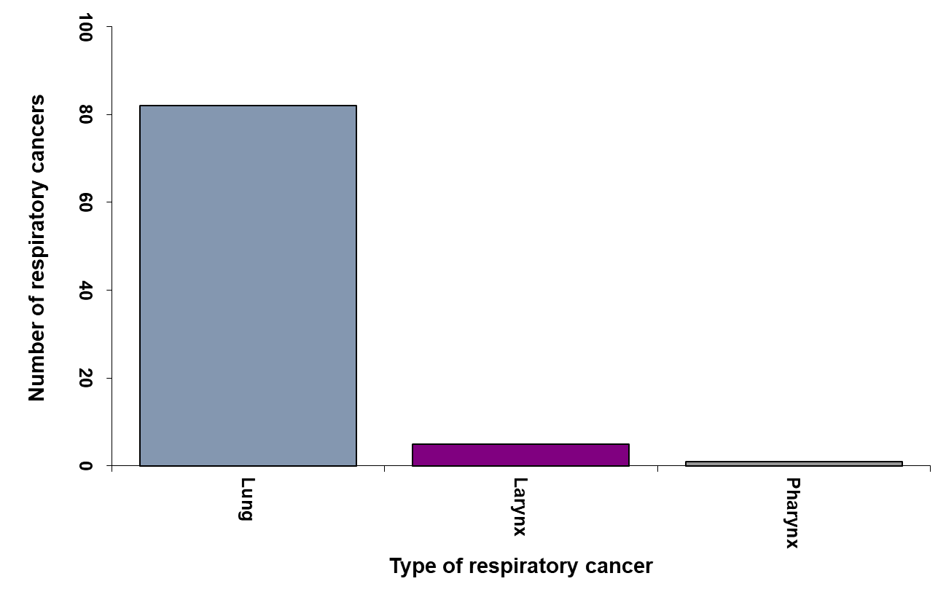
Incidence of de novo respiratory tract cancers by type
Notes:
Figure 38. Incidence of de novo respiratory tract cancers by type

Slide 23
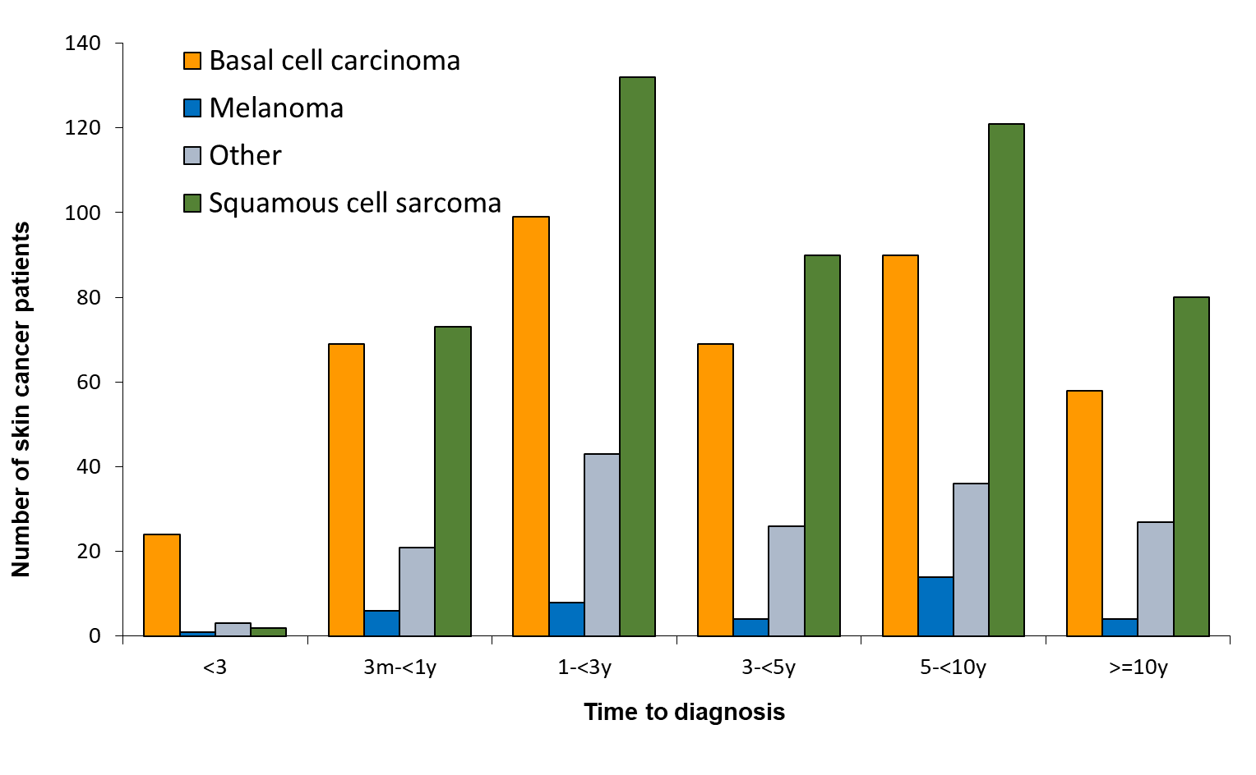
Time to first skin cancer development post-transplant by type of skin cancer
Notes:
Figure 39

Slide 24
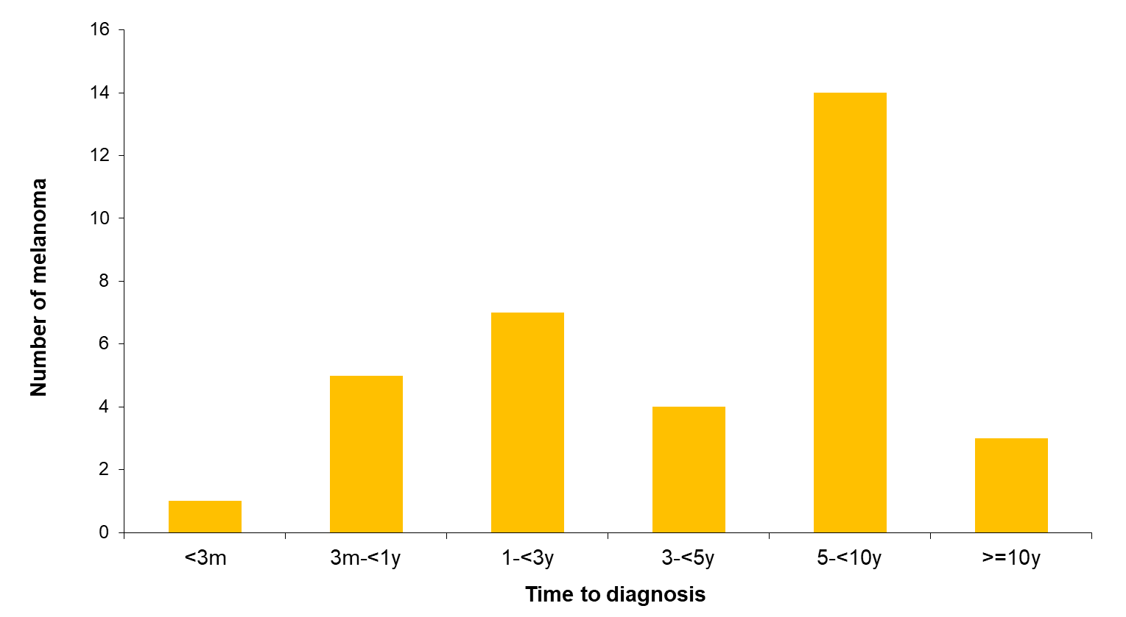
Time to first melanoma development post-transplant
Notes:
Figure 40. Time to first melanoma development post-transplant
Note: This includes patients who developed melanoma after a non-melanoma skin cancer (first skin cancer)

Slide 25
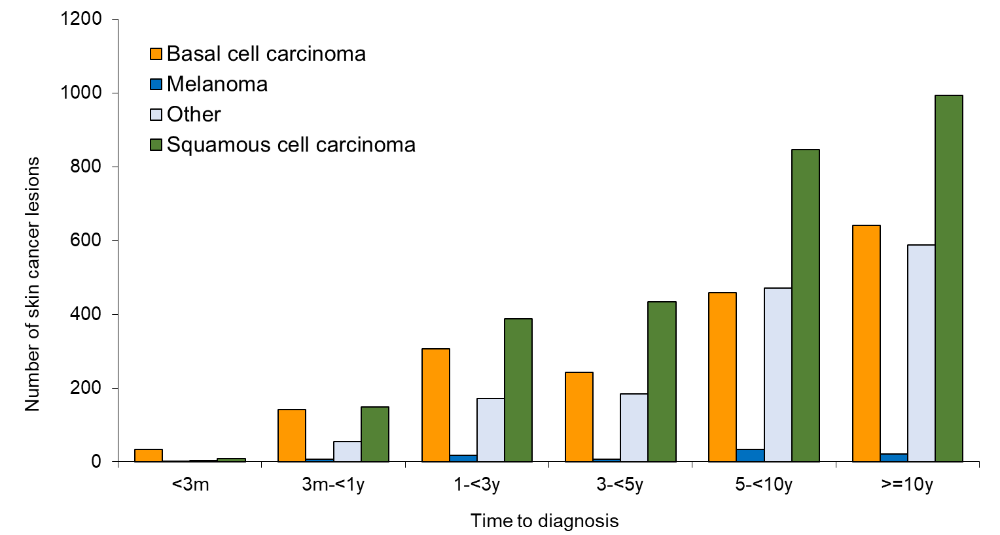
Time to all skin cancer lesions development post-transplant
Notes:
Figure 41. Time to all skin cancer lesions development post-transplant

Slide 26
Skin Cancer Development Post-Transplant
 | Number of patients that developed one or more skin cancers | Male |  |  |  | Female
 |  | Male recipients | % of all male transplant recipients | Died of this cancer | % males with this skin cancer type that died of this cancer | Female recipients | % of all female transplant recipients | Died of this cancer | % females with this skin cancer type that died of this cancer
Squamous cell | 772 | 545 | 12% | 19 | 3% | 227 | 8% | 5 | 2%
Basal cell | 630 | 456 | 10% | 1 | 0% | 174 | 6% | 0 | 0%
Bowen's disease | 307 | 201 | 4% | 0 | 0% | 106 | 4% | 0 | 0%
Miscellaneous | 92 | 61 | 1% | 0 | 0% | 31 | 1% | 0 | 0%
Melanoma | 83 | 57 | 1% | 11 | 17% | 26 | 1% | 7 | 29%
Merkel cell | 11 | 11 | 0.2% | 4 | 29% | 0 | 0% | 0 | 0%
Total skin cancer patients* | 1,101 | 761 | 16% | 35 | 4% | 340 | 13% | 12 | 4%
Total transplant recipients | 7,302 | 4,624 |  |  |  | 2,678
Notes:
Table 15. Skin Cancer Development Post-Transplant

Slide 27
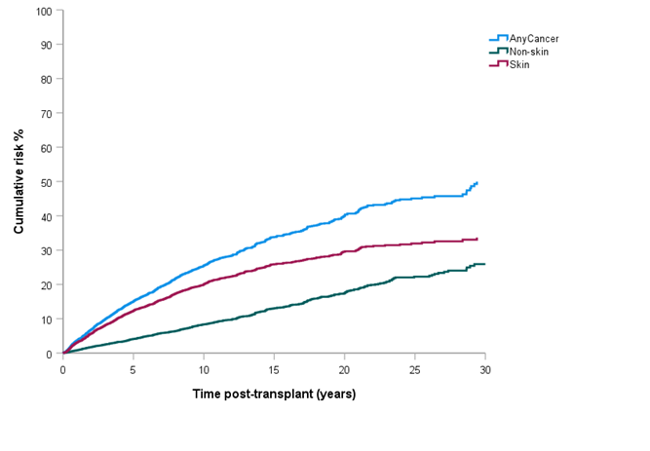
Cumulative risk of diagnosis of skin or non-skin cancer following liver transplantation
Notes:
Figure 42. Cumulative risk of diagnosis of skin or non-skin cancer following liver transplantation

Slide 28
Liver cancer recurrence in liver cancer patients
De novo cancer group | Time post-transplant (years)
 | 0 | 1 | 5 | 10 | 15 | 20 | 25 | 30
Any de novo cancer | 0% | 3% | 15% | 26% | 34% | 40% | 45% | 50%
De novo skin cancer | 0% | 3% | 12% | 20% | 26% | 30% | 32% | 34%
De novo non-skin cancer | 0% | 1% | 4% | 8% | 13% | 17% | 22% | 26%
Notes:
Table 17. Liver cancer recurrence in liver cancer patients

